Slide 1
Platform Orientation
An Overview
Notes:
Platform Orientation
Introduce yourself as needed.
Ask students to introduce themselves. By conducting a round robin. (Use the class roster or randomly select students one-by-one until everyone has introduced themselves)
Ask students to share the following:
What is your name?
One fun fact about yourself.
What you hope to get out of the training?
Time: 5-minutes

Slide 2

topics covered
Access Credentials
Community Platforms
Access Platforms
Platform Navigation
Login Form
Single Sign-on (SSO)
Service and Support
Using OTA Platforms
Notes:
Topics Covered
Review the topics to be discussed.
Remind students that active participation, interaction and inquiry are required actions and they should be self-motivated to engage in lively, provocative discussions.
Time: 1-minutes

Slide 3
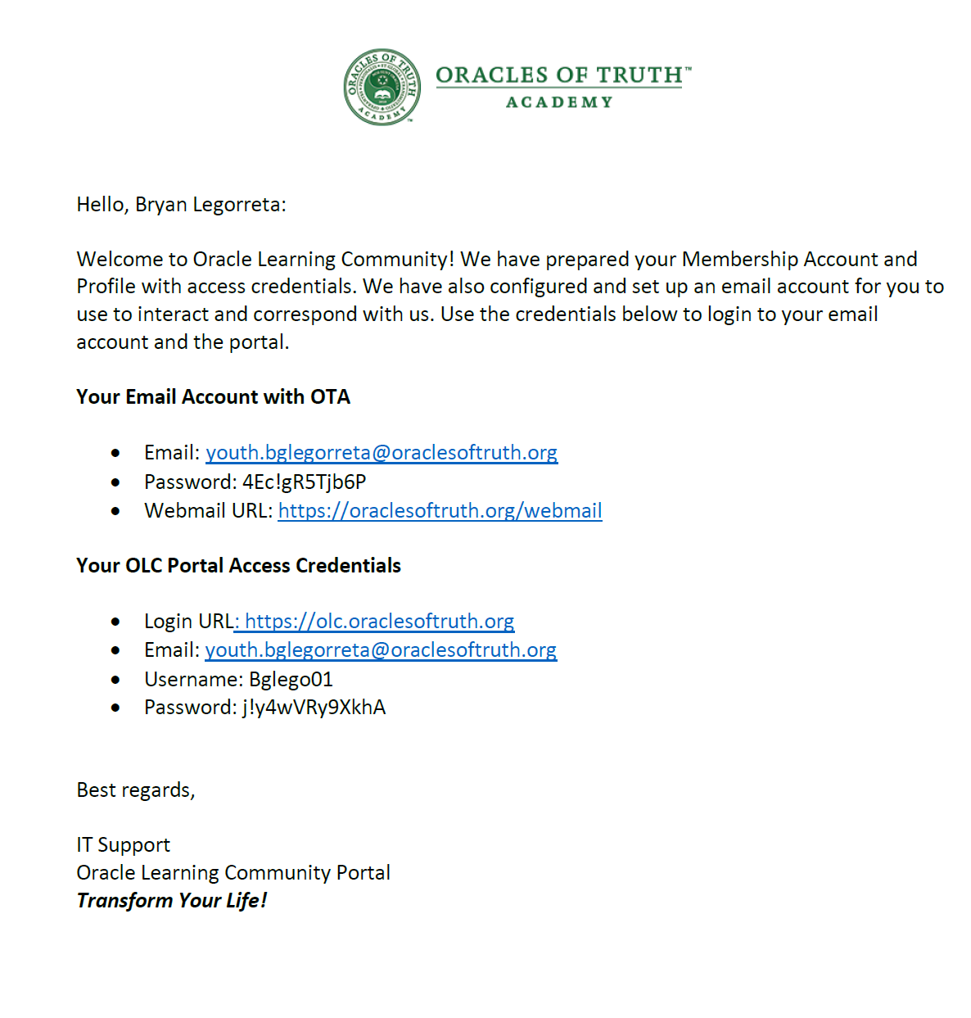
access credentials
An email account and member account with passwords were setup for each student
Access your email using OTA’s Webmail
Use your email account to communicate with program staff as needed
Login to access, navigate, and register for eCourses using OLC Portal
https://oraclesoftruth.org/webmail
https://olc.oraclesoftruth.org
Notes:
Access Credentials
Review access credentials with participants.
Explain that an email account and member account has been setup for each participant.
Discuss where they can go to access their email account.
Discuss where they can go to access their member account and register for eCourses.
Time: 3-minutes

Slide 4

demonstration + practice
Show learners how to access and login to OTA Webmail
Allow learners to practice accessing and logging into their OTA Webmail and read and send email.
Duration: 10-minutes
Notes:
Demonstration
Demonstrate how to access and login to the OTA Web Mail site.
Allow learners to practice accessing their email account.
Time: 5-minutes

Slide 5





community platforms
Oracle Learning Community
RITMO Fellowship Community
OLC Support Desk
Business Philanthropist Community
Notes:
Community Platforms
Give a high-level overview of each platform and how the OT Academy designs and produces new platforms to meet and support the diverse needs of the pollutions it serves. Review each of the following briefly:
Oracle Learning Community (OLC) Portal: This is the main academic community focus on whole person care administration and business philanthropy.
RITMO Fellowship Community: This is a leaning centered leadership community focused on personal transformation, self-care, self-love, exemplary leadership, and professional development.
Business Philanthropist Community: This is a social entrepreneur leadership community focused on for-profit, nonprofit, and hybrid conceptual, startup and mature business ventures.
OLC Support Desk: This is a central customer service and support platform connected to each learning community site
Time: 2-minutes

Slide 6
access platforms
OLC Portal
https://olc.oraclesoftruth.org
OLC Support Desk
https://support.oraclesoftruth.org
RITMO Community
https://drshinshuri.com
Notes:
Access Platforms
Briefly review the site URL for each platform.
Ask students to follow along and visit each site link too.
Share each site link in the live webinar chat (webinar) or on the chalkboard (classroom).
Click to visit each site link to access the plaforms.
Time: 2-minutes

Slide 7
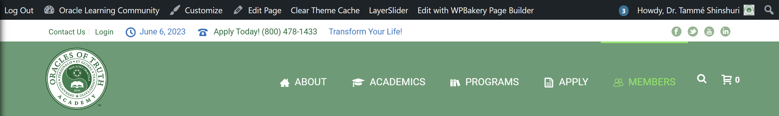
platform navigation
Admin Menu: Available menu reserved for administrators above the Top Menu (black)
Main Menu: Prominent location at top of every page (green)
Top Menu: Located above the Main Menu (white)
Profile Menu: Located right corner in the Admin Menu
My Account: First submenu under Members menu in Main Menu
My Dashboard: Second submenu under Members menu in Main Menu
Profile Menu
Notes:
Platform Navigation
Using the OLC Portal platform (Main Academy Site), review the navigation areas of the site that are most frequently accessed and used including the main Members areas. Explain how the main navigation areas are in the same location on each platform.
Use the arrow keys to display the main navigation areas one-by-one while discussing each one.
Time: 2-minutes

Slide 8
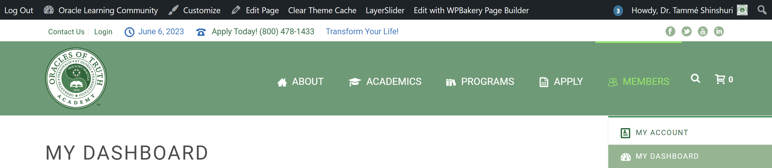
platform navigation (cont.)
My Account: First submenu under Members menu in Main Menu
My Dashboard: Second submenu under Members menu in Main Menu
Members Menu
Notes:
Platform Navigation (cont.)
Continue the discussion from the previous slide.
Use the arrow keys to display the Members submenu and login link.
Time: 1-minutes

Slide 9
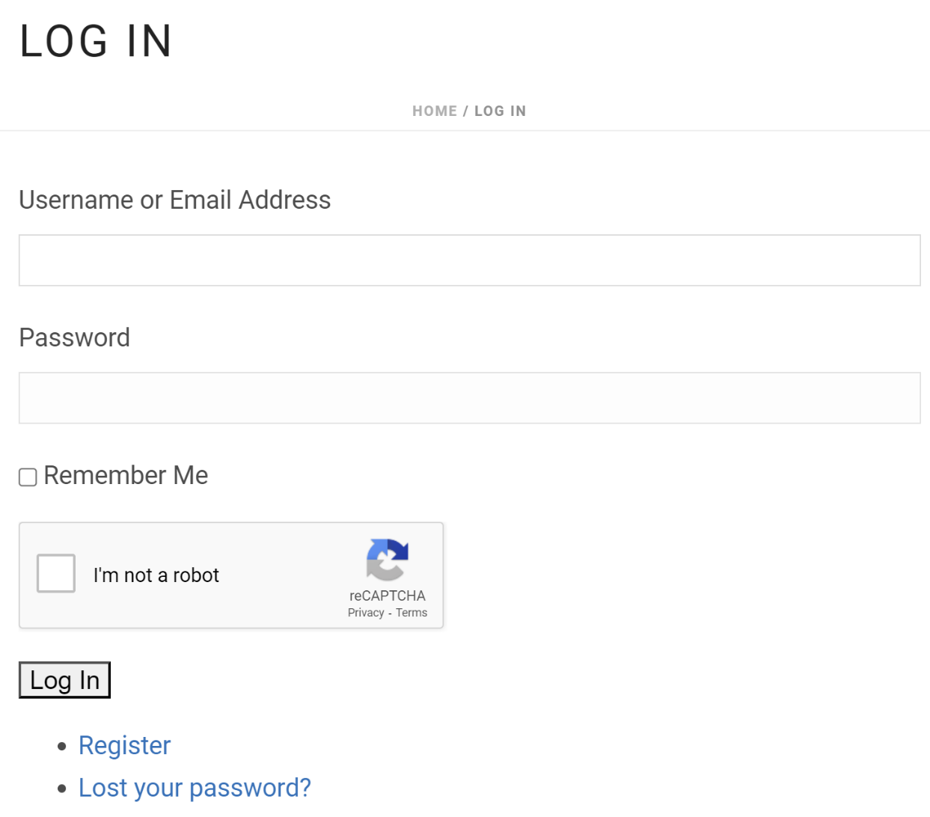
login form
Login credentials include:
  Site URL
  Username or Email Address
  Password
Notes:
Login Credentials
Students should have received their access credentials to login. Explain to them that they must use the login credentials to login and access their Member Account.
Explain each of the login field elements:
Username or Email Address
Password
Remember Me
I’m not a robot (reCAPTCHA)
Login button
Register link
Lost your password?
Time: 1-minutes

Slide 10


single sign-on (SSO)
Single Sign-on Steps
Visit the OLC Portal (Main Site)
Use access credentials to login to OLC Portal first.
Visit any one of the other sites and login by clicking the OLC User Login button on the homepage.
OLC Support Desk
RITMO Community
BP Community
(not available yet)
Notes:
Single Sign-on (SSO)
Review the single sign-on process for accessing any platform that is connected to OLC Portal.
Explain why OLC Portal is the Main Identity site and that all other platforms are Service Provider Identity sites.
Main Identity Site: This is the central site that hosts all accounts for each member. A user's personal identifiable information is stored in this site (e.g., First Name, Last Name, username, passwords, email addresses, etc.)
Service Provider Identity Site: This is a connected site that receives personal information about the user from the Main Identity Site to allow direct access to the receiving site, which has information, data, content, or intellectual properties that are private and protected by state and federal laws to which the user needs access or use for limited and strict purposes.
Time: 1-minutes

Slide 11

service and support
Level 1: This first level is a self-service option with documentations, tutorials, articles to help you find what you need when needed
Level 2: This second level option is an interactive live chat with a real person who will answer your direct questions
Level 3: This third level is an advance support option for when you need more than customer service but technical assistance with an uncommon issue
Notes:
Service and Support
The OLC Support Desk is the central customer service and support site. Students can gain direct access to receive customer service and technical support.
Review the three levels of service and support.
Level 1: Self-service
Level 2: Live Chat
Level 3: Advanced Support
Time: 1-minutes

Slide 12
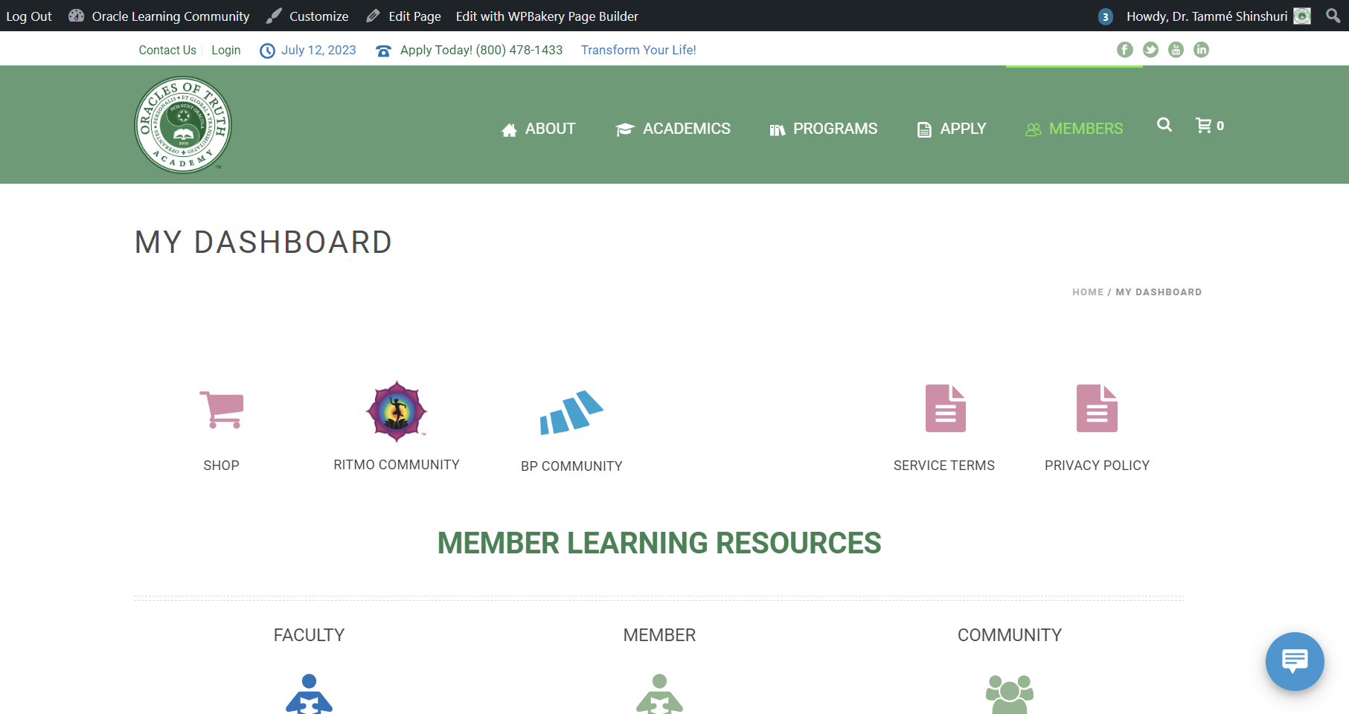
service and support (cont.)
Customer service and support can be accessed from two locations:
  Live Chat on any platform
  OLC Support Desk directly from My Dashboard
Notes:
Service and Support (cont.)
Continue the discussion about customer service and support
Highlight the location on the platform where Live Chat can be accessed.
Explain that it is in the same location on each platform site.
Time: 1-minutes

Slide 13
demonstration
Show how to login to OLC Portal and navigate and peruse the site
Show how to visit RITMO Community use Single Sign-on and peruse the site
Show how to visit OLC Support Desk use Single Sign-on and peruse the site
Duration: 15-minutes
Notes:
Demonstration
Demonstrate how to access and login to the OLC Portal site
Demonstrate how to Single Sign-on to the OLC Support Desk and RITMO Community.
Time: 5 minutes

Slide 14
practice activity
Access and login to OLC Portal and peruse the site
Go to My Dashboard and visit OLC Support Desk then Single Sign-on
Go to RITMO Community then Single Sign-on
Duration: 15-minutes
Notes:
Practice Activity
Distribute the Access Credentials that was configured and set up for each student.
OLC Portal Login
Ask students to practice accessing and logging in to the OLC Portal
Conduct a round robin session to check to see which students successfully completed the activity
Assist any students that did not successfully login using the methods previously discussed.
OLC Support Desk and RITMO Community Login
Ask students to practice accessing and logging in to OLC Support Desk and RITMO Community.
Conduct a round robin session to check to see which students successfully completed the activity
Assist any students that did not successfully login using the methods previously discussed.
Time: 10 minutes

Slide 15
Using OTA Platforms
Login to Community Site
Visit My Dashboard
Access Library Archives
Watch Getting Started Videos
Customize My Profile on Your Account
Duration
15-minutes
Notes:
Workshop Assignment
Review each topic to be discussed in this session.
Time: 1 minute

Slide 16




demonstration
Login
Navigate
Demonstrate how to login, navigate, peruse My Dashboard, and configure Member Profile.
Dashboard
Member Profile
Notes:
Demonstration
Demonstrate how to login, access My Dashboard, navigate the site. Then show learners how to customize their profile.
Access the OLC Portal site.
Login using your access credentials.
Access My Dashboard and show how to peruse the site to find the resources needed to complete training and assignments.
Show how to access eCourse Catalog.
Show how to register for an eModule and eClass.
Show how to Schedule an Appointment.
Show how to access the Community Forums.
Show how to access Courseware Materials.
Access your Member Profile and Upload a profile picture.
Repeat steps 1-4 for RITMO Community and OLC Support Desk platforms.
Time: 10 minutes

Slide 17

assignment
Login to OLC Portal
Access My Dashboard
Go to the Library category
Click on Getting Started Libraries
Complete the Getting Started on OLC Portal video libraries
Access your Member Profile
Upload your favorite photo to your Member Profile
Repeat steps 1-7 for RITMO Community and OLC Support Desk
Add a profile picture to your account
Notes:
Workshop Assignment
This workshop activity is a final activity that students should perform to show that they have understood how to login, access, navigate, use, and customize their account. Ask students to complete the following actions before the first eCourse required in the program:
Login to OLC Portal.
Access My Dashboard.
Go to the Library category.
Click on Getting Started Libraries.
Complete the Getting Started on OLC Portal video libraries.
Access your Member Profile .
Upload your favorite photo to your Member Profile.
Repeat steps 1-7 for RITMO Community and OLC Support Desk.
Note: Inform learners that they can visit the site and login and complete their assignments at home using their home computer.
Time: 10 minutes

