Slide 1
Carbon Emissions Review, Part 2
The Periodic Table and
Greenhouse Gases
Notes:
Carbon Emissions Review, Part 2
Introduce yourself, as needed.
Ask students to introduce themselves, as needed.
Ask students to share the following:
What is your name?
One fun fact about yourself.
What you hope to get out of the training?
Time: 3-minutes

Slide 2
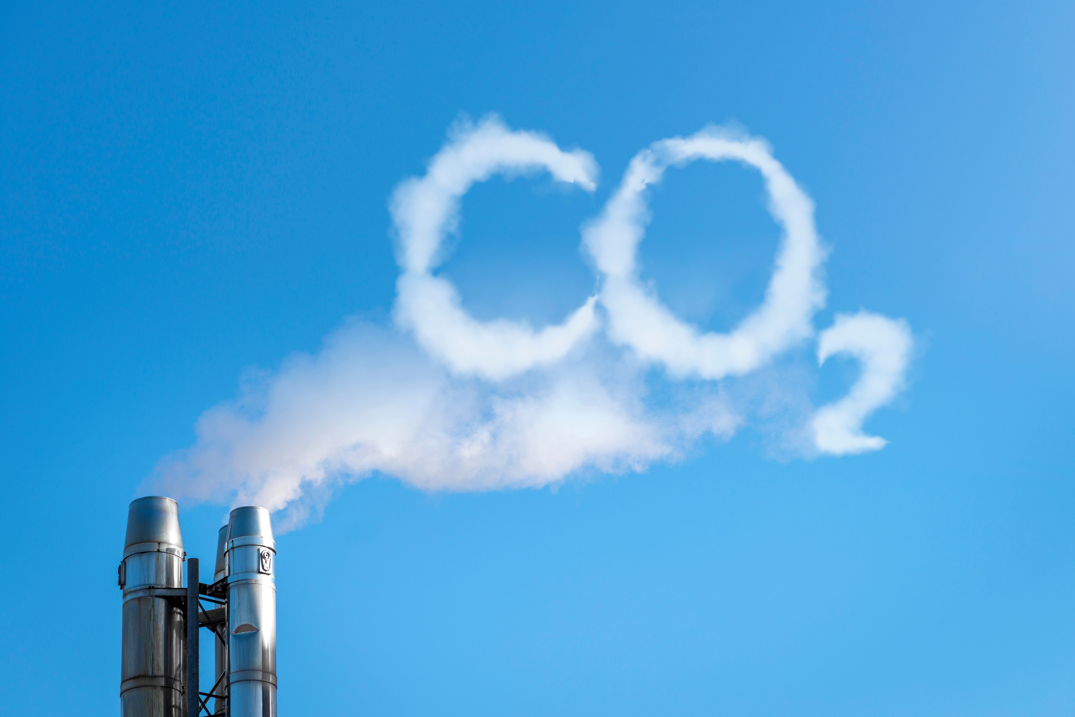
topics covered
Review Time
Greenhouse Gases + Periodic Table
Global Warming: Causes + Effects
Gamification Quiz
Notes:
Topics Covered
Review the topics to be discussed.
Remind students that active participation, interaction and inquiry are required actions and they should be self-motivated to engage in lively, provocative discussions.
Time: 2-minutes

Slide 3

review time
Access the RITMO Community.
Log in to your account.
Go to the Eco-friendly Emissions for Youth and Adults (eModule).
Reread Lesson 3: Carbon Emissions, Part 2.
10 minutes
Notes:
Review Time
Ask learners to access the RITMO Community and login to their Member Account.
Ask them to go to the Eco-friendly Emissions for Youth and Adults (eModule).
Ask learners to reread Lesson 3: Carbon Emissions, Part 2.
Time: 5-minutes

Slide 4

greenhouse gases + periodic table
Watch the video.
CO₂ Elements
CH₄ Elements
Click to Watch
Click to Watch
N₂O Elements
CO Elements
Click to Watch
Click to Watch
5:12 minutes
Notes:
Greenhouse Gases + Periodic Table
Review each video with learners.
Time: 5:12-minutes

Slide 5
greenhouse gases + periodic table (cont.)
Watch the video.
O₃ Elements
Click to Watch
5:39 minutes
Notes:
Greenhouse Gases + Periodic Table (cont.)
Review the video with learners.
Time: 5:39-minutes

Slide 6
global warming
Watch the video.
Causes and Effects of Global Warming
Click to Watch
5:59 minutes
Notes:
Global Warming
Review the video with learners.
Time: 2:29-minutes

Slide 7
Gamification Quiz
A correct answer participant receives points and value.
An incorrect answer participant loses points and value.
Gamification Point Scale
Activity | Points | Value
Easy Question | 1 | $1.00
Video Question | 3 | $3.00
Difficult Question | 5 | $5.00
Notes:
Gamification Quiz
Review Lesson 3: Carbon Emissions Review, Part 2 with participants.
Use the Gamification Point Scale to keep track of each student’s score.
Conduct a round robin with participants and have them answer the questions. Note: A correct answer the participant receives the positive points and value.. An incorrect answer participant receives negative points and value.
Keep a tally of all points and dollar value earned by each participant for each gamification review activity.
Participants must complete the full eCourse (eModule + eClass) to earn their stipend at the end of the training.

Slide 8
question #1
Carbon Dioxide is a compound gas made up of one carbon atom and how many oxygen atoms? Enter the answer in the field below.
Value: 1 point
Answer
2 or two
Notes:
Question #1
Present the question to all participants. The first hand raised gets to answer the question.
If answered correctly, participant earns points and value. Tally points and value for the participant. Go to next question.
If answered incorrectly participant loses points and value. Tally points and value. Allow another participant a chance to answer the question. If the second participant answers correctly, participant. Earns points and value. Tally points and value. If answered incorrectly participant loses points and value. Tally points and value.
Show the correct answer after the second failed attempt to answer the question.
Go to next question.

Slide 9
question #2
Nitrous Oxide is a compound gas made up of what quantity of the following elements? Select the best answer.
  One nitrogen atom and two oxygen atoms
  Two nitrogen atoms and two oxygen atoms
  Two nitrogen atoms and one oxygen atom
  One nitrogen atom and one oxygen atom
Value: 1 point
Answer
C
Notes:
Question #2
Present the question to all participants. The first hand raised gets to answer the question.
If answered correctly, participant earns points and value. Tally points and value for the participant. Go to next question.
If answered incorrectly participant loses points and value. Tally points and value. Allow another participant a chance to answer the question. If the second participant answers correctly, participant. Earns points and value. Tally points and value. If answered incorrectly participant loses points and value. Tally points and value.
Show the correct answer after the second failed attempt to answer the question.
Go to next question.

Slide 10
question #3
Methane is a compound gas made up of one carbon atom and how many hydrogen atoms? Enter the answer in the field below.
Value: 1 point
Answer
4 or four
Notes:
Question #3
Present the question to all participants. The first hand raised gets to answer the question.
If answered correctly, participant earns points and value. Tally points and value for the participant. Go to next question.
If answered incorrectly participant loses points and value. Tally points and value. Allow another participant a chance to answer the question. If the second participant answers correctly, participant. Earns points and value. Tally points and value. If answered incorrectly participant loses points and value. Tally points and value.
Show the correct answer after the second failed attempt to answer the question.
Go to next question.

Slide 11
question #4
Carbon Monoxide is a compound gas made up of one atom from which two elements? Enter the answer in the field below.
Value: 1 point
Answer
Carbon and Oxygen
Notes:
Question #4
Present the question to all participants. The first hand raised gets to answer the question.
If answered correctly, participant earns points and value. Tally points and value for the participant. Go to next question.
If answered incorrectly participant loses points and value. Tally points and value. Allow another participant a chance to answer the question. If the second participant answers correctly, participant. Earns points and value. Tally points and value. If answered incorrectly participant loses points and value. Tally points and value.
Show the correct answer after the second failed attempt to answer the question.
Go to next question.

Slide 12
question #5
Which of the following cause air pollution from carbon emissions? Select all that apply.
  Eating
  Smog
  Fire
  Breathing
Value: 1 point
Answer
B, C, and D
Notes:
Question #5
Present the question to all participants. The first hand raised gets to answer the question.
If answered correctly, participant earns points and value. Tally points and value for the participant. Go to next question.
If answered incorrectly participant loses points and value. Tally points and value. Allow another participant a chance to answer the question. If the second participant answers correctly, participant. Earns points and value. Tally points and value. If answered incorrectly participant loses points and value. Tally points and value.
Show the correct answer after the second failed attempt to answer the question.
Go to next question.

Slide 13
question #6
Which of the following are examples of man-made carbon emissions effecting the planet?
  Agriculture
  Transportation
  Energy Consumption
  Manufacturing
Value: 1 point
Answer
A, B, C, and D
Notes:
Question #6
Present the question to all participants. The first hand raised gets to answer the question.
If answered correctly, participant earns points and value. Tally points and value for the participant. Go to next question.
If answered incorrectly participant loses points and value. Tally points and value. Allow another participant a chance to answer the question. If the second participant answers correctly, participant. Earns points and value. Tally points and value. If answered incorrectly participant loses points and value. Tally points and value.
Show the correct answer after the second failed attempt to answer the question.
Go to next question.

Slide 14
question #7
Which of the following is not a compound gas? Select the best answer.
  Carbon Dioxide
  Nitrous Oxide
  Tropospheric Ozone
  Methane
Value: 1 point
Answer
C
Notes:
Question #7
Present the question to all participants. The first hand raised gets to answer the question.
If answered correctly, participant earns points and value. Tally points and value for the participant. Go to next question.
If answered incorrectly participant loses points and value. Tally points and value. Allow another participant a chance to answer the question. If the second participant answers correctly, participant. Earns points and value. Tally points and value. If answered incorrectly participant loses points and value. Tally points and value.
Show the correct answer after the second failed attempt to answer the question.
Go to next question.

