Slide 1
Community Carbon Reduction Practices
+ Review
What’s Your Community Carbon Footprint and
Carbon Handprint?
Notes:
Community Carbon Reduction Practices + Review
Introduce yourself, as needed.
Ask students to introduce themselves, as needed.
Ask students to share the following:
What is your name?
One fun fact about yourself.
What you hope to get out of the training?
Time: 3-minutes

Slide 2

topics covered
Review Time
Exemplary Leadership Skills
Select Team Leader
Review How to Use Each Tool
Monitoring Thermal Energy
Monitoring Light Energy
Monitoring Electrical Energy
Monitoring Air Pollution
Forum Demonstration
Online Team Activity
Gamification Quiz
Notes:
Topics Covered
Review the topics to be discussed.
Remind students that active participation, interaction and inquiry are required actions and they should be self-motivated to engage in lively, provocative discussions.
Time: 2-minutes

Slide 3

review time
Access the RITMO Community.
Log in to your account.
Go to the Eco-friendly Emissions for Youth and Adults (eModule).
Reread Lesson 8: Becoming Eco-friendly Stewards, Part 3.
10 minutes
Notes:
Review Time
Ask learners to access the RITMO Community and login to their Member Account.
Ask them to go to the Eco-friendly Emissions for Youth and Adults (eModule).
Ask learners to reread Lesson 6: Becoming Eco-friendly Stewards, Part 3.
Time: 5 minutes

Slide 4

exemplary leadership skills
To earn points in this phase of the eCourse you must develop and use the following leadership skills:
  Hear
  Listen
  Follow directions
  Pay attention
  Pace yourself
  Raise your hand before speaking an answer
  Work as a team
Notes:
Exemplary Leadership Skills
Review Exemplary Leadership Skills with learners.
Use the Exemplary Leadership Skill Handout with descriptions and examples
Discuss each skill with learners.
Answer any questions that emerge.
Time: 5-minutes

Slide 5

select a team leader
Each team must select a Team Leader who will serve as the team’s Peer Mentor.
The Team Leader will work with the Flexible Facilitator to report the team’s progress and data for each team assignment.
Team Members work together to measure and collect data to complete each activity.
Points for each activity are earned as a team.
Notes:
Select a Team Leader
Explain the important of the Team Leader/Peer Mentor Role.
Divide learners into groups. Based on the size of your cohort class. Note: Group sizes can vary (e.g. 3-4 or 4-5 students).
Assign a Team Letter to each group (e.g., A-D)
Ask each team to select a Team Leader who will server as the Peer Mentor.
Explain that the Peer Mentor role is responsible to work with you to share the teams progress and data collected as they complete their assignments together to earn Team Points.
Explain that all Team Members including the Peer Mentor must complete each team assignment, which include Monitoring Thermal Energy, Monitoring, Light Energy, Monitoring Electrical Energy, and Monitoring Air Pollution.
Explain that each team will be given each assignment but will take turns sharing the tools for each assignment.
Use the Team Tool Rotation Handout to discuss how the teams will rotate the tools to share them as they work.
Time: 5 minutes

Slide 6
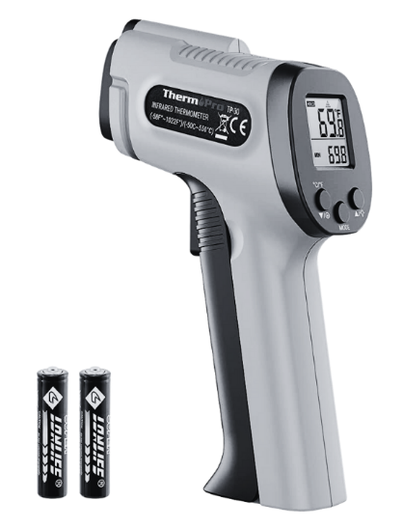
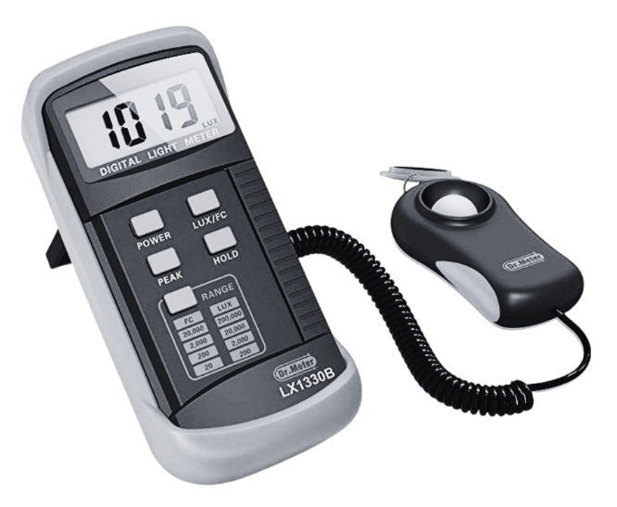
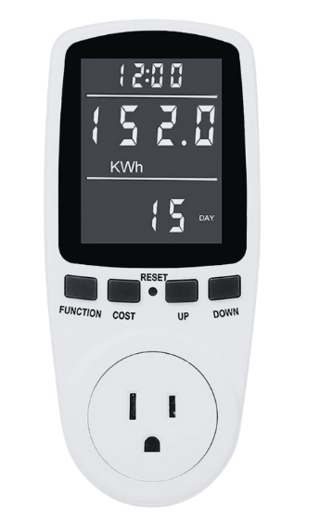
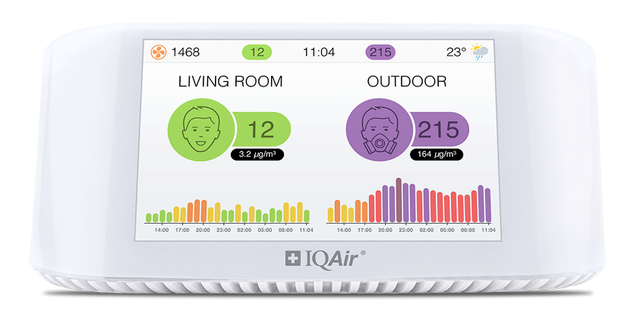
review how to use each tool
Review how to measure and record data using each tool using the Team Assignment handout for each tool.
Infrared Thermometer
Light Meter/Lux Meter
Watt Meter
Air Quality Monitor
Notes:
Review How to Use Each Tool
Distribute the Monitoring Infrared Thermometer, Monitoring, Light Intensity, Monitoring Electrical Energy, and Monitoring Air Quality to teams.
Distribute tools to each team based on the rotation schedule outlined in the Team Tool Rotation Handout.
Ask the Team Leader for each team to read the first assignment assigned to them to complete. Note: Rotate between each team based on the first assignment listed for each team.
Demonstrate how to use the tool to complete each assignment for each team to observe and ask questions. Note: Use the Team Assignment Answer Key for each assignment to guide teams to completion.
Answer any questions.
Time: 20-minutes

Slide 7
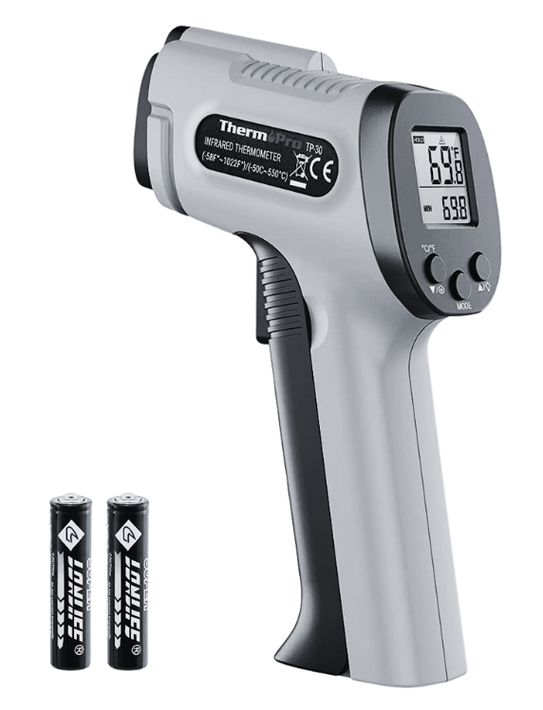
monitoring thermal energy
Use the Infrared Thermometer to measure the temperature of the various objects listed on the practice activity sheet.
Document the temperature in degrees Celsius (C°) and Fahrenheit (F°).
Each Team Member should take turns using the infrared thermometer to measure an object.
Value: 10 points
Notes:
Monitoring Thermal Energy
Use the Team Tool Rotation Handout to rotate the tools to each team based on the assignment they have already completed.
Ask the Team that is currently set to complete this activity to use the Infrared Thermometer to complete the assignment.
Rotate the Infrared Thermometer to designated Team.
Observe teams as they complete their assignment.
Collect Team Assignment Worksheet at the end of the activity to be graded.
Time: 20-minutes

Slide 8
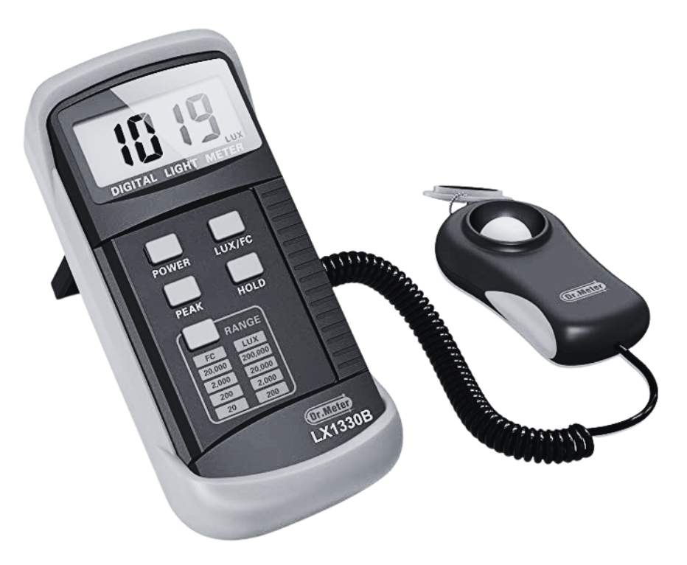
monitoring light energy
Use the Light Meter or Lux Meter to measure luminosity of the space/room listed on the practice activity sheet.
Document the temperature in degrees Celsius (C°) and Fahrenheit (F°) and the Lux Number of each space.
Each Team Member should take turns using the infrared thermometer to measure an object.
Value: 10 points
Notes:
Monitoring Light Energy
Use the Team Tool Rotation Handout to rotate the tools to each team based on the assignment they have already completed.
Ask the Team that is currently set to complete this activity to use the Light Meter/Lux Meter to complete the assignment.
Rotate the Light Meter/Lux Meter to designated Team.
Observe teams as they complete their assignment.
Collect Team Assignment Worksheet at the end of the activity to be graded.
Time: 20-minutes

Slide 9
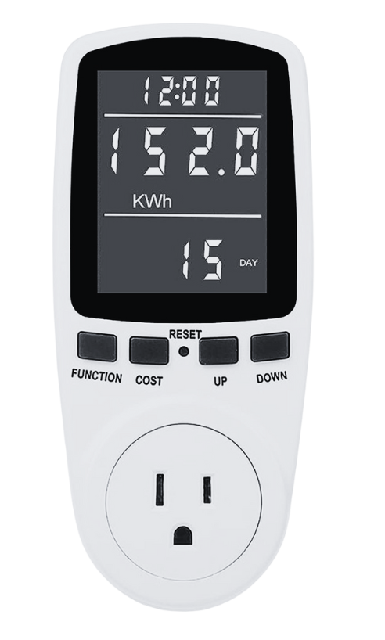
monitoring electrical energy
Use the Watt Meter to measure the electrical energy and cost of the items listed on the practice activity sheet.
Document the Time, Watt Number, and Cost of each item.
Each Team Member should take turns using the infrared thermometer to measure an object.
Value: 10 points
Notes:
Monitoring Electrical Energy
Use the Team Tool Rotation Handout to rotate the tools to each team based on the assignment they have already completed.
Ask the Team that is currently set to complete this activity to use the Watt Meter to complete the assignment.
Rotate the Watt Meter to designated Team.
Observe teams as they complete their assignment.
Collect Team Assignment Worksheet at the end of the activity to be graded.
Time: 20-minutes

Slide 10

monitoring air pollution
Use the Air Quality Monitor to measure the air quality indoors and outdoors of the items listed on the practice activity sheet.
Document the AQ Index, CO₂ Level, Humidity, and Temperature of each item.
Each Team Member should take turns using the infrared thermometer to measure an object.
Value: 10 points
Notes:
Monitoring Air Pollution
Use the Team Tool Rotation Handout to rotate the tools to each team based on the assignment they have already completed.
Ask the Team that is currently set to complete this activity to use the Air Quality Monitor to complete the assignment.
Rotate the Air Quality Monitor designated Team.
Observe teams as they complete their assignment.
Collect Team Assignment Worksheet at the end of the activity to be graded.
Time: 20-minutes

Slide 11

forum demonstration
Use the Accessing the RITMO Community Forum handout.
Access the RITMO Community Forum.
Demonstrate how to access each Team Assignment.
Demonstrate how to post their answers to the Team Assignment Thread.
Post and Share Team Data in the RITMO Community
Notes:
Forum Demonstration
Team Leader Extra Credit (Value: 20 points)
This is an opportunity to allow Team Leaders to earn extra points for their Peer Mentor Leadership. Team Leaders must complete the following tasks to earn an additional 20 points for their leadership.
Participate in a work session with Dr. Shinshuri to learn how to access the RITMO Community Forums and post responses to the forum.
Lead their team to successfully completing the Online Team Activity.
Receive constructive feedback from their team about their leadership actions after a 360° Review from all team members and the Flexible Facilitator.
Time: 30 minutes
Flexible Facilitator Tasks
Use the Accessing the RITMO Community Forum handout to complete this demonstration with teams.
Access the Eco-friendly Emissions for Youth and Adults forum.
Demonstrate to teams how to access and post their team assignments. Note: There is one assignment thread for each Team Assignment.
Time: 10 minutes

Slide 12
online team activity
The Team Leader must assign one team member to each assignment completed.
Each assigned Team Member must write a post in the online forum to share the data collected for the team activity assigned to him or her.
All Team Members must participate and support the person writing the post.
Post and Share Team Data in the RITMO Community
Value: 50 points
Notes:
Online Team Activity
Ask Team Leaders to select Team Members from their team to write a Forum Post for each Team Assignment..
Ask Teams to logon and access the RITMO Community.
Allow Teams to complete their online assignment posts for each Team Assignment.
Ask Team Leaders to monitor their team’s progress, mentor and provide support by delegating work tasks to team members and report completion when the activity is done.
Time: 45 minutes

Slide 13
Gamification Quiz
A correct answer participant receives points and value.
An incorrect answer participant loses points and value.
Gamification Point Scale
Activity | Points | Value
Easy Question | 1 | $1.00
Video Question | 3 | $3.00
Difficult Question | 5 | $5.00
Notes:
Gamification Quiz
Use the Gamification Point Scale to keep track of each student’s score.
Conduct a round robin with participants and have them answer the questions. Note: A correct answer the participant receives the positive points and value.. An incorrect answer participant receives negative points and value.
Keep a tally of all points and dollar value earned by each participant for each gamification review activity.
Participants must complete the full eCourse (eModule + eClass) to earn their stipend at the end of the training
Time: 15 minutes

Slide 14
question #1
Name each of the exemplary leadership skills.
Value: 5 points
Notes:
Question #1
Present the question to all participants. The first hand raised gets to answer the question.
If answered correctly, participant earns points and value. Tally points and value for the participant. Go to next question.
If answered incorrectly participant loses points and value. Tally points and value. Allow another participant a chance to answer the question. If the second participant answers correctly, participant. Earns points and value. Tally points and value. If answered incorrectly participant loses points and value. Tally points and value.
Show the correct answer after the second failed attempt to answer the question.
Go to next question.
Time: 1 minute

Slide 15
question #2
What is an Air Quality Monitor used to measure?
Value: 1 point
Notes:
Question #2
Present the question to all participants. The first hand raised gets to answer the question.
If answered correctly, participant earns points and value. Tally points and value for the participant. Go to next question.
If answered incorrectly participant loses points and value. Tally points and value. Allow another participant a chance to answer the question. If the second participant answers correctly, participant. Earns points and value. Tally points and value. If answered incorrectly participant loses points and value. Tally points and value.
Show the correct answer after the second failed attempt to answer the question.
Go to next question.
Time: 1 minute

Slide 16
question #3
What is an Infrared Thermometer used to measure?
Value: 1 point
Notes:
Question #2
Present the question to all participants. The first hand raised gets to answer the question.
If answered correctly, participant earns points and value. Tally points and value for the participant. Go to next question.
If answered incorrectly participant loses points and value. Tally points and value. Allow another participant a chance to answer the question. If the second participant answers correctly, participant. Earns points and value. Tally points and value. If answered incorrectly participant loses points and value. Tally points and value.
Show the correct answer after the second failed attempt to answer the question.
Go to next question.
Time: 1 minute

Slide 17
question #4
What is a Lux Meter used to measure?
Value: 1 point
Notes:
Question #2
Present the question to all participants. The first hand raised gets to answer the question.
If answered correctly, participant earns points and value. Tally points and value for the participant. Go to next question.
If answered incorrectly participant loses points and value. Tally points and value. Allow another participant a chance to answer the question. If the second participant answers correctly, participant. Earns points and value. Tally points and value. If answered incorrectly participant loses points and value. Tally points and value.
Show the correct answer after the second failed attempt to answer the question.
Go to next question.
Time: 1 minute

Slide 18
question #5
What is a Watt Meter used to measure?
Value: 1 point
Notes:
Question #2
Present the question to all participants. The first hand raised gets to answer the question.
If answered correctly, participant earns points and value. Tally points and value for the participant. Go to next question.
If answered incorrectly participant loses points and value. Tally points and value. Allow another participant a chance to answer the question. If the second participant answers correctly, participant. Earns points and value. Tally points and value. If answered incorrectly participant loses points and value. Tally points and value.
Show the correct answer after the second failed attempt to answer the question.
Go to next question.
Time: 1 minute

