Slide 1
Carbon Emissions Review, Part 1
Greenhouse Gases and
Climate Change
Notes:
Carbon Emissions Review, Part 1
Introduce yourself, as needed.
Ask students to introduce themselves, as needed.
Ask students to share the following:
What is your name?
One fun fact about yourself.
What you hope to get out of the training?
Time: 3-minutes

Slide 2
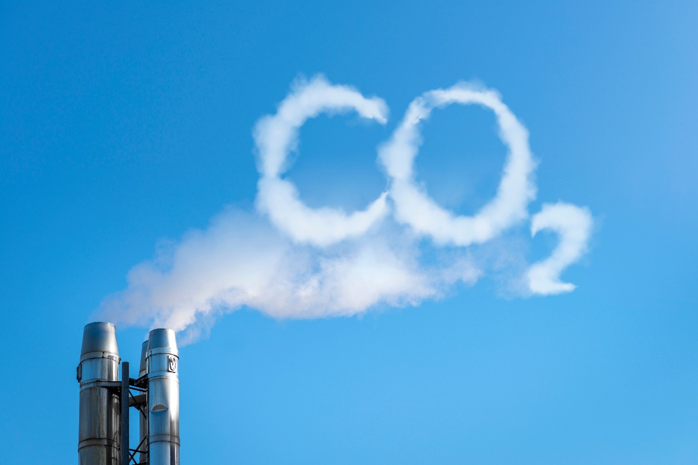
topics covered
Review Time
Climate Change
Weather vs. Climate
Greenhouse Effect
The Carbon Cycle
Gamification Quiz
Notes:
Topics Covered
Review the topics to be discussed.
Remind students that active participation, interaction and inquiry are required actions and they should be self-motivated to engage in lively, provocative discussions.
Time: 2-minutes

Slide 3

review time
Access the RITMO Community.
Log in to your account.
Go to the Eco-friendly Emissions for Youth and Adults (eModule).
Reread Lesson 2: Carbon Emissions, Part 1.
5 minutes
Notes:
Review Time
Ask learners to access the RITMO Community and login to their Member Account.
Ask them to go to the Eco-friendly Emissions for Youth and Adults (eModule).
Ask learners to reread Lesson 2: Carbon Emissions, Part 1.
Time: 5-minutes

Slide 4

climate change
Watch the video.
Climate – The Environment for Kids
Click to Watch
4:59 minutes
Notes:
Climate Change
Review each video with learners.
Time: 4:59-minutes

Slide 5
weather vs. climate
Watch the video.
Difference Between Weather and Climate
Click to Watch
2:00 minutes
Notes:
Weather vs. Climate
Review each video with learners.
Time: 2-minutes

Slide 6
greenhouse effect
Watch the video.
What is the Greenhouse Effect?
Click to Watch
2.29 minutes
Notes:
Greenhouse Effect
Review each video with learners.
Time: 2:29-minutes

Slide 7
the carbon cycle
Watch the video.
The Carbon Cycle
Click to Watch
0:58 minutes
Notes:
The Carbon Cycle
Review each video with learners.
Time: 0:58-minutes

Slide 8
Gamification Quiz
A correct answer participant receives points and value.
An incorrect answer participant loses points and value.
Gamification Point Scale
Activity | Points | Value
Easy Question | 1 | $1.00
Video Question | 3 | $3.00
Difficult Question | 5 | $5.00
Notes:
Gamification Quiz
Review Lesson 2: Carbon Emissions, Part 1 with participants.
Use the Gamification Point Scale to keep track of each student’s score.
Conduct a round robin with participants and have them answer the questions. Note: A correct answer the participant receives the positive points and value.. An incorrect answer participant receives negative points and value.
Keep a tally of all points and dollar value earned by each participant for each gamification review activity.
Participants must complete the full eCourse (eModule + eClass) to earn their stipend at the end of the training

Slide 9
question #1
Which of the following are the top three Greenhouse Gases? Select all that apply.
  Carbon Dioxide
  Methane
  Carbon Monoxide
  Nitrous Oxide
Value: 1 point
Notes:
Question #1
Present the question to all participants. The first hand raised gets to answer the question.
If answered correctly, participant earns points and value. Tally points and value for the participant. Go to next question.
If answered incorrectly participant loses points and value. Tally points and value. Allow another participant a chance to answer the question. If the second participant answers correctly, participant. Earns points and value. Tally points and value. If answered incorrectly participant loses points and value. Tally points and value.
Show the correct answer after the second failed attempt to answer the question.
Go to next question.

Slide 10
question #2
Which of the following is an indirect Greenhouse Gas? Select the best answer.
  Carbon Monoxide
  Nitrous Oxide
  Carbon Dioxide
  Methane
Value: 1 point
Notes:
Question #2
Present the question to all participants. The first hand raised gets to answer the question.
If answered correctly, participant earns points and value. Tally points and value for the participant. Go to next question.
If answered incorrectly participant loses points and value. Tally points and value. Allow another participant a chance to answer the question. If the second participant answers correctly, participant. Earns points and value. Tally points and value. If answered incorrectly participant loses points and value. Tally points and value.
Show the correct answer after the second failed attempt to answer the question.
Go to next question.

Slide 11
question #3
__________________ _________________ is often referred to as the greenhouse effect. Enter the answer in the field below.
Value: 1 point
Notes:
Question #3
Present the question to all participants. The first hand raised gets to answer the question.
If answered correctly, participant earns points and value. Tally points and value for the participant. Go to next question.
If answered incorrectly participant loses points and value. Tally points and value. Allow another participant a chance to answer the question. If the second participant answers correctly, participant. Earns points and value. Tally points and value. If answered incorrectly participant loses points and value. Tally points and value.
Show the correct answer after the second failed attempt to answer the question.
Go to next question.

Slide 12
question #4
Global warming is another way to describe which climate change phenomenon? Select the best answer.
  Greenhouse gases
  Greenhouse effect
  Hot atmosphere
  Atmospheric pressure
Value: 1 point
Notes:
Question #4
Present the question to all participants. The first hand raised gets to answer the question.
If answered correctly, participant earns points and value. Tally points and value for the participant. Go to next question.
If answered incorrectly participant loses points and value. Tally points and value. Allow another participant a chance to answer the question. If the second participant answers correctly, participant. Earns points and value. Tally points and value. If answered incorrectly participant loses points and value. Tally points and value.
Show the correct answer after the second failed attempt to answer the question.
Go to next question.

Slide 13
question #5
What’s the difference between weather and climate change? Select all that apply.
  Weather and climate change are the same.
  A temporary condition or change in environmental conditions.
  A change in weather conditions over a long period.
  A temporary change in the atmosphere.
Value: 5 points
Notes:
Question #5
Present the question to all participants. The first hand raised gets to answer the question.
If answered correctly, participant earns points and value. Tally points and value for the participant. Go to next question.
If answered incorrectly participant loses points and value. Tally points and value. Allow another participant a chance to answer the question. If the second participant answers correctly, participant. Earns points and value. Tally points and value. If answered incorrectly participant loses points and value. Tally points and value.
Show the correct answer after the second failed attempt to answer the question.
Go to next question.

Slide 14
question #6
Which of the following are good examples of weather? Select all that apply.
  Rain
  Planetary temperature increase
  Snow
  Ice melting in Antarctica
Value: 1 point
Notes:
Question #6
Present the question to all participants. The first hand raised gets to answer the question.
If answered correctly, participant earns points and value. Tally points and value for the participant. Go to next question.
If answered incorrectly participant loses points and value. Tally points and value. Allow another participant a chance to answer the question. If the second participant answers correctly, participant. Earns points and value. Tally points and value. If answered incorrectly participant loses points and value. Tally points and value.
Show the correct answer after the second failed attempt to answer the question.
Go to next question.

Slide 15
question #7
Which of the following are good examples of climate change? Select all that apply.
  Low air quality between 1970 and 2000
  Hurricane
  Tornado
  Ice melting in Antarctica
Value: 1 point
Notes:
Question #7
Present the question to all participants. The first hand raised gets to answer the question.
If answered correctly, participant earns points and value. Tally points and value for the participant. Go to next question.
If answered incorrectly participant loses points and value. Tally points and value. Allow another participant a chance to answer the question. If the second participant answers correctly, participant. Earns points and value. Tally points and value. If answered incorrectly participant loses points and value. Tally points and value.
Show the correct answer after the second failed attempt to answer the question.
Go to next question.

