Slide 1
Personal Carbon Reduction Practices
Review, Part 2
What’s Your Carbon Handprint?
Notes:
Personal Carbon Reduction Practices Review, Part 2
Introduce yourself, as needed.
Ask students to introduce themselves, as needed.
Ask students to share the following:
What is your name?
One fun fact about yourself.
What you hope to get out of the training?
Time: 3-minutes

Slide 2
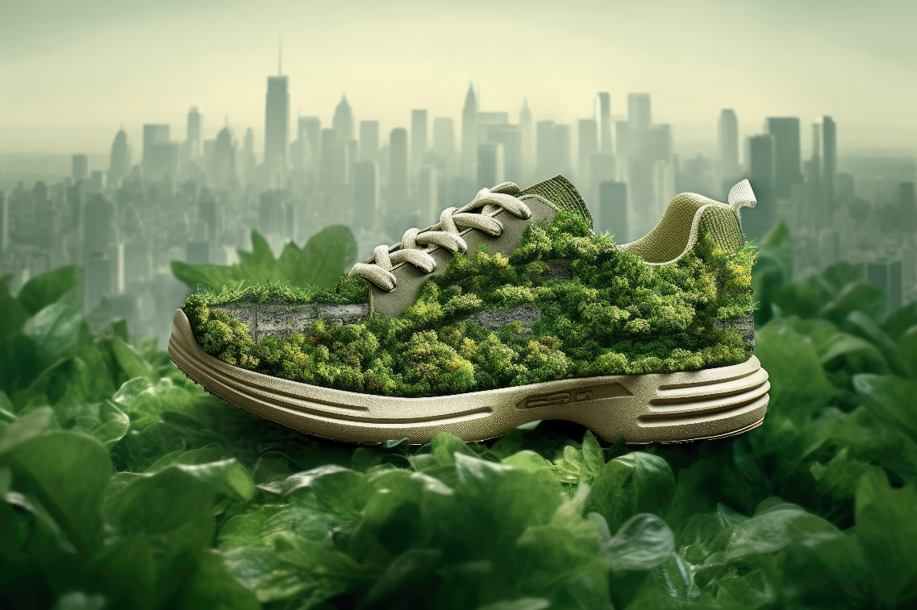
topics covered
Review Time
Increase Your Carbon Handprint
Manage Your Eco-friendly Emissions
Demonstration and Discussion
Practice Activity
Gamification Quiz
Notes:
Topics Covered
Review the topics to be discussed.
Remind students that active participation, interaction and inquiry are required actions and they should be self-motivated to engage in lively, provocative discussions.
Time: 2-minutes

Slide 3

review time
Access the RITMO Community.
Log in to your account.
Go to the Eco-friendly Emissions for Youth and Adults (eModule)
Reread Lesson 6: Becoming Eco-friendly Stewards, Part 1.
10 minutes
Notes:
Review Time
Ask learners to access the RITMO Community and login to their Member Account.
Ask them to go to the Eco-friendly Emissions for Youth and Adults (eModule).
Ask learners to reread Lesson 6: Becoming Eco-friendly Stewards, Part 2.
Time: 5 minutes

Slide 4

increase your carbon handprint
To achieve NetZero Emissions, you should increase your Carbon Handprint.
How to increase Your Carbon Handprint
View Video
View Video
5:00 minutes
Notes:
Increase your carbon handprint by…
Review each video with learners.
Time: 5-minutes

Slide 5




manage your eco-friendly emissions
Use the NetZero formula to manage your carbon emissions
NetZero
$$=$$
$$−$$
Carbon Footprint
Carbon Handprint
View Video
3:00 minutes
Notes:
Managing Your Carbon Emissions
Review the NetZero formula and discuss why it is important to use the formula to achieve NetZero.
Explain to learners that they will use the NetZero formula to calculate their eco-friendly emissions.
Time: 3-minutes

Slide 6


demonstration and discussion
Follow along and learn how to complete:
  Personal Carbon Footprint Benchmark Activity
  Personal EFE Journal
Ask questions as you investigate your current carbon emission activities and behaviors
Personal Carbon Handprint Benchmark Activity
Personal EFE Journal
Notes:
Demonstration and
Note that the courseware materials can be found on your online profile. Go to My Dashboard | Courseware | Flexible Facilitator/Peer Mentor to access the materials from the https://drshinshuri.com RITMO Community site.
Download and print all the following activities for participants to use from the Personal Carbon Reduction Practices Review, Part 2 session:
Personal Carbon Handprint Benchmark Activity
Instructions for Personal EFE Journal
Personal EFE Journal
Review each of the above activities with participants.
Review the NetZero formula and discuss why it is important to use the formula to achieve NetZero.
Explain to learners that they will use the NetZero formula to calculate their Carbon Handprint.
Time: 10 minutes

Slide 7


practice activity
Set your Carbon Handprint benchmark
Complete the Personal EFE Journal
Total your scores
Share your scores by posting in the RITMO Community.
Post and Share in the RITMO Community
Notes:
Practice Activity
Ask participants to share their results/data in the RITMO Community Forum after they complete the assignment.
Demonstrate how to access and post to the RITMO Community forum for each activity:
Personal Carbon Handprint Benchmark Activity (forum)
Personal EFE Journal (forum)
Allow time for participants to complete the activities you gave them as you reviewed and demonstrated what to do and how to do it.
Time: 10 minutes

Slide 8
Gamification Quiz
A correct answer participant receives points and value.
An incorrect answer participant loses points and value.
Gamification Point Scale
Activity | Points | Value
Easy Question | 1 | $1.00
Video Question | 3 | $3.00
Difficult Question | 5 | $5.00
Notes:
Gamification Quiz
Review Lesson 6: Becoming Eco-friendly Stewards, Part 1 with participants.
Use the Gamification Point Scale to keep track of each student’s score.
Conduct a round robin with participants and have them answer the questions. (Note: A correct answer the participant receives the positive points and value.. An incorrect answer participant receives negative points and value.)
Keep a tally of all points and dollar value earned by each participant for each gamification review activity. (Note: Use the EFE Gradebook to keep track of participant activities completed)
Participants must complete the full eCourse (eModule + eClass) to earn their stipend at the end of the training
Time: 3 minutes

Slide 9
question #1
How often should you measure and track your Carbon Handprint?
Notes:
Question #1
Present the question to all participants. The first hand raised gets to answer the question.
If answered correctly, participant earns points and value. Tally points and value for the participant. Go to next question.
If answered incorrectly participant loses points and value. Tally points and value. Allow another participant a chance to answer the question. If the second participant answers correctly, participant. Earns points and value. Tally points and value. If answered incorrectly participant loses points and value. Tally points and value.
Show the correct answer after the second failed attempt to answer the question.
Go to next question.
Time: 1 minute

Slide 10
question #2
What is the difference between a carbon footprint and a carbon handprint. Select all that apply.
  A carbon footprint is bigger than the carbon handprint.
  A carbon handprint is smaller than a carbon footprint.
  The carbon footprint is small, and the carbon handprint is big.
  The carbon footprint and handprint must be the same size
Notes:
Question #2
Present the question to all participants. The first hand raised gets to answer the question.
If answered correctly, participant earns points and value. Tally points and value for the participant. Go to next question.
If answered incorrectly participant loses points and value. Tally points and value. Allow another participant a chance to answer the question. If the second participant answers correctly, participant. Earns points and value. Tally points and value. If answered incorrectly participant loses points and value. Tally points and value.
Show the correct answer after the second failed attempt to answer the question.
Go to next question.
Time: 1 minute

Slide 11
question #3
The statement below describes which carbon emissions factor.
This is a comparison of two equal products or services and the climate impact of those options. Carbon handprint equals the difference between the two-options carbon footprint, measured in mass of CO₂ equivalent. The bigger the handprint the better.
Notes:
Question #3
Present the question to all participants. The first hand raised gets to answer the question.
If answered correctly, participant earns points and value. Tally points and value for the participant. Go to next question.
If answered incorrectly participant loses points and value. Tally points and value. Allow another participant a chance to answer the question. If the second participant answers correctly, participant. Earns points and value. Tally points and value. If answered incorrectly participant loses points and value. Tally points and value.
Show the correct answer after the second failed attempt to answer the question.
Go to next question.
Time: 1 minute

Slide 12
question #4
Name three things you can do in the community to reduce carbon emissions?
Notes:
Question #4
Present the question to all participants. The first hand raised gets to answer the question.
If answered correctly, participant earns points and value. Tally points and value for the participant. Go to next question.
If answered incorrectly participant loses points and value. Tally points and value. Allow another participant a chance to answer the question. If the second participant answers correctly, participant. Earns points and value. Tally points and value. If answered incorrectly participant loses points and value. Tally points and value.
Show the correct answer after the second failed attempt to answer the question.
Go to next question.
Time: 1 minute

Slide 13
question #5
Name four things you can do to reduce carbon emissions for yourself and at home?
Notes:
Question #5
Present the question to all participants. The first hand raised gets to answer the question.
If answered correctly, participant earns points and value. Tally points and value for the participant. Go to next question.
If answered incorrectly participant loses points and value. Tally points and value. Allow another participant a chance to answer the question. If the second participant answers correctly, participant. Earns points and value. Tally points and value. If answered incorrectly participant loses points and value. Tally points and value.
Show the correct answer after the second failed attempt to answer the question.
Go to next question.
Time: 1 minute

Slide 14
question #6
It is generally said that your Carbon Handprint should be big, and your Carbon Footprint should be small? Select the best answer.
  True
  False
Notes:
Question #6
Present the question to all participants. The first hand raised gets to answer the question.
If answered correctly, participant earns points and value. Tally points and value for the participant. Go to next question.
If answered incorrectly participant loses points and value. Tally points and value. Allow another participant a chance to answer the question. If the second participant answers correctly, participant. Earns points and value. Tally points and value. If answered incorrectly participant loses points and value. Tally points and value.
Show the correct answer after the second failed attempt to answer the question.
Go to next question.
Time: 1 minute

Slide 15
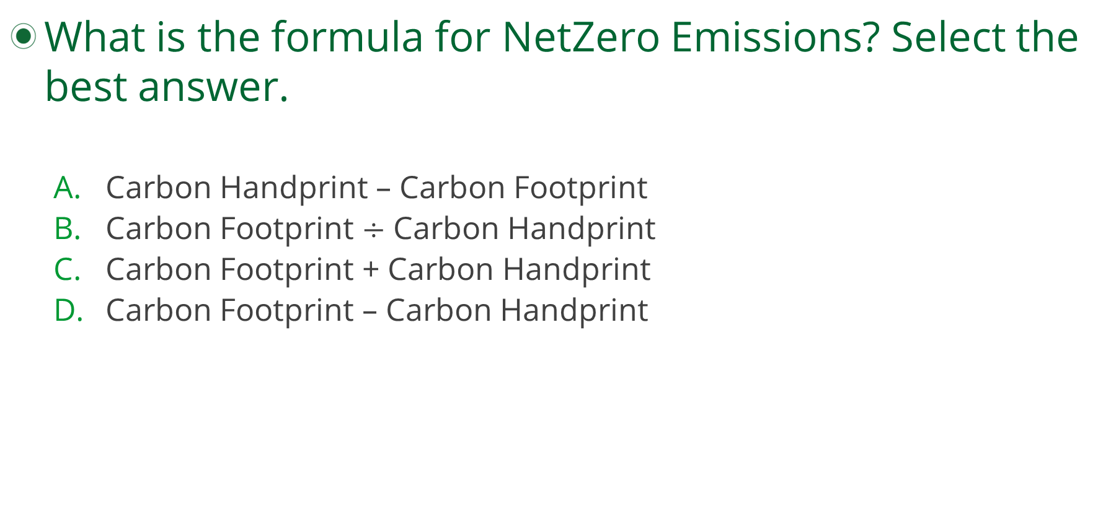
question #7
What is the formula for NetZero Emissions? Select the best answer.
  Carbon Handprint – Carbon Footprint
  Carbon Footprint $÷$ Carbon Handprint
  Carbon Footprint + Carbon Handprint
  Carbon Footprint – Carbon Handprint
Notes:
Question #7
Present the question to all participants. The first hand raised gets to answer the question.
If answered correctly, participant earns points and value. Tally points and value for the participant. Go to next question.
If answered incorrectly participant loses points and value. Tally points and value. Allow another participant a chance to answer the question. If the second participant answers correctly, participant. Earns points and value. Tally points and value. If answered incorrectly participant loses points and value. Tally points and value.
Show the correct answer after the second failed attempt to answer the question.
Go to next question.
Time: 1 minute

