Slide 1
eClass
Self-love Experience Leadership
Notes:
Welcome participants to the Self-Love Experience Leadership eClass. I am your facilitator ___________________________.
This eClass is about you sharing your learning and understanding of the materials you learned in the eModule. The eClass is to aid you in your understanding of apply the materials to your daily routine and life.

Slide 2

Defining Self-love
Identify the various types of love
Define self-love for yourself
Explain how you will apply self-love
Notes:
This e-Class will be about defining self-love.
We will review Homework Review, Identify the different types of love, Define self-love for yourself, and lastly, Explain how you will apply self-love.
Throughout this presentation, I am asking that you be engaged in the class by sharing, answering questions, listening, supporting your peers with encouraging words, and showing up for yourself by doing the work and applying it to and in your life.

Slide 3

Session 2
In this session, you will apply your learning from eModule lesson Self-love Introduction. This includes:
Identify the various types of Ancient Greek terminology for the word love.
Explore your own and others perspective of self-love.
Share your own definition of self-love and how you apply it in life.
Notes:
Class Session 2 will give you the opportunity to apply your learning from the eModule lesson Self-love Introduction. In this session, we will:
Identify the various types of Ancient Greek terminology for the word love.
Explore your own and others perspective of self-love.
Share your own definition of self-love and how you apply it in life.

Slide 4
Identify the various types of love
Notes:
Identify the various types of love.
In the eModule, you were introduced to the various types of Greek love. How many types of Greek love were there? Please raise your hand to give your answer.
In the next slide, I will show you different images that represent the different types of Greek love. By observing the images, I want you to tell me what type of love the images represent. To share your answer, please raise your hand by clicking the hand button on your screen.

Slide 5

What love type does this fit?
Philia (Friendship)
Notes:
As you look at the image, what do you notice or discern? Type your observation into the chat section.
Class, what love type does this image fit? (Have the class raise their hands to give the Greek name or randomly pick a student).
This love type is Philia: Friendship or brotherly love.

Slide 6
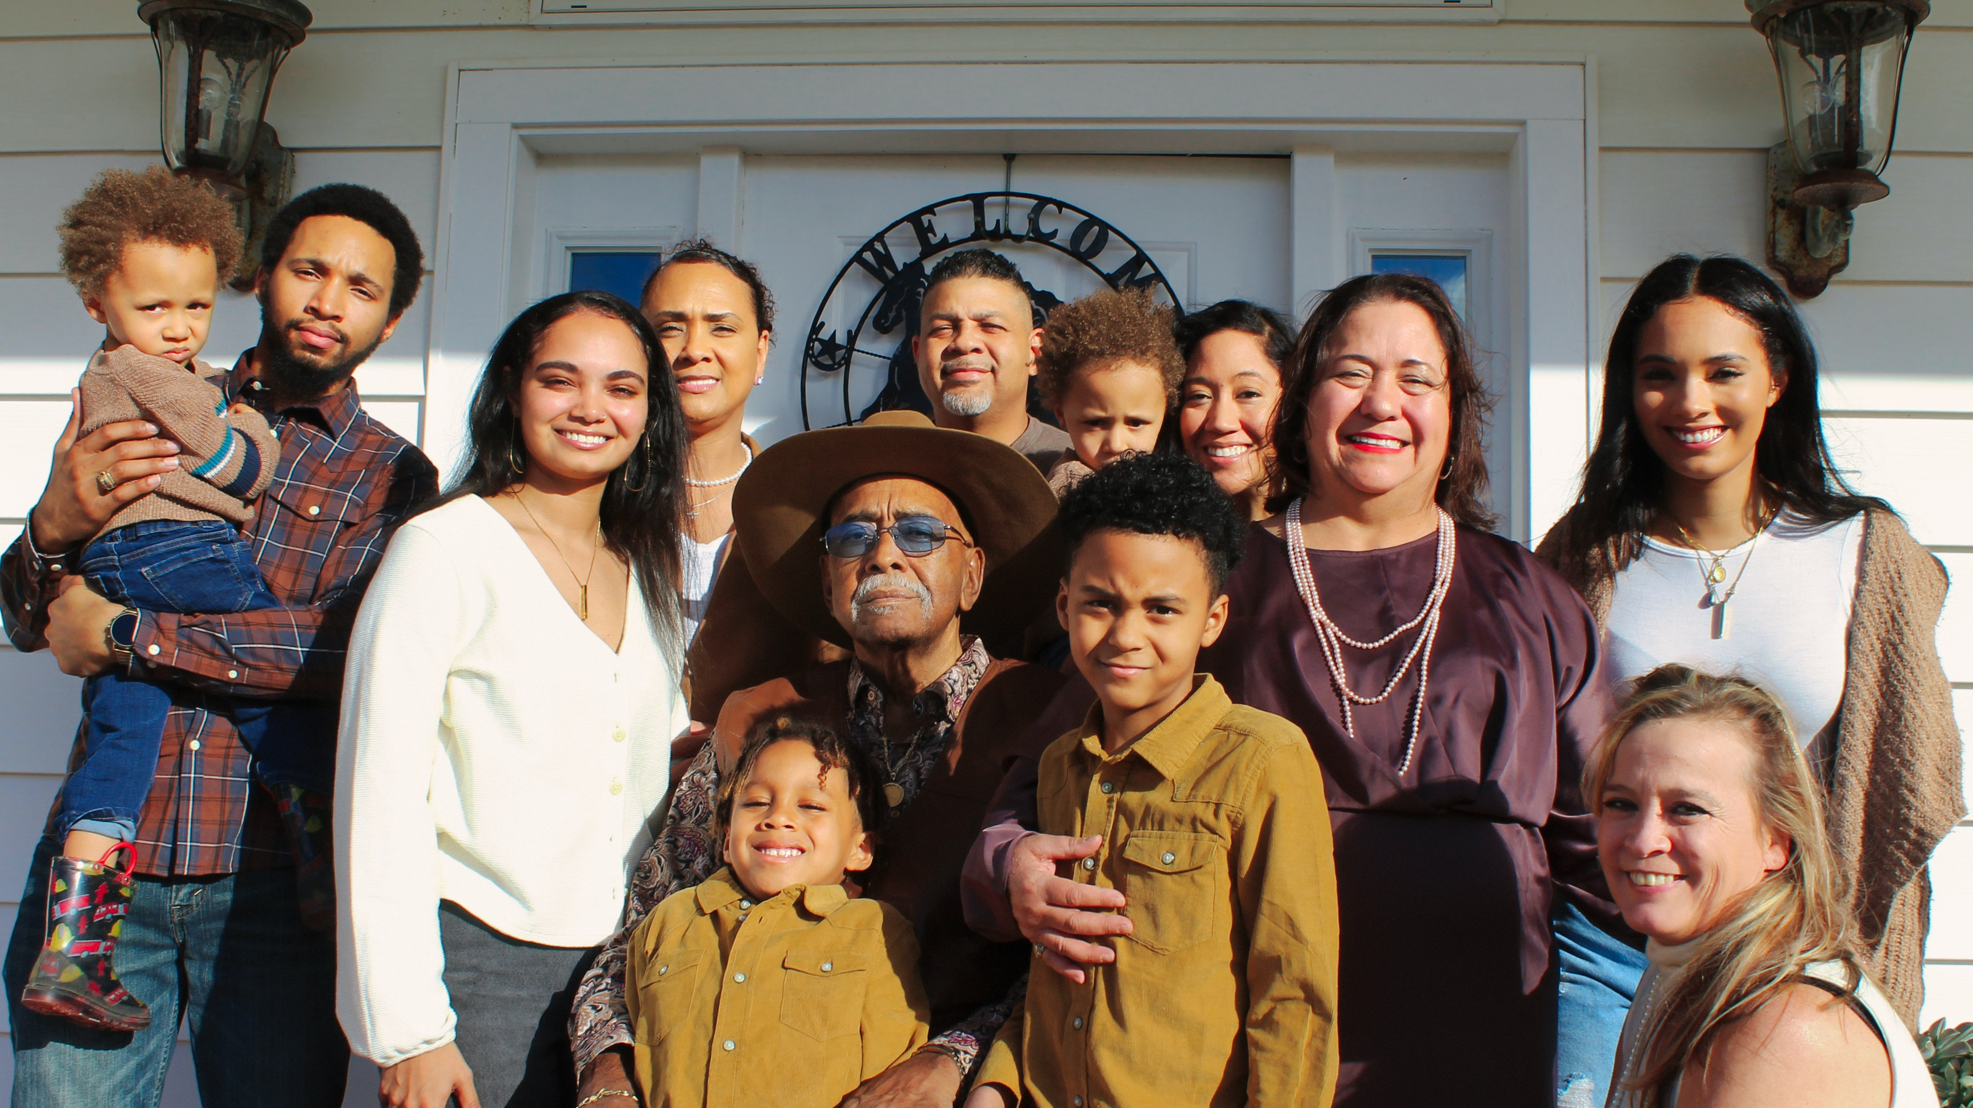
What love type does this fit
Storge (Family)
Notes:
Class what love type will you say this image is?
This love is Storge (stor gay), It’s the love of family.

Slide 7
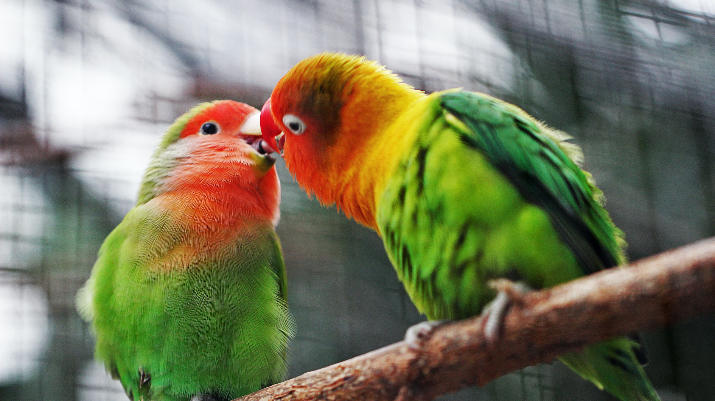
What love type does this fit?
Eros (Romantic lover)
Notes:
What do you see in this image?
What love type does this fit?
This love type is Eros. It is love shared with a person you are romantically into. This love is shared between lovers.

Slide 8

What love type does this fit?
Agape (Universal Love)
Notes:
Choose a participant who have not raised their hands to share with the class the Greek love type for this image.
Agape is universal love. It is love for all man kind.

Slide 9

What love type does this fit ?
Ludus (Flirting)
Notes:
What love type does this fit?
Ludus love fliting or crushing on someone you love or like.

Slide 10
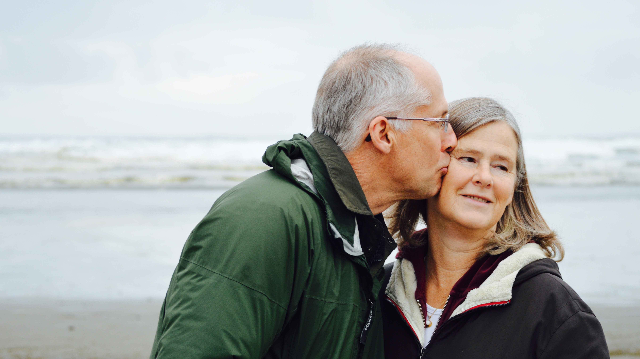
What love type does this fit?
Pragma (Mature love)
Notes:
Pragma is mature love. This love is shown in couples that have been together for a long time. This love have learned how to love each other over time and overcoming many challenges together.

Slide 11
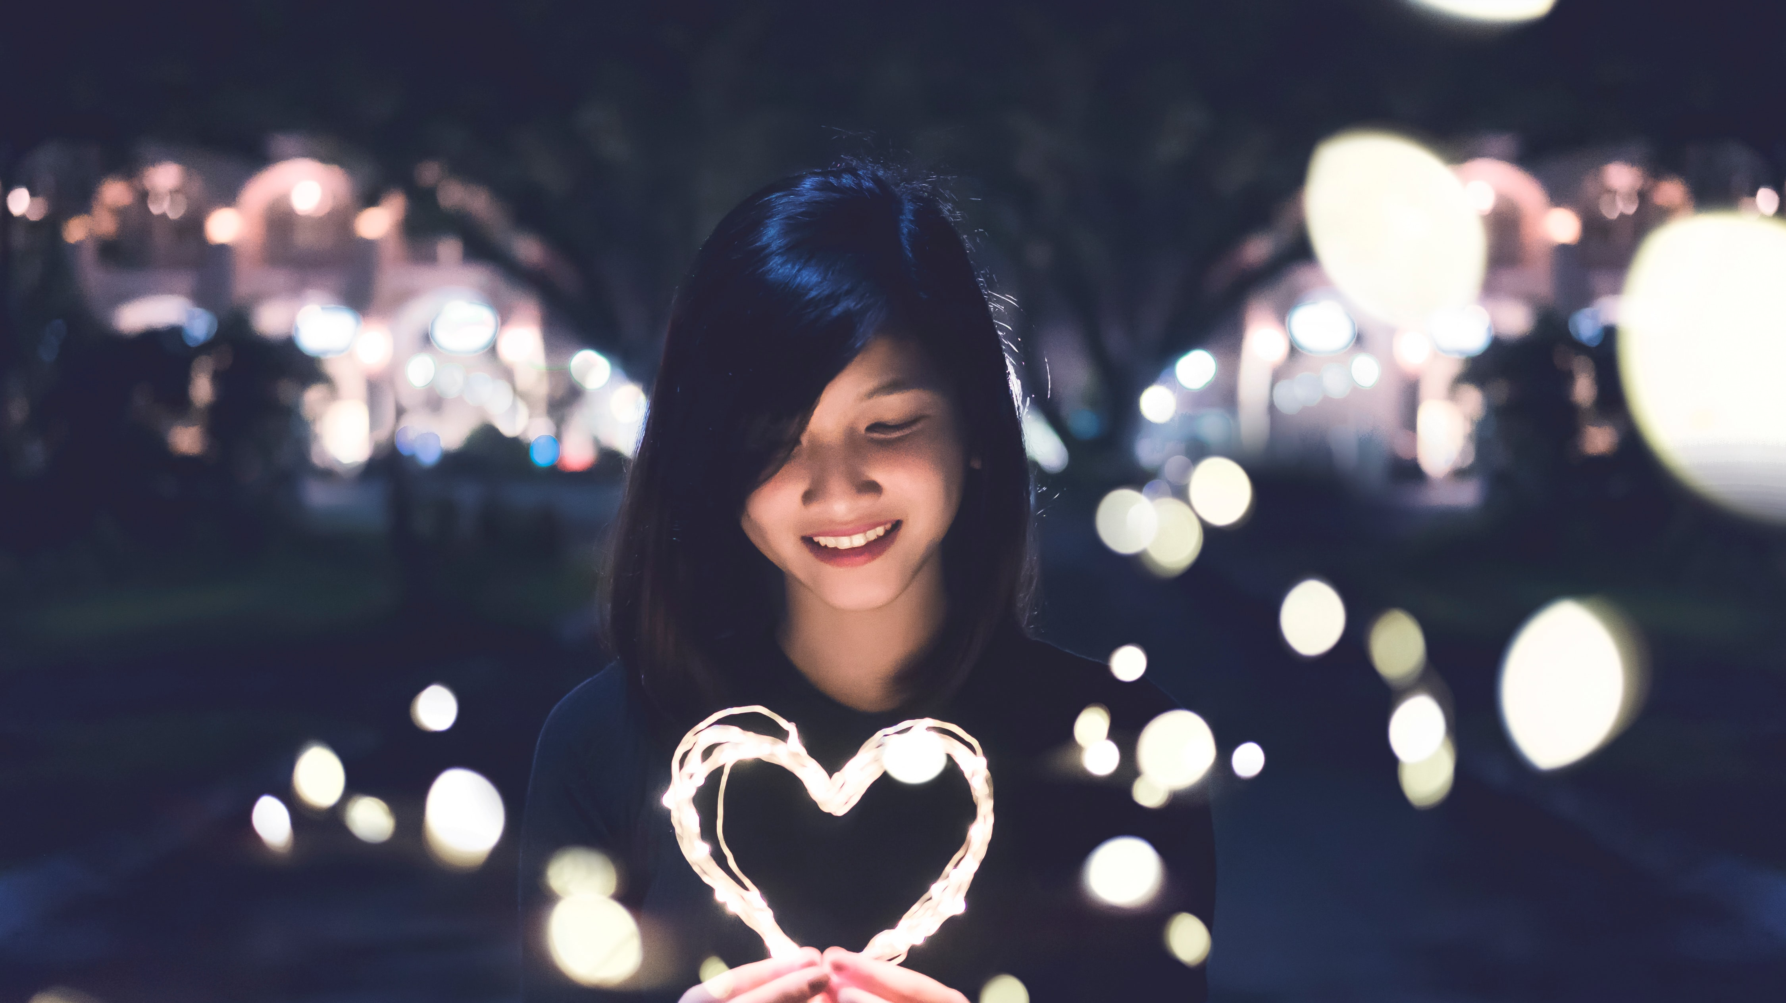
What love type does this fit?
Philautia (Self-love)
Notes:
Philautia is self-love. It is loving oneself first so that they can love others.

Slide 12

Any questions
Notes:
Great job class at recognizing the different type of Greek love. Do you have any questions about the different types of love?

Slide 13
Define self-love for yourself
Notes:
In this topic you will define self-love for yourself. In the next slide we will watch a video called “There is no “Self”, just I.

Slide 14
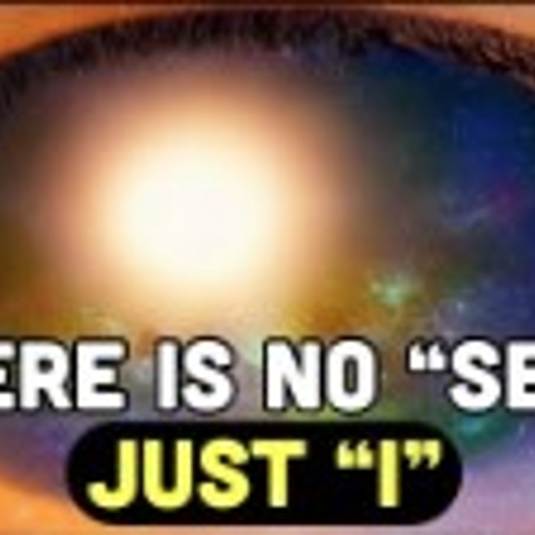
There is no “Self” just “I”
There are many questions that we often have about ourselves and how it relates to being who we are.
Let’s view There is no “Self” just “I” video to gain better understanding.
https://youtu.be/exaAg8SdHR4
Notes:
There is No “Self” Just “I” video
There are many question that we hold inside and never seek to ask others about when it deals directly to how we see ourselves.
Let’s view this 8:00 minute video that help gives some understanding of our self in thought.
Click on the link in the chat to view.
https://youtu.be/exaAg8SdHR4

Slide 15
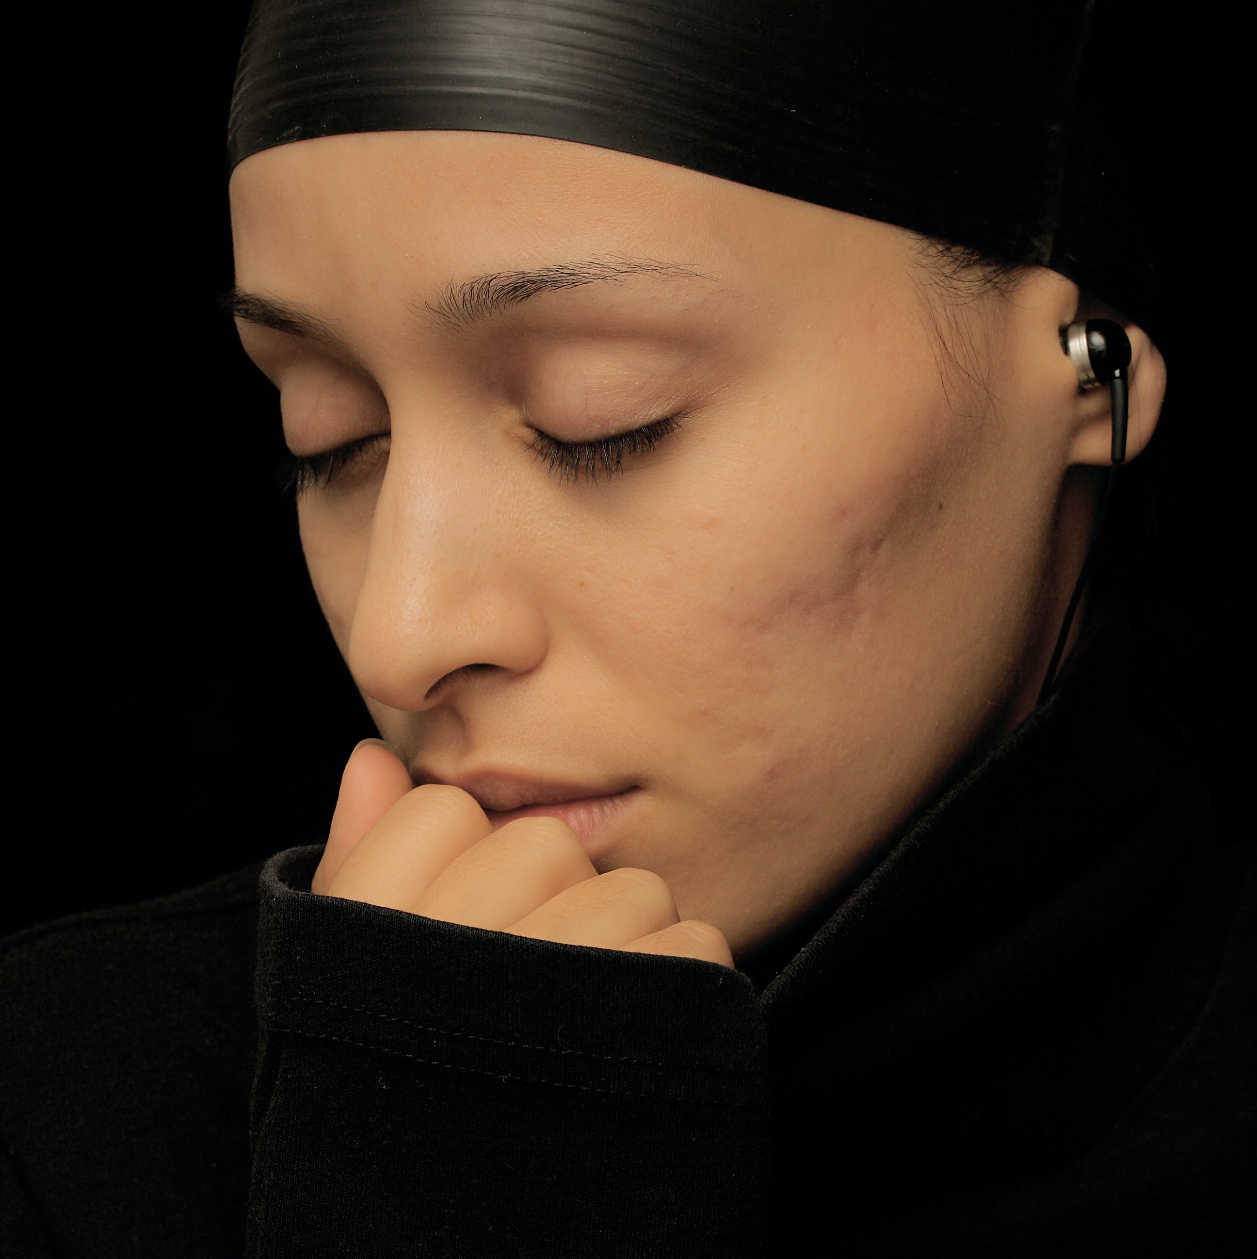
Video activities
How did the video make you feel?
What did you learn?
Did the video answer any questions you may have had in the past or now?
Notes:
Video Activities
There is No “Self” Just “I” video has so much information to pull from. This video causes us to reflect within to find the answers to many questions presented in the video or even questions we may have had before viewing the video.
Ask the class to share their perspective of the video “There is no “Self” Just “I”. Randomly select students to share if no one raises their hand.
Class, how did the video make you feel?
Were there anything new you learned from the video?
What questions came to mind when watching the video?

Slide 16

Self-love discovery
What are some things you uncovered during your research of the word self-love?
Give some examples of discovery that changed your perspective on self-love.
Share with the class your personal definition of self-love you wrote during the eModule Self-love introduction activities.
Notes:
Self-love discovery
The eModule aided you in gaining an understanding of self-love and helped you to discover what self-love looks like for you.
Class, during your self-love discovery and research what have you learned about self-love?
Share some examples of your discovery that changed your perspective on self-love and your definition of self-love for yourself.

Slide 17
Any questions
Notes:
This conclude this topic. Do you have any questions about topic Define self-love for yourself?

Slide 18
Explain how you will apply self-love
Notes:
Explain how you will apply self-love
Class, you should have gained a better understanding of the different types of love, and you have defined self-love for yourself. Now its time to show how you will process self-love into your daily life. This slide is all about applying self-love and putting a plan in place to daily practice.
Having a plan in place will help you to stay focus and on track with your goals, plans and life.

Slide 19

Applying self-love
Continue to review the various types of Greek love.
Take time to notice areas of your life where the seven types of Greek love show up in your life.
Identify the type of relationships you have with those around you.
Share with your family and friends your definition of self-love and why it is important to you.
Review your definition of self-love daily
Notes:
It is one thing to learn about self-love, but the rewarding part is known how to use what you have learned in your life daily.
Take a few seconds to reflect on areas of your life where you have seen the various types of love show up. Whatever the experience was, take a few seconds to write it down in your journal and what you observed about it. This will help you to be more aware of the various types of loving surrounding you.
This conclude this session. Are there any questions about applying self-love? (Wait for any questions the students may have) If no questions, ask for feedback on the materials and presentation.
Just as reminder, you will need to set up time with myself to schedule your one-on-one interview time.
(If there are no questions remind the student to set up their interview time. Also ask the class was the presentation beneficial, is there anything they would have loved, but was not in the slide, and what they did not like about presentation).

Slide 20

Applying self-love
Set a goal for yourself to continue to develop your understanding of self-love.
Make the needed changes within your relationship with others to move forward in your growth and awareness of self-love.
Notes:
In order to apply self-love to your life daily, you will need to set goals for yourself surrounded by self-love. Setting goals and applying the goals to your life is no different than setting a goal to get all A’s on your next report card, or to get a new job with more pay. It is all the same, you just need to set the goals, plan it, and apply it.

Slide 21
Any questions
Notes:
This conclude this session. Are there any questions about explain how you will apply self-love? (Wait for any questions the students may have) If no questions, ask for feedback on the materials and presentation.
(If there are no questions remind the student to set up their interview time. Also ask the class was the presentation beneficial, is there anything they would have loved, but was not in the slide, and what they did not like about presentation).

Slide 22

Homework
Make a journal entry about your experience and observation of the various Greek type of love.
Share your family and friends' response of your definition of self-love with the class.
In your journal, describe how your definition of self-love will appear in your life.
Share your journal entries with the RITMO Community Fellowship.
Click on the link access the RITMO Community Fellowship forum https://drshinshuri.com/forums/
Notes:
After every session there will be homework.
For this homework make a journal entry about your experience and observation of the various Greek love types covered in this session.
Share your family and friends’ response of your definition of self-love with the class.
Describe how your definition of self-love will appear in your life.
Share your journal entry with the RITMO Fellowship Community
Think about becoming Self-love peer mentor.

Slide 23
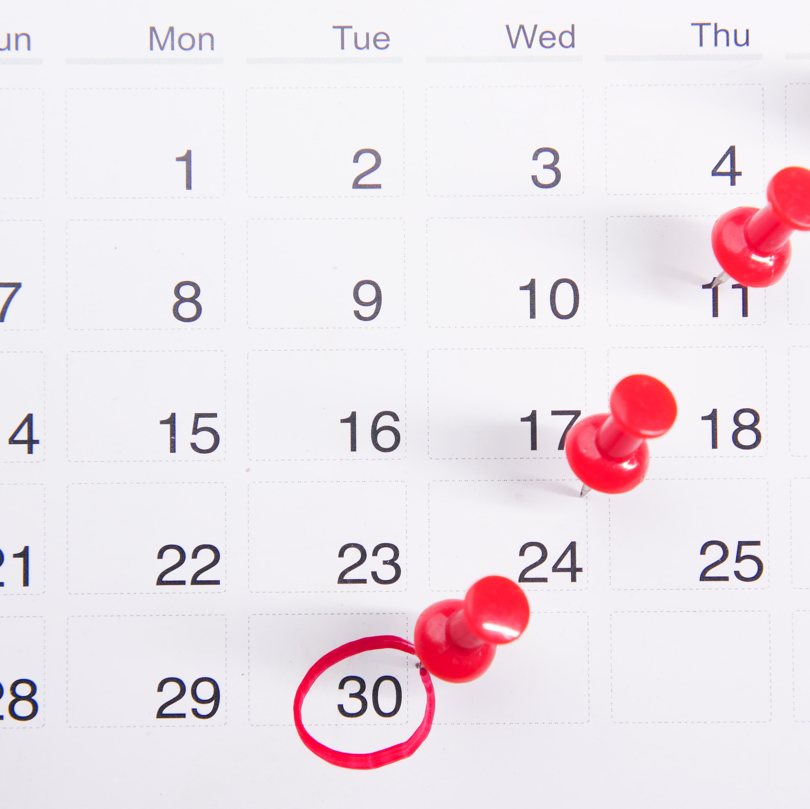
Schedule appointment
Each session is up to 1-hour max.
Click on link in form to schedule your appointment. https://drshinshuri.com/schedule-an-appointment/
Notes:
Class, after each eClass, you will have the opportunity to schedule an appointment to review any types covered in this session. Each session is up to1-hour max.
The appointment for this session will explore your understanding of the various Greek love types, applying, and defining what self-love is to yourself.
This will also be a safe place to gain clarity of current or previous topics or issues you may be facing now.

