Slide 1
E-Class
Self-love Experience Leadership
Notes:
Welcome participants to the Self-Love Experience Leadership eClass. I am your facilitator ___________________________.
This eClass is about you sharing your learning and understanding of the materials you learned in the eModule. The eClass is to aid you in your understanding of apply the materials to your daily routine and life.

Slide 2

Connections
Homework review
Managing through self-love
Connecting with others
Discernment of behavior
Notes:
This eClass is about Connections.
We will review Homework Review, Managing Through Self-love, Connections with others, and discerning others behavior.
Throughout this presentation, I am asking that you be engaged in the class by sharing, answering questions, listening, supporting your peers with encouraging words, and showing up for yourself by doing the work and applying it to and in your life.

Slide 3
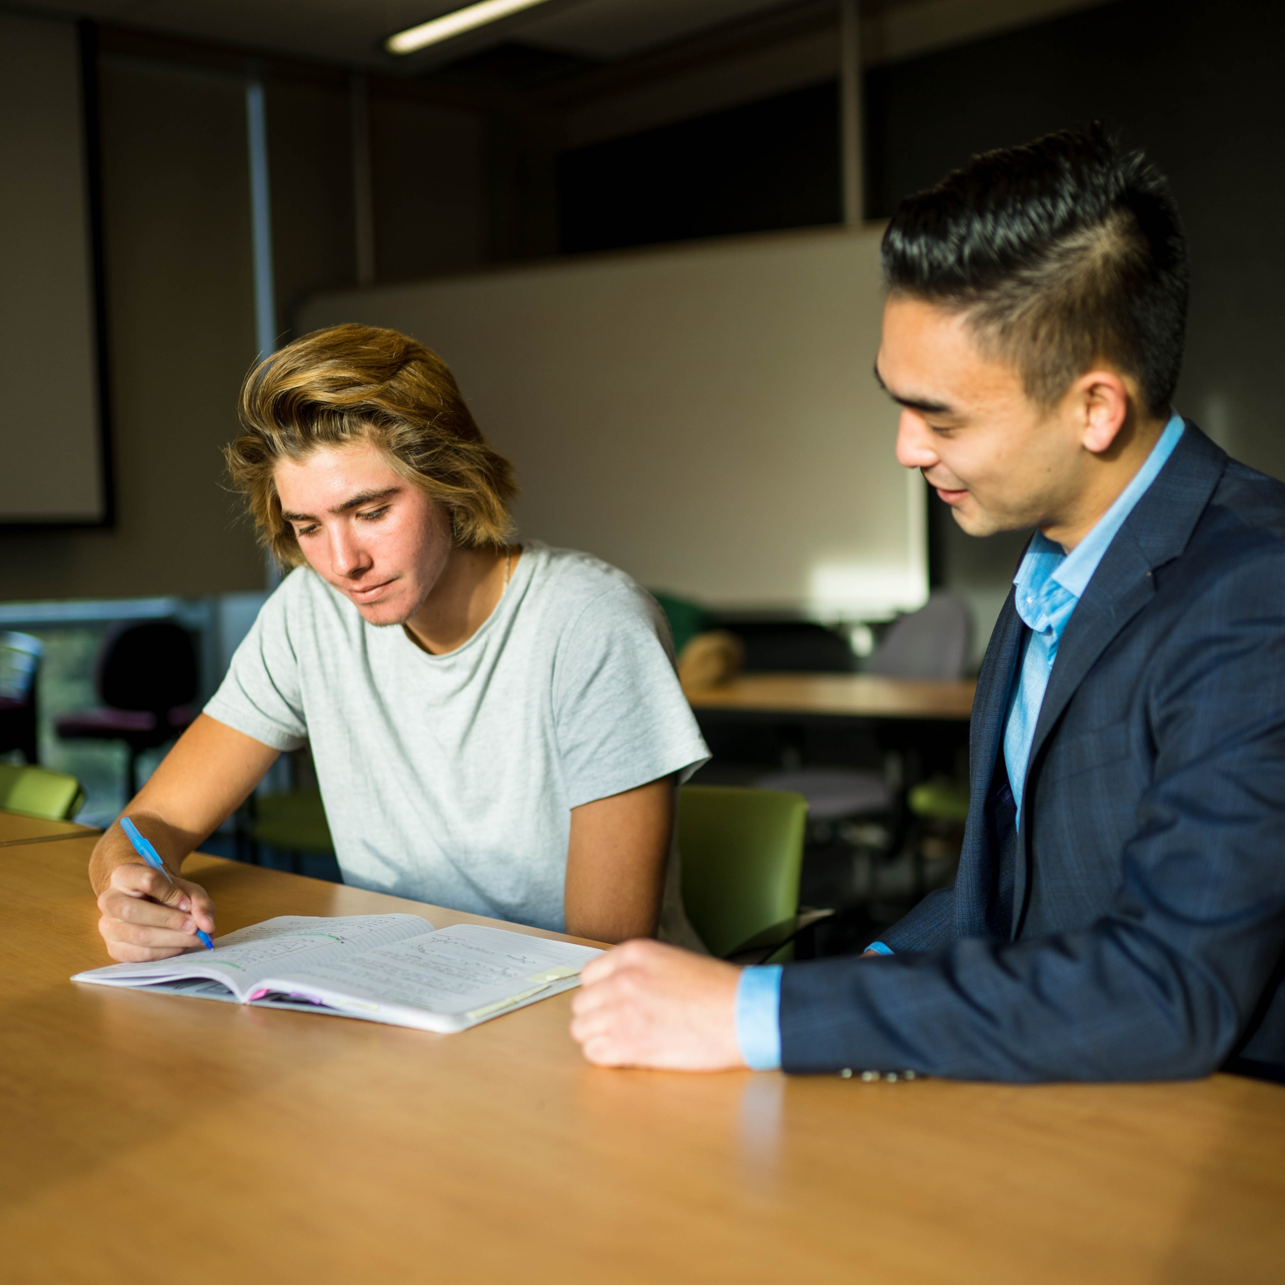
Homework review
Make a journal entry about your experience and observation of the various Greek type of love.
Share your family and friends' response of your definition of self-love with the class.
In your journal, describe how your definition of self-love will appear in your life.
Think about becoming a peer mentor for self-love?
Share your journal entries with the online community.
Notes:
Class this is the time to review your homework;
With a show of hands, how many attempted, or completed their homework?
Class lets review your homework. Did you practice reciting the Six Self-love Principles and your own affirmation?
Where there anything you changed from your affirmation because of our previous session?
Share any updates or changes with the class by raising your hand. If no one volunteers, you will be called upon.

Slide 4

Session 3
In this eClass, you will apply your learning from the eModule Essentials of self-love this includes:
Managing loving yourself
Connection with others
Discerning others behavior
Notes:
Class Session 3 will give you the opportunity to apply your learning from the eModule lesson Essentials of Self-love. In this session, we will discuss and apply methods for:
Managing loving yourself
Connection with others
Discerning others behavior

Slide 5
Managing through
Self-love
Notes:
Managing through self-love.
In the eModule Essentials of Self-love, you were introduced to different forms of communication. Do you recall what the different form of communication are from the eModule?
Please raise your hand to give your answer. The different form were Intrapersonal and Interpersonal communication. Do anyone recall what is the difference between intrapersonal and interpersonal communication?
Please raise your hand to give your answer…. Intrapersonal communication is the conversation you have within yourself, or in your mind. Intrapersonal communication is having a conversation with other people.
Managing through self-love speak on managing how you treat yourself ( which is Intrapersonal Communication) and managing how others treat you (Interpersonal Communication).

Slide 6
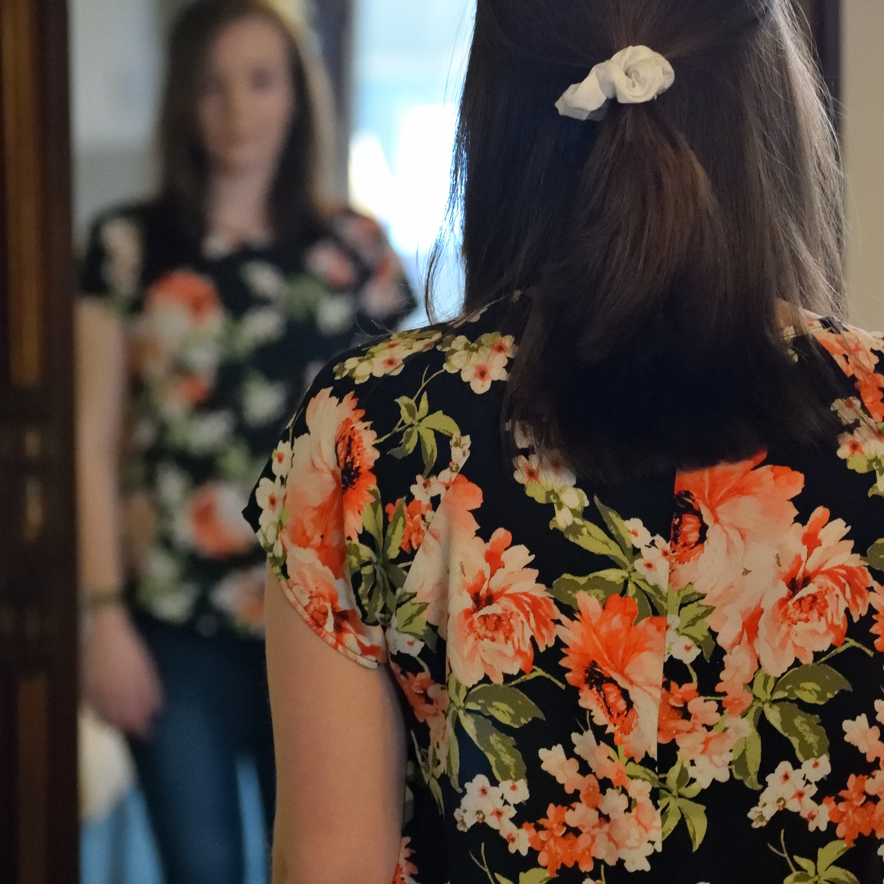
Managing how you treat yourself
What is Intrapersonal Communication?
What are some examples of Intrapersonal Communication?
Notes:
What does Intrapersonal Communication mean from the eModule? The act of communication transmission to an existing or occurring within the individual, self, or mind.
Can anyone give an example of intrapersonal communication?
-talking to yourself outload
-talking to yourself in your thoughts.
In the next slide, we will focus on Intrapersonal communication. We will watch a video given a better understanding of how intrapersonal communication show up in our daily life.

Slide 7

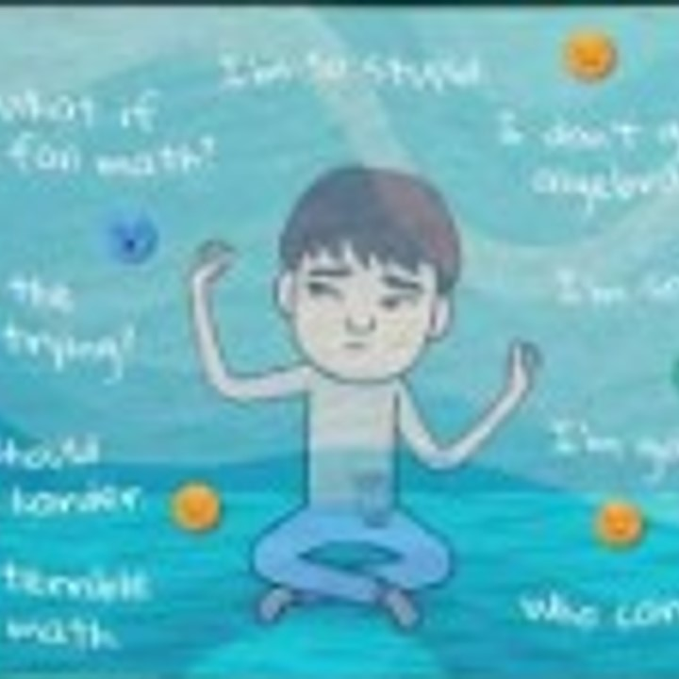
You're not your thoughts
Let’s watch a video that illustrate how your self-talk can take over your feelings when responding to everyday situations.
Watch and listen for understanding how your thoughts can affected your life.
https://youtu.be/0QXmmP4psbA
Notes:
You’re not your thoughts.
We will watch a video that illustrate how self-talk can take over your mood and emotions when responding to everyday situation.
Listen and watch for understanding of how your thoughts pay a role in your daily life.
Click on the link in the chat to watch “You’re not your thoughts.” https://youtu.be/0QXmmP4psbA
This video will take about 4 minutes.

Slide 8

You are not your thoughts review
After watching You are not your thoughts video, what did you notice about yourself?
Did you take notice of your thoughts?
Share your reaction of the video
Notes:
That was a lot to unpack right?
After watching “You are not your thoughts”, How did it make you feel about yourself?
Were there something new you learned about yourself?

Slide 9
Love me more
Do you recall watching the Love me More video by Sam Smith in the Essentials of Self-love eModule?
Share with the class your first reaction about the video.
What did you notice about yourself after watching and listening to “Love Me More”.
Let’s watch the Love me more video again. However, this time pay attention to how you react now to the video message.
You will have 3:48 to watch this video.
Notes:
In the Essential of Self-love eModule one of your activities were to watch “Love me more” by Sam Smith. Do you recall watching the music video? Answer yes or no in the chat.
To view the music video Love me more, click on the link in the chat.

Slide 10
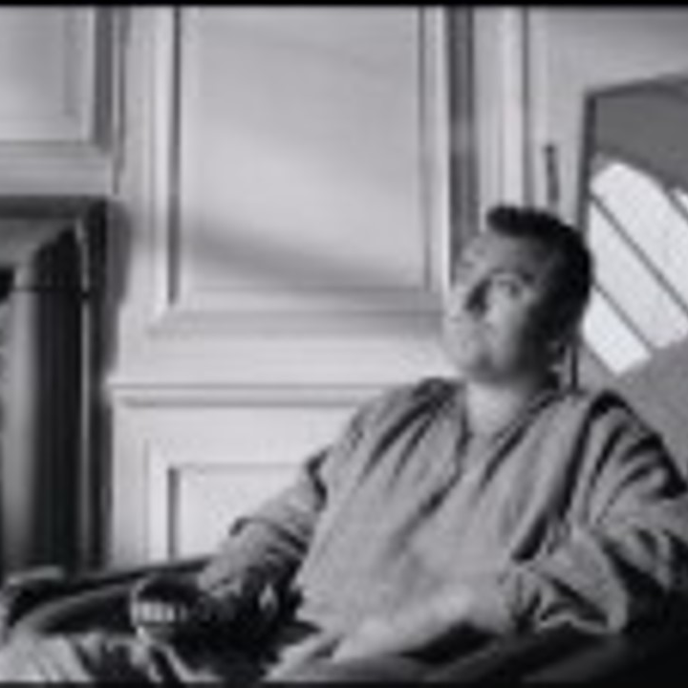
Click on the link in the chat to watch Love Me More by Sam Smith
https://youtu.be/H1hDzq98WIY
Notes:
Send the Link for Love Me More by Sam Smith to the group chat. https://youtu.be/H1hDzq98WIY
Have the participants Click on Link from Chat to watch the video.
This video will take about 4 minutes to view the chat.

Slide 11
Love me more video review
Share with the class your reaction now about the video.
Did you notice a change in how you viewed the video or yourself?
Class did you see any changes in you classmates first responds compared to their new response?
Notes:
Once the class has finished the clip. Let's here their response to the video.
What did you get from the video? Please raise your hand to give your responds.
How did the video make you feel?
Did you notice anything about yourself from hearing the words in the song?

Slide 12

negative words
What are some ways negative self-talk affects your life?
Notes:
Negative words affect everyone.
In most cases we speak more negative words than positive words about ourselves daily.
Let's review how your negative self-talk or intrapersonal communication affects your self-talk.
By raising your hands, share with the class how negative self-talk has affected or impacted your life.

Slide 13
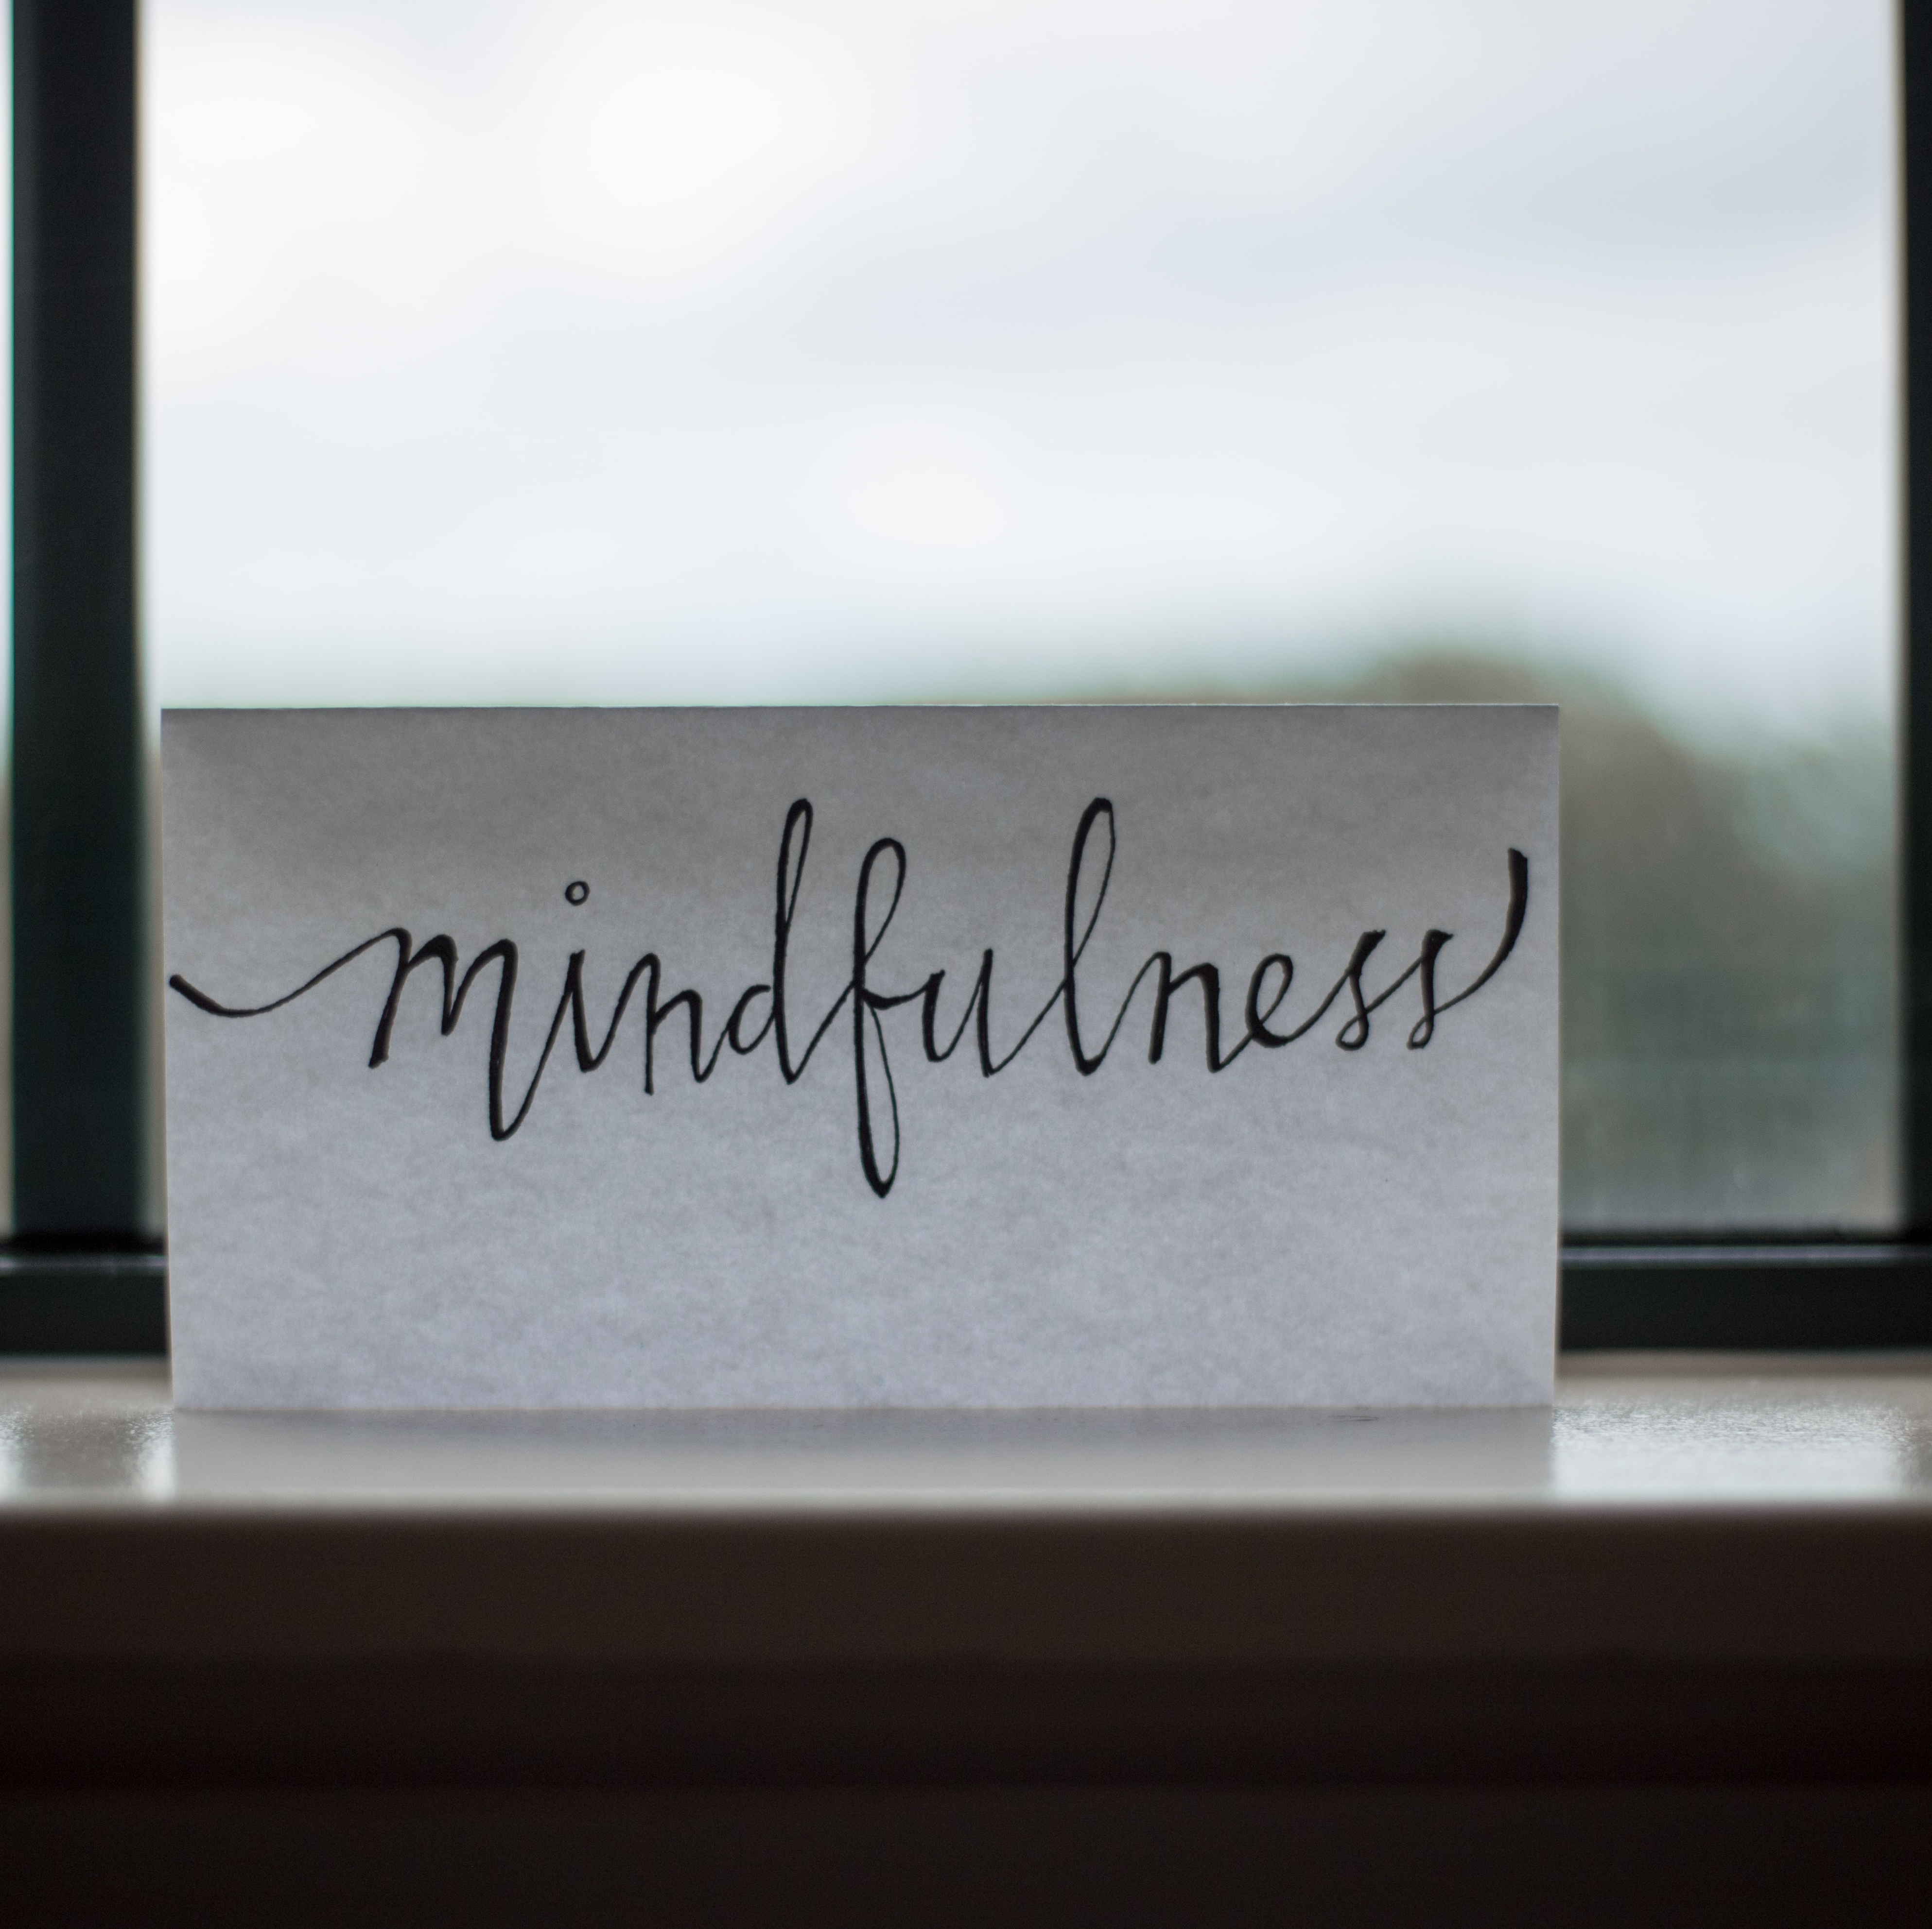
Removing negative thoughts
Being aware of negative thoughts
Accepting your flaws
Understanding your weakness
Knowing your strength
Replacing with positive words of self worth and power
Doing what you enjoy
Notes:
It is one thing to notice the negative thoughts you may have about yourself; however, it is great to be able to remove those thoughts that affect your daily routine or how you live life.
Being aware of negative thoughts will help you to make the changes needed to add more positive thoughts or remove the reoccurring or repeated negative thoughts from your mind.
Accepting your flaws will help you to embrace who you are from the inside out. In doing this it will help you to find positive words to speak about yourself.
Understanding your weakness: sometimes it challenging to find anything positive to say about yourself when you feel like you have so many flaws. Knowing your flaws, will help you to strengthen area of your life where you can improve on or seek the needed help to overcome them.
Knowing your strength, Give you a starting point in speaking positive words or self-talk into your life. This place of strength can help you overcome other areas of your life where you are flooded with negative self-talk.
Replacing negative word with self-worth and confident. You are more than capable to rewrite your thoughts about you. Learn new words of positive affirmation to help you develop positive thoughts.
Doing what you enjoy, will keep your mind focus on the good and happy thoughts. It will also help you to create new and health habits towards yourself.

Slide 14
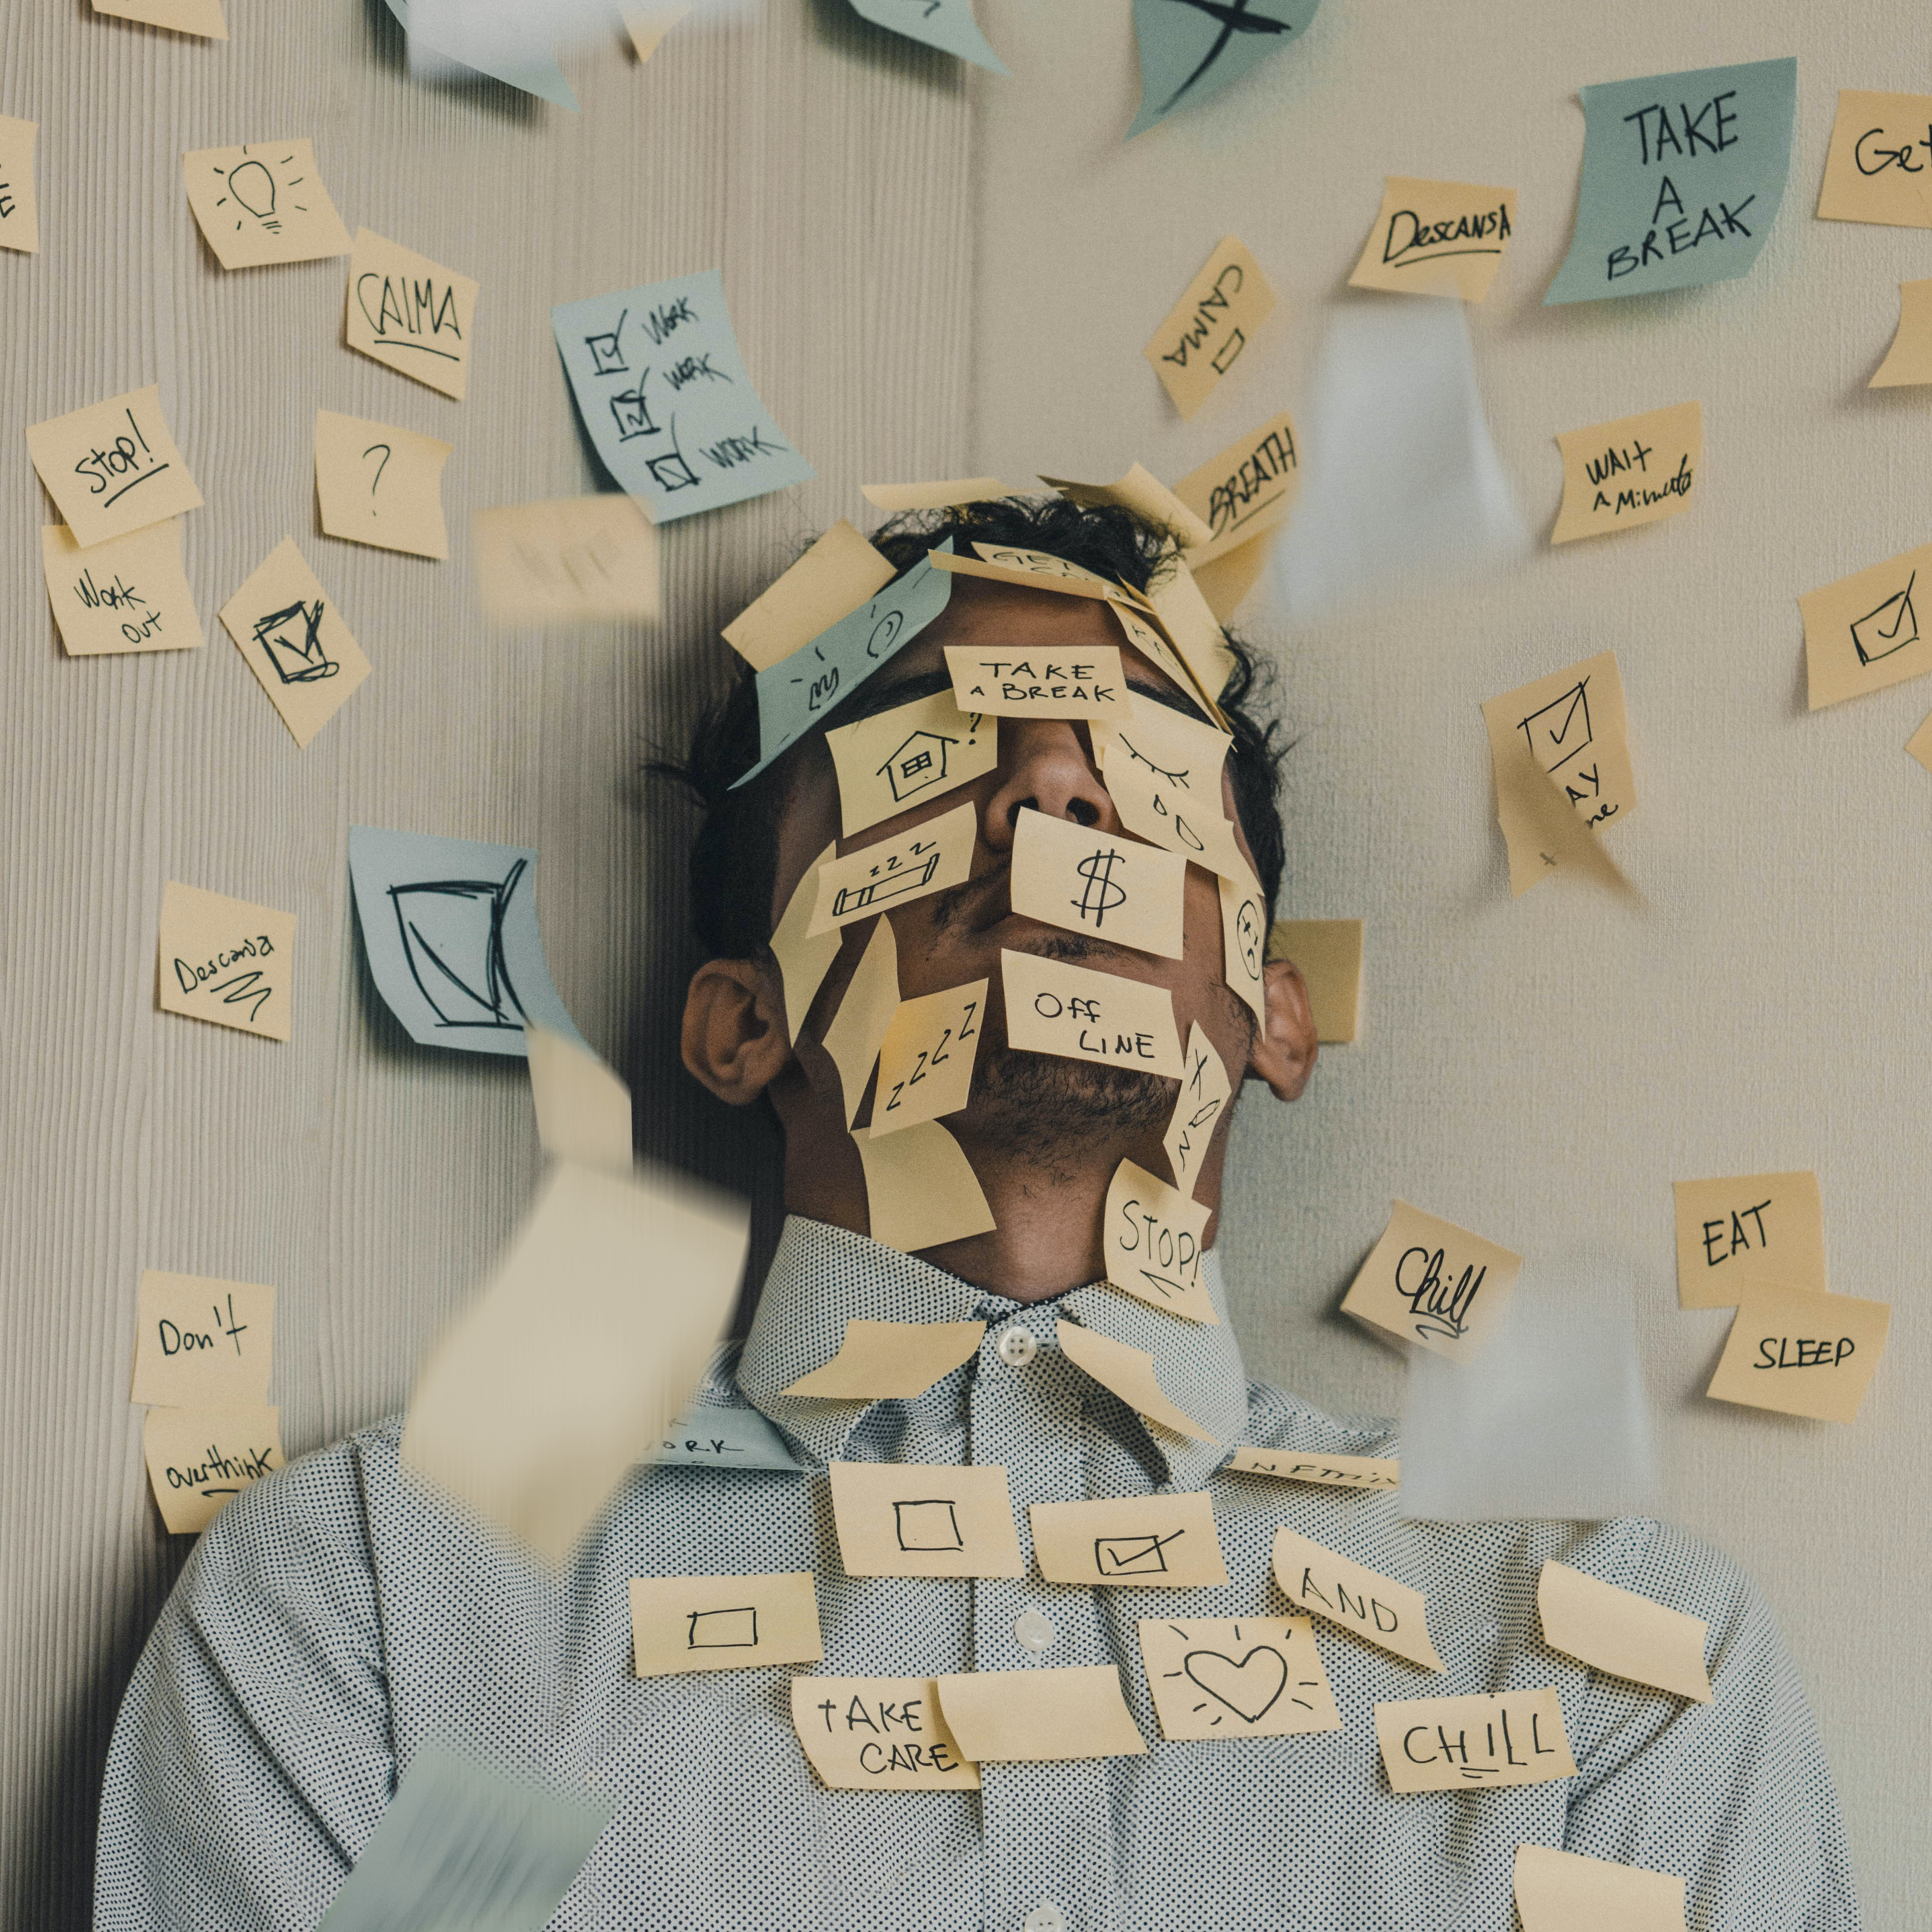
Managing prioritizing yourself
Let’s think about a moment where you were bullied or made to do something you did not want to do.
How did that make you feel?
Did you have a choice in doing or not doing it?
Prioritizing yourself is putting you first.
Being in your control of yourself to say no.
Meeting your set goals for yourself without allowing others to take over your life with their plans.
Managing what you do or do not do within your day.
Notes:
Managing prioritizing yourself
In this slide we will talk about prioritizing yourself.
Do anyone know what prioritizing means? Raise your hand to give your answer.
Prioritizing means, to list or rate in order of priority. Priority means the quality of state of being prior.
Where there any moments you can recall being pressured or told to do something you did not want to do? How did that make you feel?
Being in control of yourself, is knowing when to stand up for yourself. One example would be saying no to friends when you do not want to use drugs or go to a party.

Slide 15

Making the needed changes for you
Write down some ways you can show up for yourself?
Share with the class your ways of making yourself a priority?
What will you do differently if you're not able to meet your needs or want as planned?
This may happen because of a schedule issue or someone needing your time?
Notes:
Making the needed changes requires some adjustment on your part to see the changes happen.
Write down some ways you can show up for yourself first.
Share with the class different ways for you to make yourself a priority.

Slide 16

Any questions
Notes:
This conclude this topic. Do you have any questions about Managing through self-love?

Slide 17
Connecting with others
Notes:
As you may recall from the eModule, it is human nature to desire some form of connection to others.
In doing so, we communicate with them by way of interpersonal communication.

Slide 18
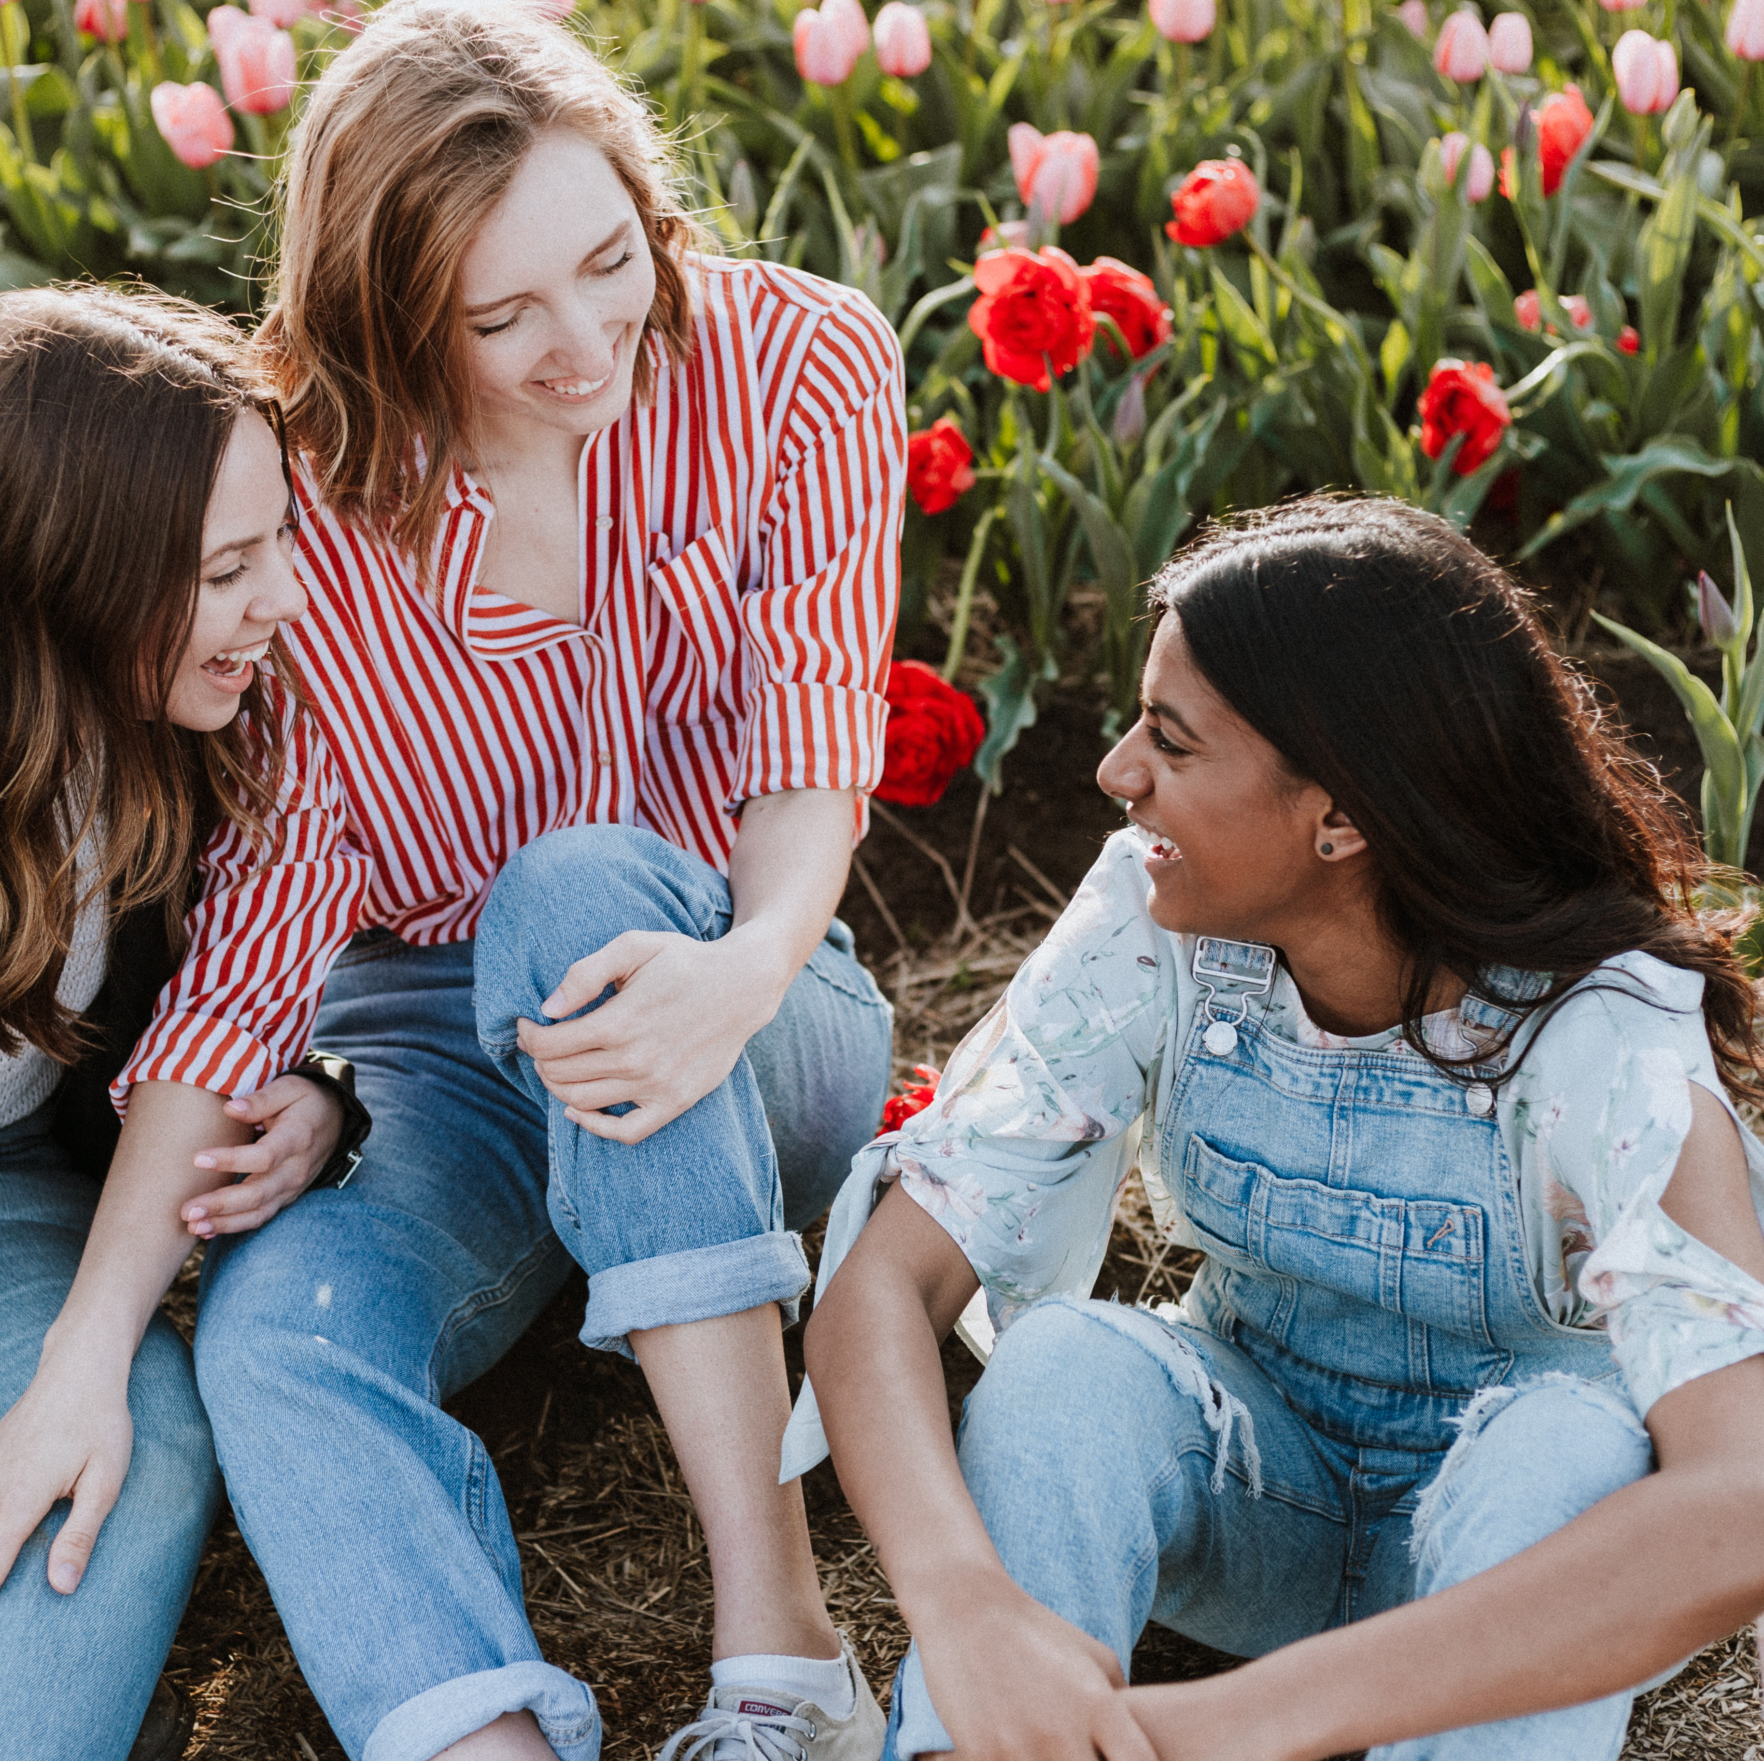
Managing how others treat you
What is Interpersonal Communication?
What are some examples of Interpersonal Communication?
Notes:
What does Interpersonal Communication mean from the eModule? It is the act of communication transmission of or relating to the interactions between individuals.
Can anyone give an example of interpersonal communication?
-talking to other individuals
-Sharing information and expressing thoughts or feelings, either face-to-face or through a means such as phone, email, social media, or virtual classroom.
It refers to verbal and non-verbal communication which includes body language facial expressions, and tone.
In the next slide we will watch a video called Thousand Words. Let’s see some examples of Interpersonal communication.

Slide 19
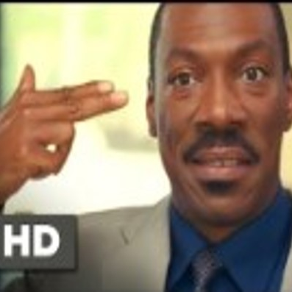
Thousand words
Interpersonal communication can be communicated in different ways.
Let's look at Thousands Words staring Eddie Murphy.
Pay close attention to the different ways Eddie. Murphy communicated with those around him.
Click on the link in the chat.
https://youtu.be/8rX7fkDLEx0
Notes:
Thousands Words movie video is a great example of how Interpersonal communication can be communicated in different ways.
We will watch a 2:23 minutes clip from the Thousand Words movie.
Pay close attention for the different ways the character communicate with those around him.
In the chat (Send the link to the chat) click on the link to view the video. https://youtu.be/8rX7fkDLEx0

Slide 20
Thousand Words Review
What did you notice happening in the movie clip?
Share with the class what you notice.
Notes:
How many after reviewing the movie clip Thousand Words, thought about a time where this took place in your life by a show of hands.
Please share with the class what you notice in the clip.
Share with the class your life experience with Interpersonal Communication.

Slide 21
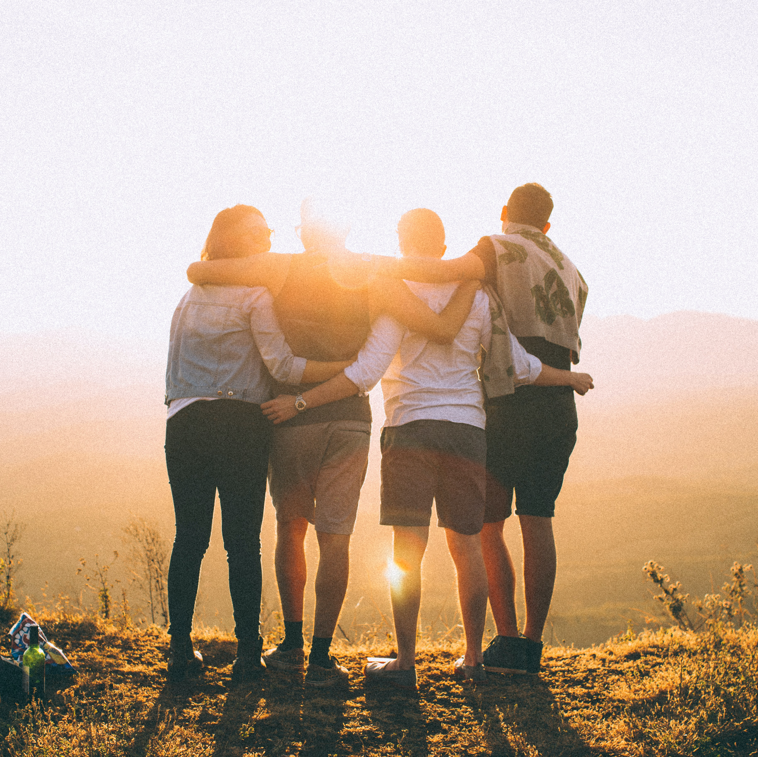
Connection
Connection and building relationships with others is equally important to personal development.
Our connection with others helps us to grow, gain an understanding of the world around us and our environment.
Share with the class, what your current relationship with others say about your connection to others.
Notes:
Connection and building relationship with others can help you gain an understanding about life, new perspective, and lifelong friendship.
Are your doing more of the work or equally shared with your friends to maintain your relationship or friendship?

Slide 22
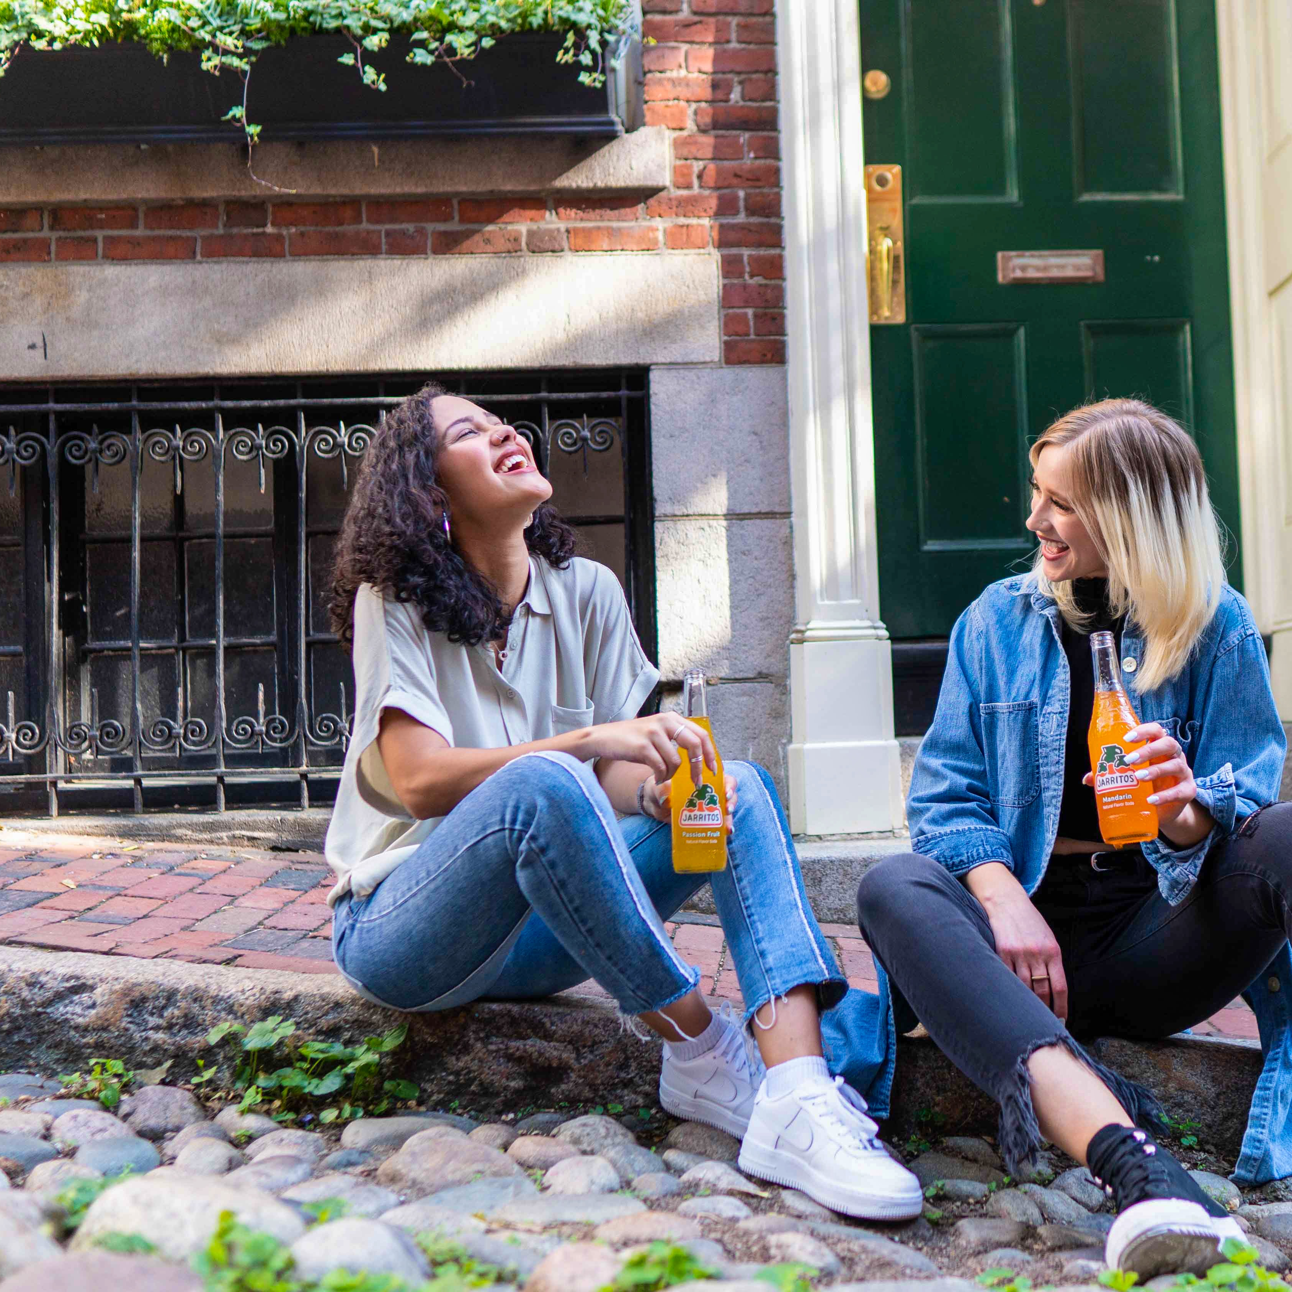
Connection
Teach others how you want to be treated by your action.
Speak up and or remove any negative vibe from your friendship with others.
Pay attention to how others make you feel when you are in their presence.
Notes:
When it comes to building relationship and friendship, some people do not realize, we teach others how to show up in our lives. If you are one, that is always available whenever your friend or family call, you have taught them to know you are always available.
Once you gain a better understanding of yourself, than will you be able to remove out any negativity from your life and relationship with others.

Slide 23
Any questions
Notes:
Do you have any questions about Connecting with others and or would like to share you story?

Slide 24
Discernment of behavior
Notes:
You may have recalled our team speaking about discernment in eModule Essential of Self-love.
Discernment is key to understanding self-love when you are in a peculiar situation and there are few indicators for how you should interact, respond, share, and communicate with others based on your personal perspective and how others may be treating you in that moment.

Slide 25
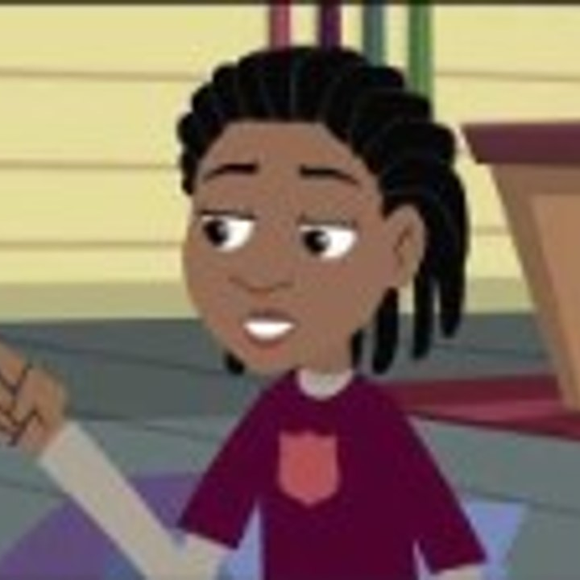
Discernment video
Let’s watch a video about discernment
Pay attention to the message on how to use discernment.
Click on the link in the chat to view the video.
https://youtu.be/gj0hYeObwoU?si=ERXd8D4i15R9z1SO
Notes:
Let’s watch a 3:32 minute video about discernment and how it may appear in your daily routine.
Pay attention to the message on how to use discernment.
Click on the link in the chat to view the video https://youtu.be/gj0hYeObwoU

Slide 26
Discernment video review
Share with the class, what you notice about the video message?
Did you notice any similarities to your own person life experiences?
Notes:
Everyone may have experienced a gut feeling about something or felt off about something you were about to do or have happen to you. Those experiences can be described as discernment.
Have the participants to share with the class what they notice about the video message and how it relates to their personal life experience.
Did you notice any similarities to your own personal life experiences?

Slide 27
Discernment
In the next slides you will see different images.
Use discernment to help you give your understanding of what you see in the images.
Notes:
In the next slides you will view different images and state your discernment of the picture to the class.
There is no wrong answer. However, give your best answer.

Slide 28
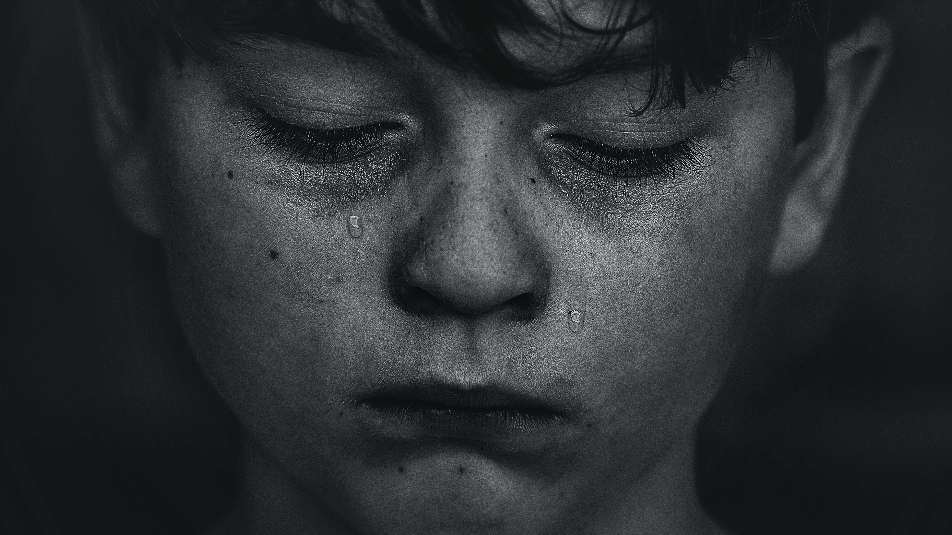
This person is?
Sad
Notes:
In this clip, this person appears to be___________.

Slide 29
This person is?
Tired
Notes:
This people in this clip appears to be__________.

Slide 30
This person is?
Thinking
Notes:
The lady in this clip appears to be___________

Slide 31
This person is?
Happy
Notes:
This child appears to be_________.

Slide 32
This person is?
Hungry
Notes:
The person in this clip appears to be___________.

Slide 33
Any questions
Notes:
Great job on using your Discernment of others. This conclude this topic and session. Do you have any questions about discernment?
What did you like about this eClass?
Are there anything you would like to see in this eClass that was not in it?

Slide 34
Homework
In your journal, write how you plan to manage your self-talk?
How will you manage your connection with other?
Journal your experience of you using discernment in your personal environment.
  Write what you notice.
  Did you notice it right away?
Share in the RITMO Fellowship Community you’re your experience.
Access the RITMO Community Fellowship forum https://drshinshuri.com/forums/
Notes:
For this homework, write in your journal how you plan to manage your self-talk?
How will you manage your connection with other? Share your experience using discernment in your personal environment.
Share with the RITMO community Fellowship Community.
Think about becoming a Self-love peer mentor.

Slide 35
Schedule appointment
Each session is up to 1-hour max.
Click on link in form to schedule your appointment. https://drshinshuri.com/schedule-an-appointment/
Notes:
Class, after each eClass, you will have the opportunity to schedule an appointment to review any types covered in this session. Each session is up to1-hour max.
The appointment for this session will explore your understanding of connection and discernment.
This will also be a safe place to gain clarity of current or previous topics or issues you may be facing now.
Also, this will be a great time to start thinking about becoming a self-love mentor.

