Slide 1
eCourse
Self-love Experience Leadership
Notes:
Welcome participants to the Self-Love Experience Leadership eClass. I am your facilitator ___________________________.
This eClass is about you sharing your learning and understanding of the materials you learned in the eModule. The eClass is to aid you in your understanding of apply the materials to your daily routine and life.

Slide 2

Setting Your Standard
Homework Review
Six principles of self-love
Elements of an affirmation
Recite personal affirmation
Notes:
This eClass is about Setting Your Standard.
In this eClass we will review Homework, Six Principles of self-love, the elements of affirmation, and recite personal affirmation.
Throughout this presentation, I am asking that you be engaged in the class by sharing, answering questions, listening, supporting your peers with encouraging words, and showing up for yourself by doing the work and applying it to and in your life.

Slide 3
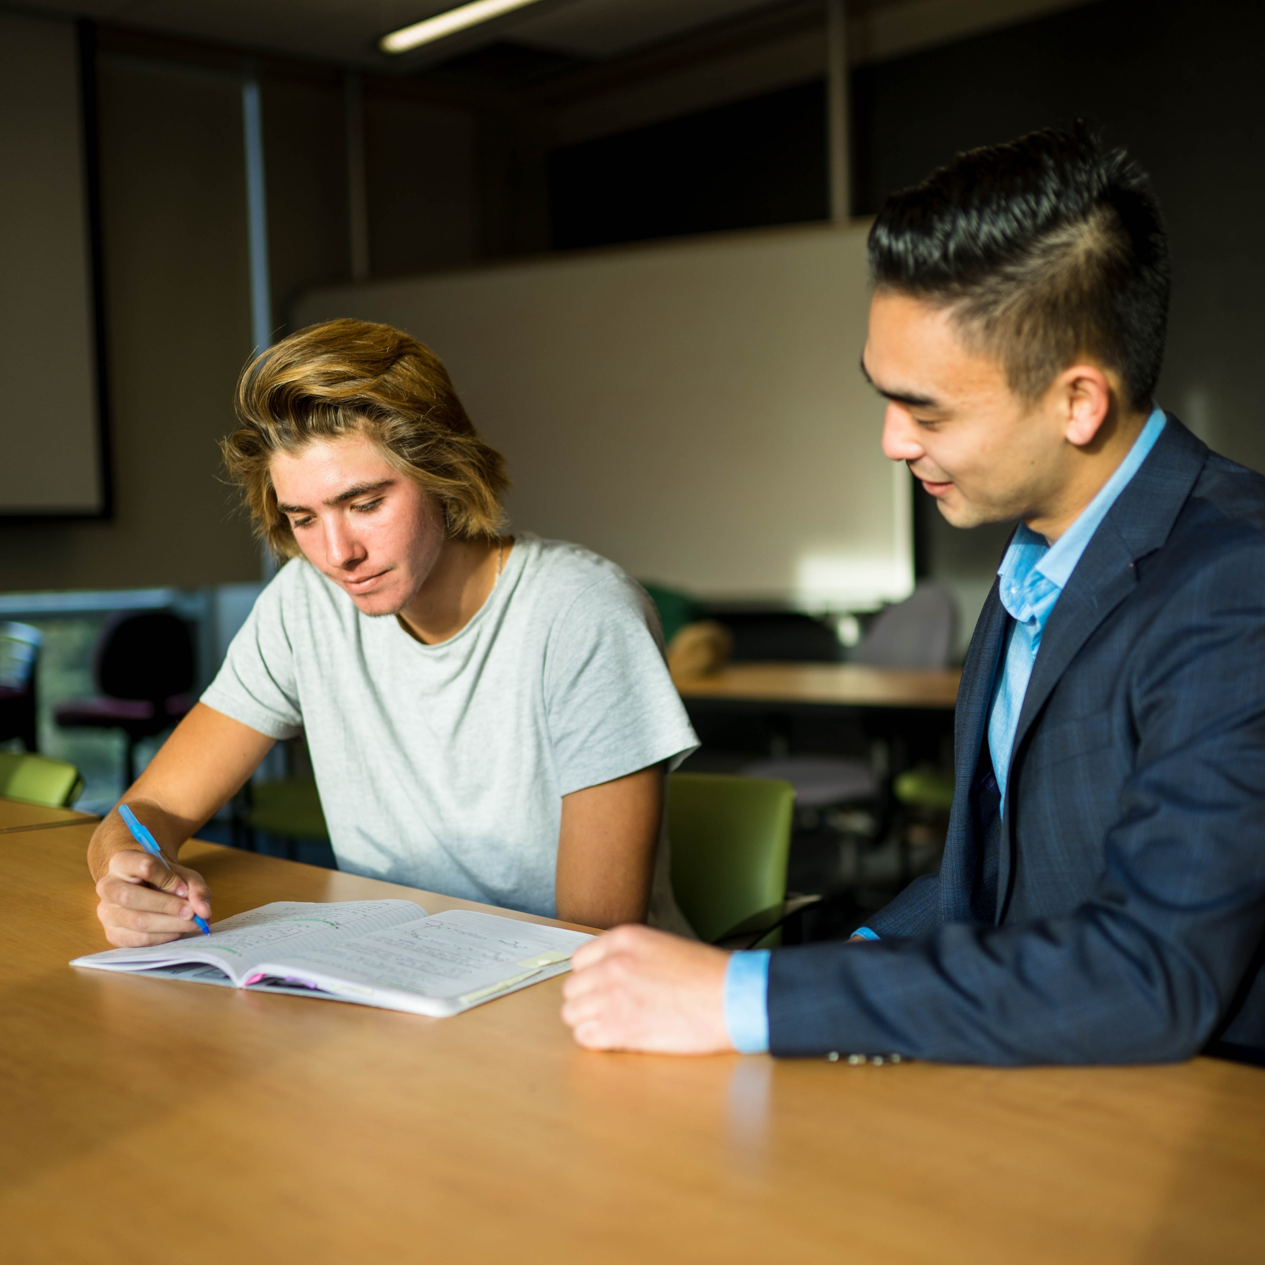
Homework Review
In your journal, write how you plan to manage your self-talk?​
How will you manage your connection with other?​
Journal your experience of you using discernment in your personal environment.​
    Write what you notice. ​
    Did you notice it right away?​
Share in the RITMO Fellowship Community you’re your experience. ​
Click on the link access the RITMO Community Fellowship forum https://drshinshuri.com/forums/
Notes:
Homework Review
Class how many of you did your homework and would like to share your experience with the class?
Please raise your hand to volunteer.

Slide 4

Session 4
In this eClass, you will apply your learning from the eModule Self-love Principles. This includes:
State the Six Principles of Self-love
Elements of Self-love Affirmation
Recite personal Self-love Affirmation
Notes:
Six Principles of self-love
In the eModule, you were introduced to the Self-love Principles. In this eClass you will apply the learning from the eModule to practicing how to apply it.
Session 4 we will State the Six Principles of Self-love, the Elements of Self-love Affirmation, and Recite personal Self-love Affirmation.

Slide 5
Six Principles of Self-love
Name the Six Self-love Principles
Notes:
In this topic you will review the Six Principles of Self-love.
The Six Principals are the standard for loving yourself. Do you recall what the Six Principles are from the eModule? Please raise your hand to give your answer.
The Six Self-love Principles are
-Be okay with not being okay
-Practice being kind to yourself
-Be open to letting go of past failures
-Love all of you from the inside out, the good and not-so-good of you
-Speak positive words towards yourself
-Love yourself more daily
Let’s review the Six Self-love Principles

Slide 6

Be okay with not being okay
How do you feel when you are not okay?
You do not have to feel okay with how things are going in your life.
You need to be aware and make the needed changes to better your life or situations.
Notes:
Be okay with not being okay.
When you are not doing so way or you are having a bad day, how does that make you feel?
Every day may not be the greatest day in your life and its okay to have those moments. Be aware when those moments appears and make the needed changes to acknowledge it and make a better choice for yourself.

Slide 7
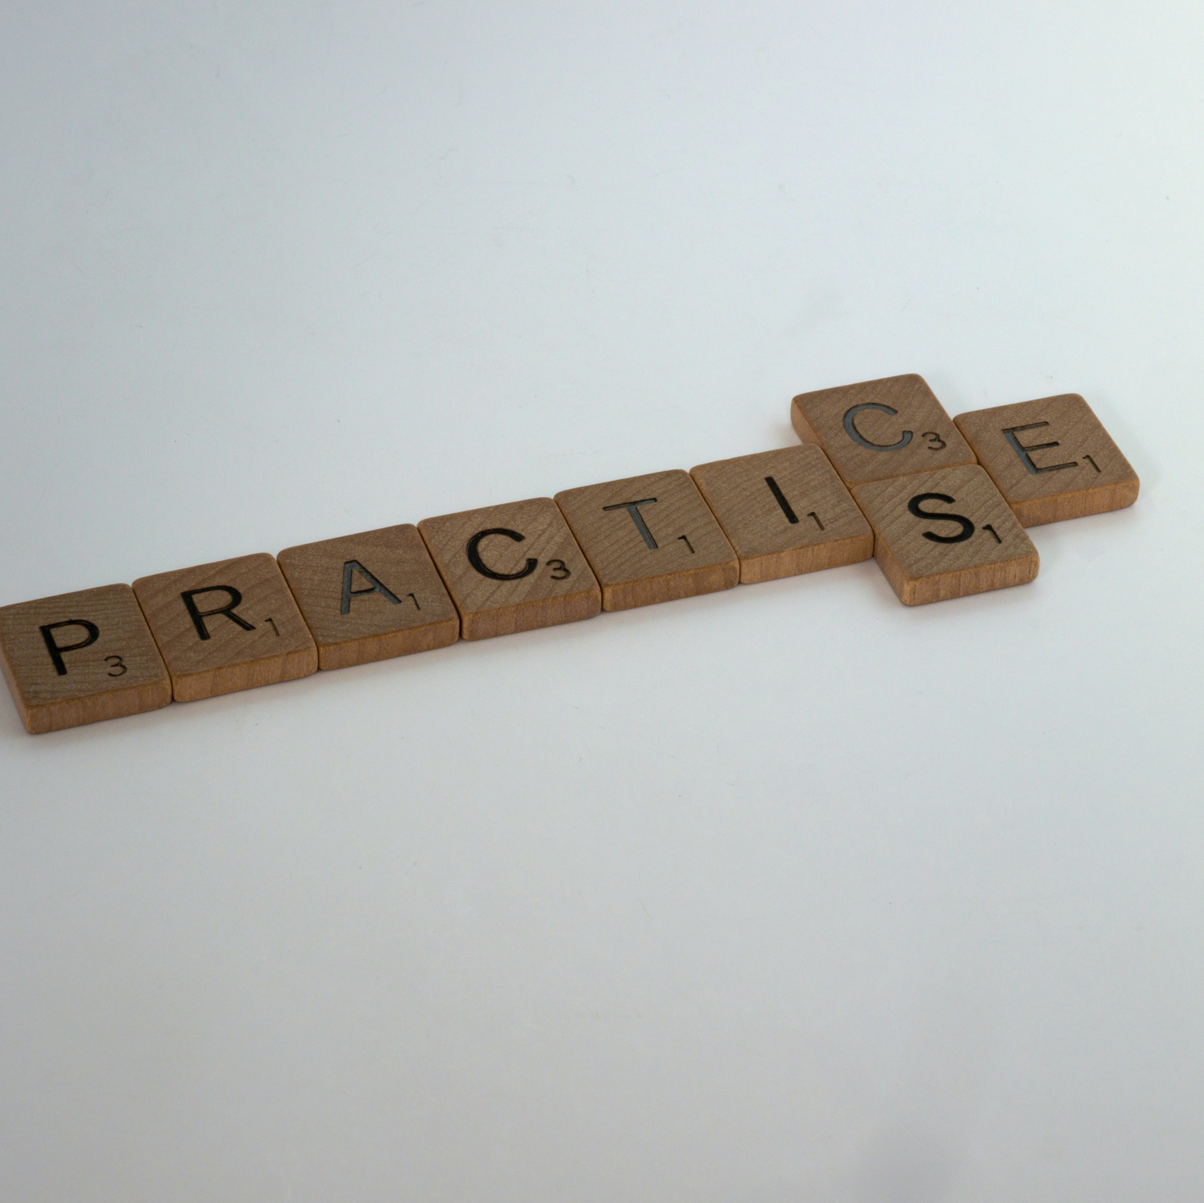
Practice being kind to yourself
If you do not know how to be kind to yourself, start with doing something nice for yourself.
Do something that makes you happy.
Think of one thing you love about yourself and embrace that one thing.
Notes:
Practice being kind to yourself.
Some people do not know how to be kind to themselves. Being overly critical about yourself is not being kind to you.
Practice being nice to yourself; like you would another person.
Do something that makes you happy or light up.
What is one thing you love about yourself?

Slide 8
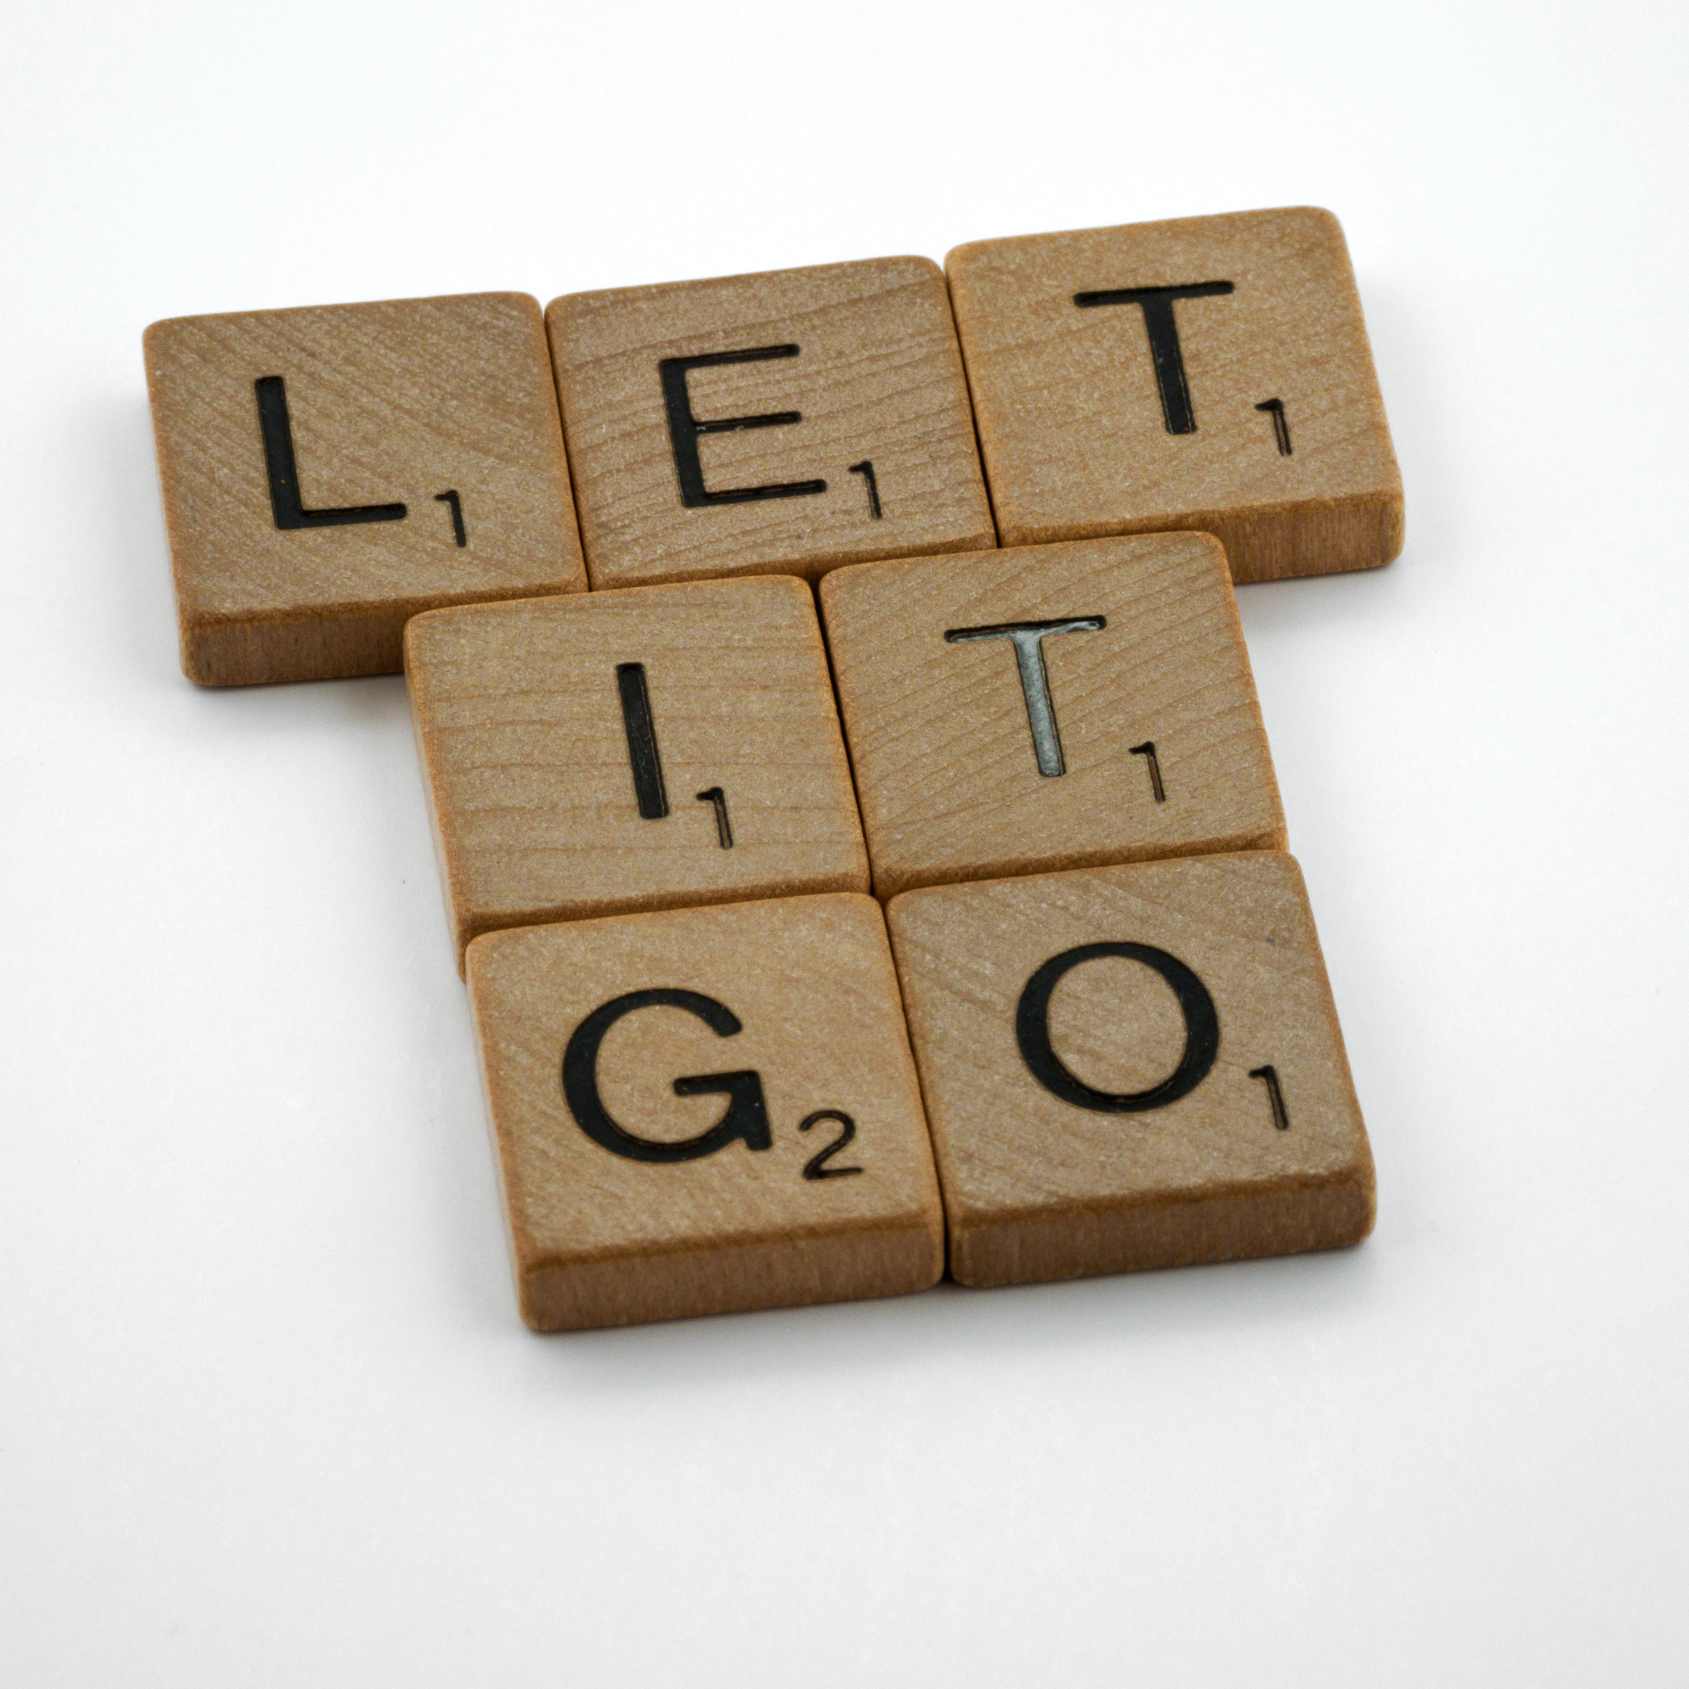
Be open to letting go of past failures
What is stopping you from moving past your failures?
Understand that you are not your past failures.
Learn from them and move on.
Notes:
Be open to letting go of past failures.
Find out what is holding you back from moving forward.
You are in a better place to make better decisions with gained experiences and knowledge.
Let go of your past failures and move on to know opportunities and experiences.

Slide 9

Love all of you from the inside out..
What’s holding you back from loving on yourself more?
Do not live in shame for anyone.
There will always be something you will won’t to change about yourself.
Notes:
Love all of you from the inside out…
What’s holding you back from loving yourself? Is it shame or embracement?
Whatever, it maybe, do not stay in that place. Instead allow yourself to embrace all of you and those things you dislike about yourself, you have all the power to change it.

Slide 10

Speak positive words towards yourself
In the eClass connection; we viewed the video You are not your thoughts. The video showed us how negative thoughts have an impact in our life.
Make sure you are aware of what you are saying to yourself.
Change the negative words into positive words: your personal affirmation.
Notes:
Speak positive words towards yourself.
Its is easy to be critical of our oneself. However, it can appear to be challenging to find positive words to speak to ourselves. This is your time to shine. No matter how it appears, give yourself the best words of encouragement and motivation to win for yourself.
No negative self-talk.

Slide 11

Love yourself more daily
Focus on loving yourself first
Find time to embrace yourself
Spend time with yourself in nature or in a quiet place.
Write letters to yourself as you would someone you like.
Notes:
Love yourself more daily.
Loving yourself is not a trend. It is a lifestyles. Do it daily with no regrates. Embrace your oneness with who you are from the inside out. Take time to date yourself, as you would another person. Fall in love with being you.

Slide 12

Any questions
Notes:
This end the topic for the Six Principles of Self-love. Are there any questions about the Six Principles of Self-love?

Slide 13
Elements of an Affirmation
Name the Elements
Notes:
In this topic will cover the Elements of an Affirmation.
In the eModule, Self-love Principles, one of the activities were to watch a video tutorial on How to create an affirmation. What were the elements of a good affirmation?

Slide 14

Element of self-love affirmation
Use personal pronouns (e.g., I, me, my, you, myself, yourself, etc.)
Use action verbs
Use emotional words (e.g., feel, love, caring, etc.)
Write in the present tense
Make it short, easy, and direct
Make it positive
Notes:
Element of Self-love Affirmation.
In a Self-love Affirmation, you want to make sure you use personal pronouns (I, me, my, you, myself, e.g.,)
You want to make sure you have action verbs that can be completed and obtain.
Use emotional words such as feel, love, caring, etc.
Write it in the present tense. This is something you are planning to accomplish now.
Make it short, easy, and direct. You want to make it short so that it will not be overwhelming for you, and its easy to remember and straight to the point.
Always make it positive. An affirmation should make you feel good about yourself and or your accomplishments.

Slide 15
Element of self-love affirmation
Where there anything you found challenging with writing your affirmation?
Did you find it difficulty to find the right words for your affirmation?
Notes:
Sometimes it seem difficult doing something kind for ourselves than it does doing for others. So, writing an affirmation that is directly related to yourself can be challenging to do.
Where there anything you found challenging when writing you affirmation?
Was it finding the right words, or what to focus on?
No, matter what the challenge is, start where you are and build from there. You can always go back and refreshing your affirmation. The plan is to have a resources or goal in mind to accomplish that is for you.

Slide 16
Any questions
Notes:
This end the topic for How to create an affirmation.
It is important to remember to have fun with you affirmation. It is an inspiration to you from you to overcome any challenges or obstacles you may face while learning to embrace who you are in on this self-love journey.

Slide 17
Recite personal Affirmation
Notes:
In this topic you will recite your personal affirmation to the group.
Since, this is a large group of us today; I will like each of you to recite two of your information to the class.
There can be many reason behind why you pick or chosen how to form your personal affirmation.

Slide 18

Owning your words
Recite two of your personal affirmation
Share with the class, why you choose your affirmation?
How important is it for you to live your written affirmations.
Notes:
Class, in the eModule you wrote you own personal affirmation. Share with the class your affirmation and why you choose this affirmation.
Why is it important for you to recite your personal Self-love Affirmation daily?

Slide 19
Any questions
Notes:
Class, we have come to the end of Recite personal affirmation session, Great job for taking the time to learn and write your own personal affirmation. As we grow as a person on this self-love journey, continue to update your affirmation for the next opportunity in your life.

Slide 20
Homework
Continue to recite the Six Self-love Principles.
Recite your affirmation daily
Write in your journal how your affirmation makes you feel.
Add or make changes to your affirmation if needed.
Share any changes or updates you have made to your affirmation inside the online community.
Access the RITMO Community Fellowship forum https://drshinshuri.com/forums/
Notes:
For this homework, class continue to recite the Six Self-love Principles, your personal affirmation and make the changes you need to your affirmation to continue growing. Write in you journal how your affirmation makes you feel.
Share with the RITMO community Fellowship Community.
Think about becoming a Self-love peer mentor.

Slide 21

Schedule appointment
Each session is up to 1-hour max.
Click on link in form to schedule your appointment. https://drshinshuri.com/schedule-an-appointment/
Notes:
Class, after each eClass, you will have the opportunity to schedule an appointment to review any types covered in this session. Each session is up to1-hour max.
The appointment for this session will explore your understanding of the Six Principles of Self-love, and the Elements of an Affirmation,
This will also be a safe place to gain clarity of current or previous topics or issues you may be facing now.
Also, this will be a great time to start thinking about becoming a self-love mentor.

