Slide 1
eClass
Self-love Experience Leadership
Notes:
Welcome participants to the Self-Love Experience Leadership eClass. I am your facilitator ___________________________.
This eClass is about you sharing your learning and understanding of the materials you learned in the eModule. The eClass is to aid you in your understanding of apply the materials to your daily routine and life.

Slide 2

Slowing Down
Homework review
Effects of rushing your day-to-day
Pace yourself
Enjoying the moment
Notes:
This e-Class is about slowing down. We will review the following topics: Homework Review, the effects of rushing your day-to-day, pace yourself, and lastly, enjoying the moment.
Throughout this presentation, I am asking that you be engaged in the class by sharing, answering questions, listening, supporting your peers with encouraging words, and showing up for yourself by doing the work and applying it to and in your life.

Slide 3

Homework review
Listen to the Self-love Essence Mantra
Write in your journal your experience and reaction to the Self-love Essence Mantra.
Share your journal entries with the online RITMO Community Fellowship.
Access the RITMO Community Fellowship forum https://drshinshuri.com/forums/
Notes:
Homework review:
For your homework, you were to listen to the Self-love Essence Mantra, write in your journal your experience with listen to the Self-love Essence Mantra. How did it make you feel, what did you notice about yourself, and any other experiences you may have had, than you were to share with the RITMO online community your experience.
By a show of hands how many did their homework?
How many times did you listen to the Self-love Essence Mantra?
Share your experience when you first listen to the Self-love Essence Mantra.

Slide 4

Session 7
In this session, you will apply your learning from the eModule No Rushing. This includes:
Effects of rushing in your day-to-day
Pace yourself
Enjoying the moment
Notes:
Session 7:
In this session of the eClass, you will apply your learning from the eModule No Rushing.
In this session, we will apply our learning to
Effects of rushing in your day-to-day
Pace yourself
Enjoy the moment.

Slide 5
Effects of rushing your day-to-day.
Notes:
This topic is about the effects of rushing your day-to-day. When you hear the word “Rushing” what comes to mind? Please raise your hand to give your response.
In the eModule, you reviewed the definition for Rushing. Does anyone recall the definition for Rushing? Please raise your hand to give your response. (if not voluntary, call on a participant)
One of the definition in the eModule came from the American Heritage Dictionary. They describe rushing as to move swiftly, hurry. To act with great haste. To make a sudden or swift attach or charge.
When we are planning our day, rushing is never added into the planning process. However, even through we did not included rushing into our day, it seems to find a place in our world with or without our permission. Before we go into the effects of rushing, lets see why we rush.

Slide 6

Why do we rush?
We put off doing something because we do not want to do it.
It was not a priority
Too many obstacles or distraction in our way
Interruption from others
Wanting things done right away
Stressed about doing what something
When you are rushing, are you alone or with someone?
Notes:
There are many reasons why we rush. We rush because we put off doing something because we do not want to do it. It was not a priority. Too many obstacles or distraction in our way. Class what can be some distraction that will cause you to rush? (Have the class name some distraction; mobile devices, talking with friends, daydreaming, etc.) Please enter your answer in the chat or raise your hand to give your response.
When you are rushing, are you alone or with someone? Give your response in the group chat.
Sometimes depending on others and their timing can cause a chain or domino affect in our day. Do anyone know that a domino affect is? Raise your hand to give your response.

Slide 7

It’s a mood changer
Rushing can change our mood for the first hours or minutes of our day.
Rushing can cause our interaction with others to not be so kind.
Rushing can cause one to be stressed
Rushing can change your emotions
What did you notice about yourself when you were rushing?
Did you lose focus quickly?
What type of mood are you normally in when your rushed or rushing?
Notes:
Rushing can change our whole day, and even if it does not affect the whole day; it affects a greater part in the shift of our mood. Rushing can be a mood changer.
(Have the class use the group chat or raise their hand to give their full response to the questions)
No matter how your day goes,

Slide 8

Any questions
Notes:
This end the topic the Effects of rushing your day-to-day. Are there any questions about the effects of rushing your day-to-day?

Slide 9
Pace yourself
Notes:
This topic is about Pace Yourself.
When it comes to self-love, we must pace ourselves. It can become very much so a habit to want to rush the things we need to do for ourselves just like we tend to do with other things of importance in our life. However, we must pace ourselves to allow our self-love journey to began. This is nothing someone else can do for you, it is all on you.
One way of pacing yourself is to breath. In the next slide, we will watch a video that you watch in the eModule called 4-7-8 Calm Breathing Exercise - Relaxing Breath Technique. Follow along with the video and do the technique.

Slide 10

4-7-8 Breath Technique Activity
Pace yourself requires you to slow down.
Many do not know how to pace ourselves during stressful or times where we are rushing during the day.
Let's watch the 4-7-8 Breath Techniques to help us to stay on top of our breathing.
https://youtu.be/PmBYdfv5RSk
Notes:
Breathing is so natural for us, when we are rushing throughout the day, we can sometimes forget to breath properly.
Pacing yourself, requires you to slow down.
Let's review the 4-7-8 Breath Techniques to help us to know how to breath properly throughout the day.
Click on the link in the chat to view 5:00 minutes to clip.

Slide 11

4-7-8 Breathing Technique Review
How did this activity make you feel?
Did you notice a change in your breathing?
How often do you see yourself applying this to your daily lifestyle?
Notes:
By a show of hands, how many had a hard time in the beginning with breathing properly?
The 4-7-8 Breathing Technique can be a useful resource to make sure you are pacing yourself throughout the day. If you are breathing properly, you will be able to calm you mind and slow yourself down.
Did you notice a change in your breathing after the first attempt?
How often do you see yourself applying this new technique to your daily lifestyle?

Slide 12
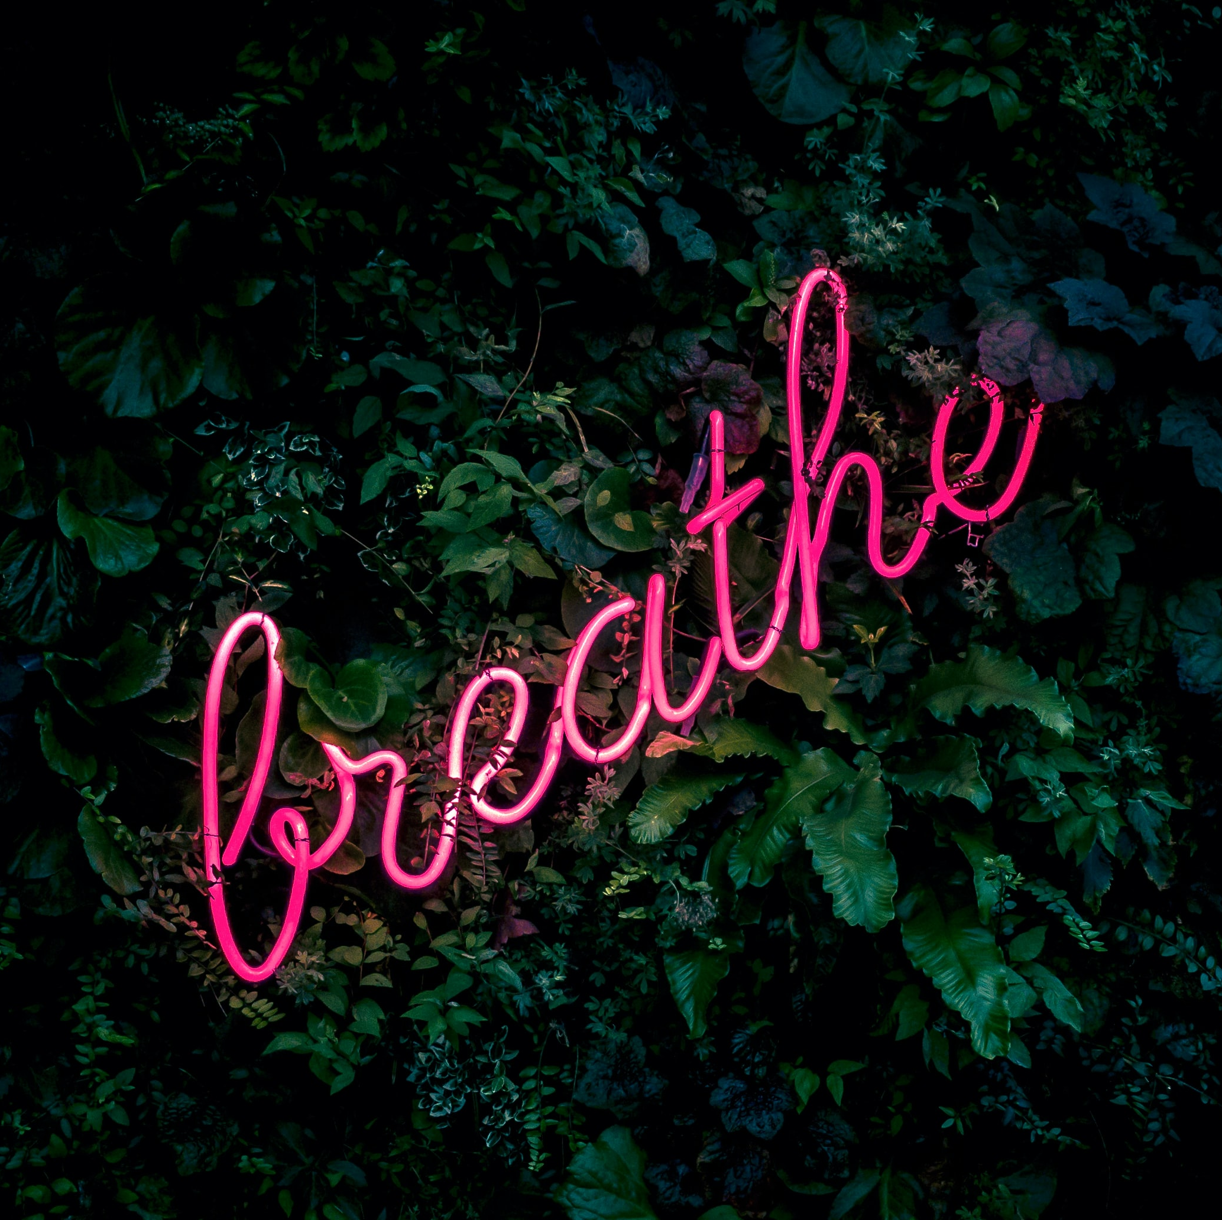
Take a minute
What is Prana?
Share with the class a time you used the breathing methods from the 4-7-8 breathing video after learning it in the eModule.
How important is breathing in pacing yourself?
Be patient with yourself
Notes:
In the eModule you learned about Prana. Do you recall what Prana is? Answer yes or no in the group chat.
What is Prana? Raise your hand to give your response.
Prana is called life force energy. It is our breath. It is the flow and operation of our body depending on each breath we inhale and exhale.
When you are going throughout the day and start to feel rush, take time to breathe. Inhale in and exhale out slowly to relax your mind and body. As you learned in the eModule; according to Unimed Living “we breathe on average 17,000 to 24,000 (12-tp-16 breaths per minute) times a day.”
Every breath counts and is very important to the function of our body and mind.
Share with the class your experience with using the 4-7-8 breathing techniques. Raise your hand to share your experience.
How important have breathing properly change your day?
Using the proper methods of breathing can change your mood in a positive way. The techniques can bring you back to a place of focus and patients with yourself.

Slide 13
Any questions
Notes:
This end the topic for Pace yourself.
(Ask the participants: if no volunteer, pick someone)
Are there any questions about this topic?
Are their anything you want to share about this topic?

Slide 14
Enjoying the moment
Notes:
Enjoying the moment
With everything that is going on in the world. The last thing we want to do is to let go of the very thing that helps us to forget about the issues we face in our daily life.
Some of those issues maybe stressed, a bad job, family issues, the lack of good friendships, or life issues.
We tend to lose ourselves with our technology, social media, drugs, or anything to captivate our attention.

Slide 15
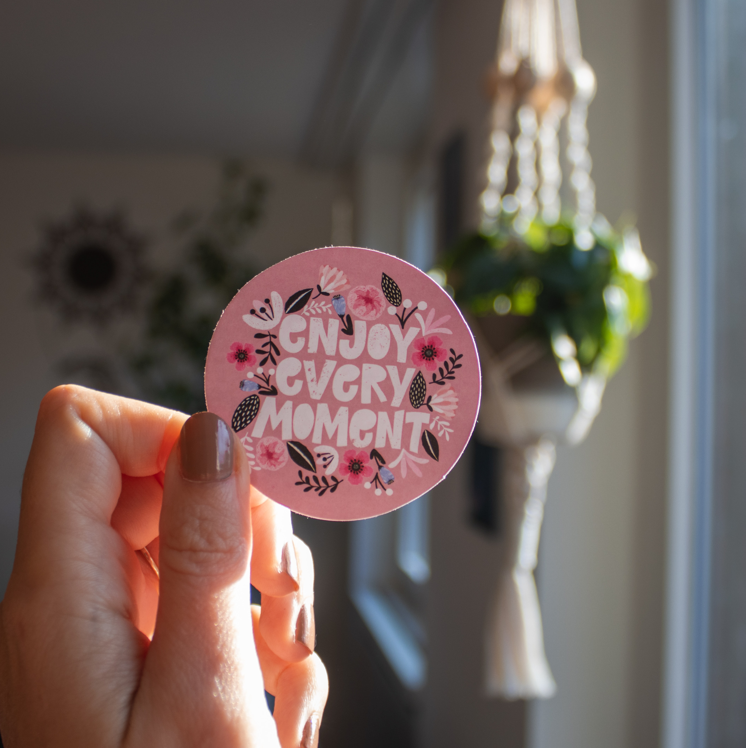
Every moment counts
How often do you put your phone down when you are out?
Does your phone distract you from people, activities, or being present?
When you are out, are you aware of your surrounding or what is going on around you?
How often do you just enjoy being in the moment?
Notes:
Every moment counts in our lives. Each moments give us clarity on how we see or not see the world around us.
How often do you put your phone down when you are out? (Ask the class to give their response in the group chat).
Its not often that we feel comfortable putting away our phones when we are out with friends or family. We carry our phones like it has become an added part of our bodies.
Does your phone distract you from people, activities, or being present?
Many of us have had experiences where you were out and did not recall any of the events or things taking place because we were distracted with the phone, daydreaming or a time you were riding in the car or bus and did not recall the first couple seconds of the ride.
When you are out, are you aware of your surrounding or what is going on around you? There have been times where my phone had me losing track of time or being present in the moment.
How often do you just enjoy being in the moment?
Its is easy to think you are enjoying the moment, but in must case you are not. Enjoying the moment, require you to be fully engage, just like you are in this eClass. It require you investing your focus and being presence.
Learning to love yourself more daily requires you to enjoy you, even when things seems difficult; enjoy yourself. Find something positive about your day and celebrate it. Being presence for yourself is enjoying every moment of who you are.

Slide 16
Any questions
Notes:
This end this session. Ares there any question for the topic Enjoying the moment?
(Wait for any questions the students may have) If no questions, ask for feedback on the materials and presentation.
Just as reminder, you will need to set up time with myself to schedule your one-on-one interview time.
(If there are no questions remind the student to set up their interview time.
Also ask the class was the presentation beneficial, is there anything they would have loved, but was not in the slide, and what they did not like about presentation).

Slide 17

Homework
Throughout the week, when you feel rushed, take a second to breathe.
Continue to practice and develop your breathing skills from the 4-7-8 video.
Write in your journal your experience with the breathing techniques.
Share with the online community, how you plan to enjoy every moment and how breathing impacted your day.
Access the RITMO Community Fellowship forum https://drshinshuri.com/forums/
Notes:
Homework!!!
Throughout the week, when you feel rushed, take a second to breathe. Take the time to slow yourself down by using the tools given to you.
Continue to practice and develop your breathing skills from the 4-7-8 Breathing Technique video.
Write in your journal your experience with the breathing techniques
Share with the community, how you plan to enjoy every moment and how breathing impacted your day.

Slide 18
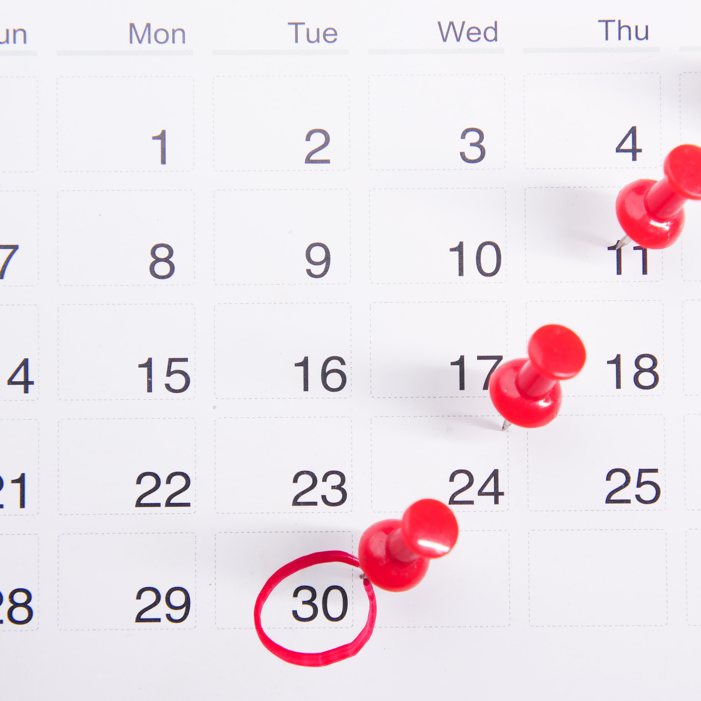
Schedule appointment
Each session is up to 1-hour max.
Click on link in form to schedule your appointment. https://drshinshuri.com/schedule-an-appointment/
Notes:
Class, after each eClass, you will have the opportunity to schedule an appointment to review any types covered in this session. Each session is up to1-hour max.
The appointment for this session will explore your understanding of the effects of rushing your day-today, pace yourself, and enjoying the moment.
This will also be a safe place to gain clarity of current or previous topics or issues you may be facing now.
Also, this will be a great time to start thinking about becoming a self-love mentor.
.

