Slide 1
eCourse
Self-love Experience Leadership
Notes:
Welcome participants to the Self-Love Experience Leadership eClass. I am your facilitator ___________________________.
This eClass is about you sharing your learning and understanding of the materials you learned in the eModule. The eClass is to aid you in your understanding of apply the materials to your daily routine and life.

Slide 2

Permission
Homework review
Permission for self-love
Doing something you love
Taking action for yourself
Notes:
This eClass is about permission. This eClass will permission for self-love, choosing to enjoy yourself, and Self-love Permission Pledge. Throughout this presentation, I am asking that you be engaged in the class by sharing, answering questions, listening, supporting your peers with encouraging words, and showing up for yourself by doing the work and applying it to and in your life.

Slide 3
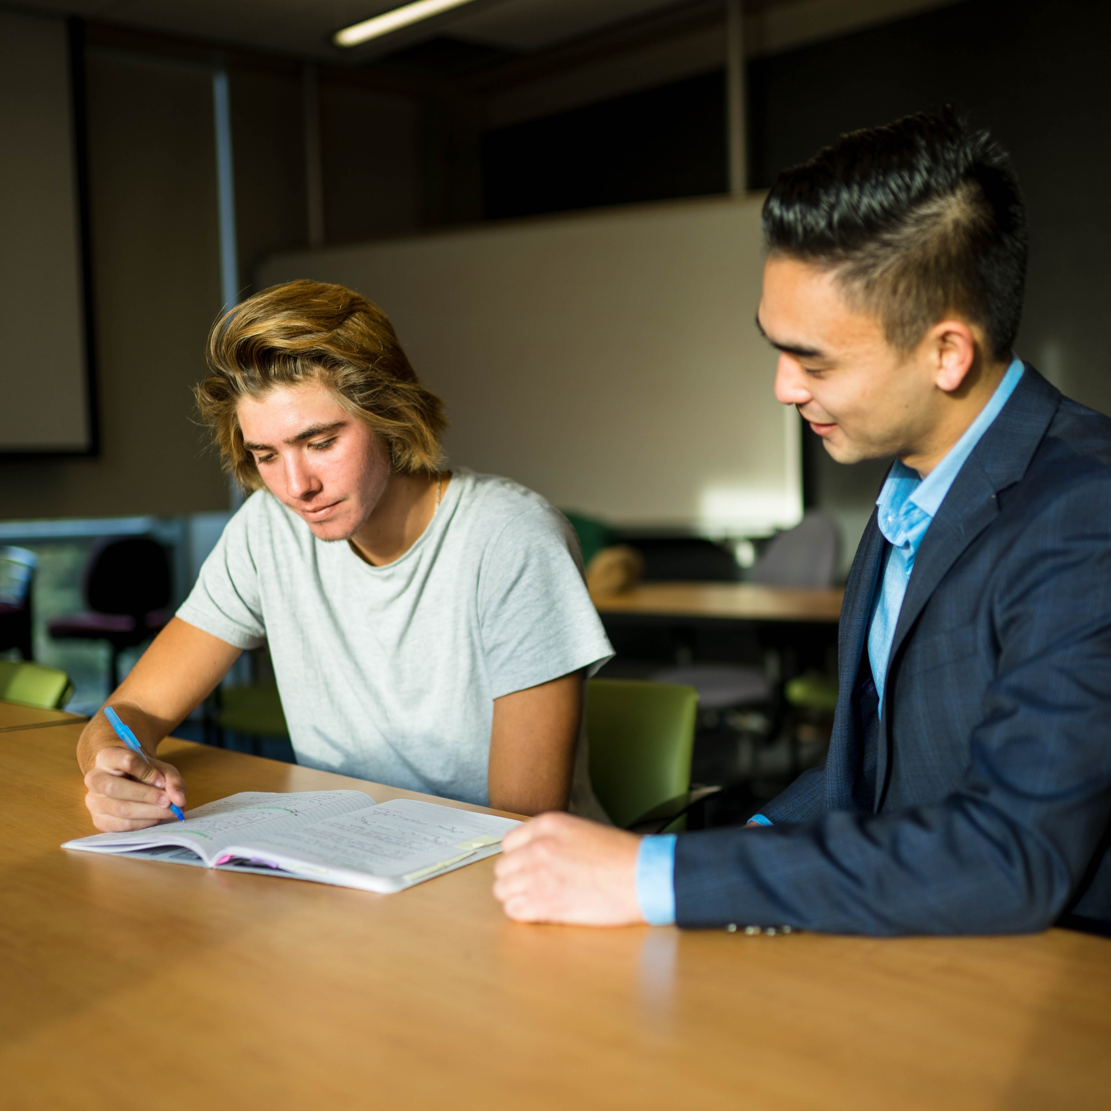
Homework review
Continue to recite the Six Self-love Principles.
Recite your affirmation daily
Write in your journal how your affirmation makes you feel.
Add or make changes to your affirmation if needed.
Share any changes or updates you have made to your affirmation inside the online community.
Access the RITMO Community Fellowship forum https://drshinshuri.com/forums/
Notes:
Class this is the time to review your homework;
Did you practice reciting the Six Self-love Principles and your own Self-love Affirmation?
Where there anything you changed from your affirmation because of our previous session?
Share any updates or changes with the class by raising your hand. If no one volunteers, you will be called upon.

Slide 4

Session 5
In this session, you will apply your learning from the eModule Give Yourself Permission. This includes:
Permission for self-love
Doing something you loveChoosing to enjoy yourself.
Taking action for yourself
Notes:
Session 5: In this session of the eClass, you will apply your learning from the eModule Give yourself Permission.
During this session you will apply your learning to Permission for self-love, Choosing to enjoy yourself, and Self-love Permission Pledge.

Slide 5
permission for self-love
Notes:
The importance of permission for self-love
In the Give yourself Permission eModule, you were introduced to the awareness of given yourself permission to love yourself. In the next slides we will review how to apply given yourself permission to love you.

Slide 6
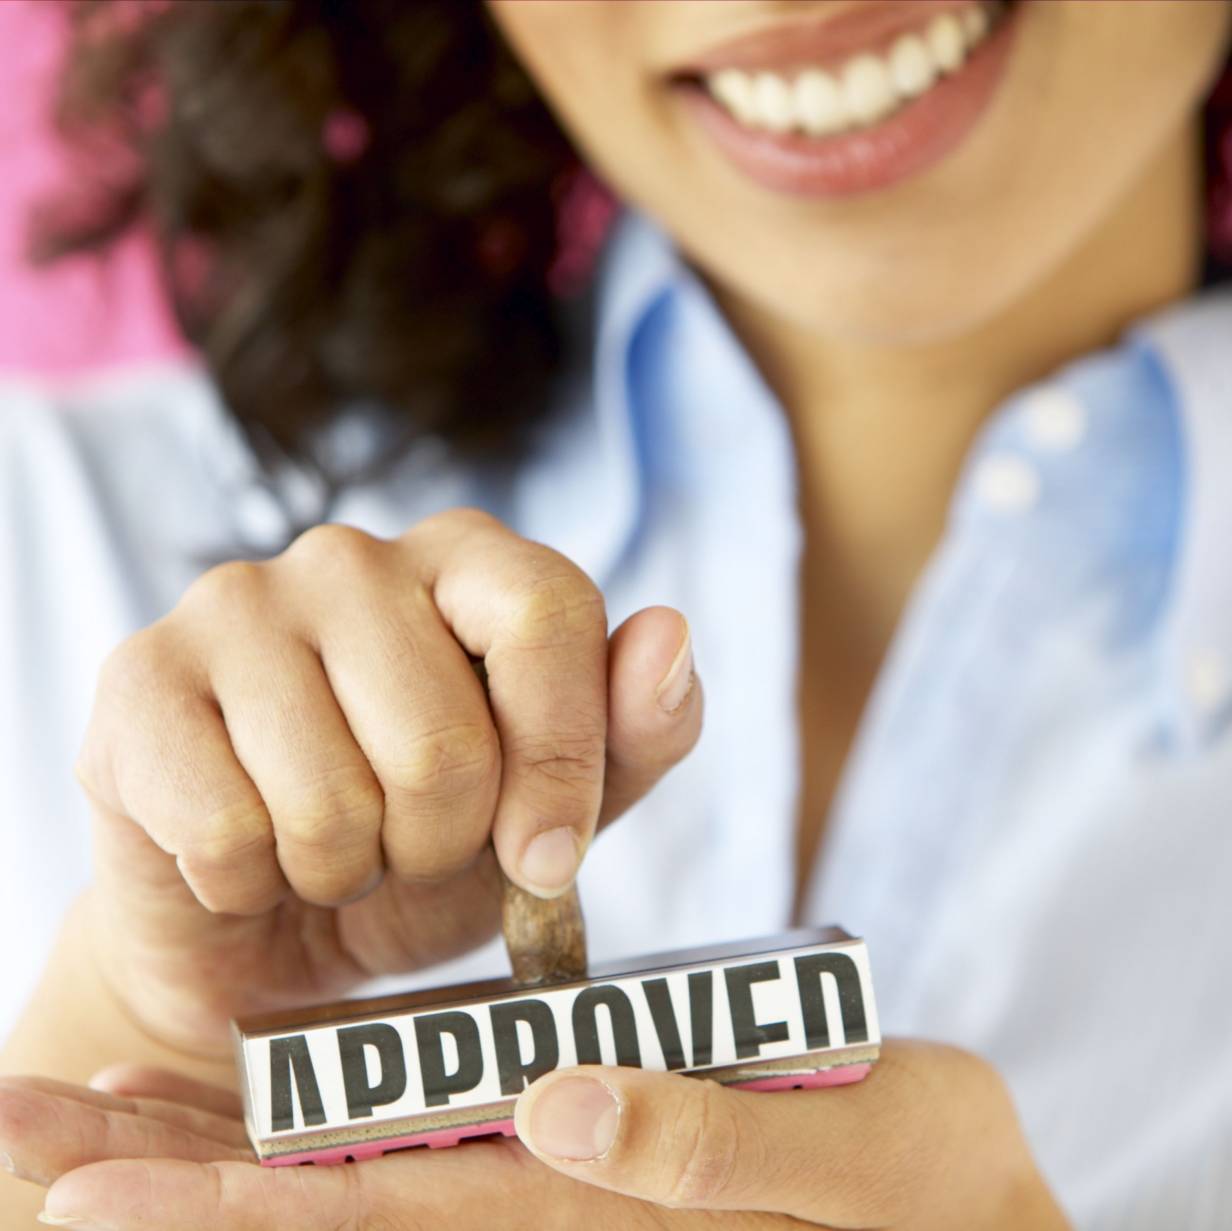
Permission for change
What does permission mean?
What does it look like to give yourself or someone permission?
Given yourself permission, helps prepare your mind for something new.
It cause you to think closely about the next steps.
Notes:
Permission for change. Do anyone recall from the eModule, the definition for the word permission means? Please raise your hand to give your answer.
According to American Heritage Dictionary, Permission means the act of permitting, especially in giving formal consent; authorization. An authorization to do something, as quote from ta book under copyright.
Give me some example of what it looks like to give yourself permission to do something. Please raise your hand or be randomly pick.
When you give yourself permission it helps your brain become aware that change or an activity is about to take place. It is no different than you asking you parents or guardians permission to go to the park or a friend's house. In both, cases you do not have to worry about your parents worrying, you being in trouble, or even yourself worry if you made the right decision to not call home first.
Given yourself permission allow you to have clear thoughts on what steps you need to take next or even, start putting a plan in place.

Slide 7

Processing change
Permission, helps you to process change quicker by taking away the challenge or questions you may produce about doing something new.
It starts the mind to brainstorm possibilities
Notes:
Processing change can be challenging if you do not know how.
One of the first steps many people miss is giving yourself permission to change.
Given yourself permission to change helps your mind to be open to something new.
It opens you mind to accept new opportunities for life experiences.
It keeps you mind alert to all the possibilities to better enjoy yourself while loving on you in a healthier way.

Slide 8

Processing change 5-minute break out session
Think of a habits or one thing you do that you would like to change about yourself.
Write down three things you do not like about the habit or the thing you do not like about yourself.
Write down three things you can do now to change your habit or the thing you do not like about yourself.
Share with the group those three things you do not like and the thing you can do to make the needed changes.
How did you feel about thinking about different alternatives new ways to make the changes in how you do and see yourself?
Notes:
Class, we will break off into groups.
This break out session will be 5-minutes.
Each group must think of habits or one thing you do that you would like to change about yourself.
Write down three things you do not like about the habit or the thing you do not like about yourself.
What down three things you can do now to change your habit or thing you do not like about yourself.
Share 1 thing from your list with the group what you do not like and can change now. Share how it made you feel.

Slide 9

Processing change review
Was it hard to pick one thing you would like to change about yourself or habits? Share with the class your experience in the breakout session.
What did you learn about yourself, when thinking of new ideas or ways to bring about change in your life?
Do you think this will be something you can do long term (daily in your life)?
Notes:
Process Change review,
Was it hard to pick one thing you would like to change about yourself or habits? Share with the class your experience in the breakout session.
What did you notice about yourself, when thinking of alternatives or new ways to bring about change in your life.
Will you continue making the needed changes daily?

Slide 10
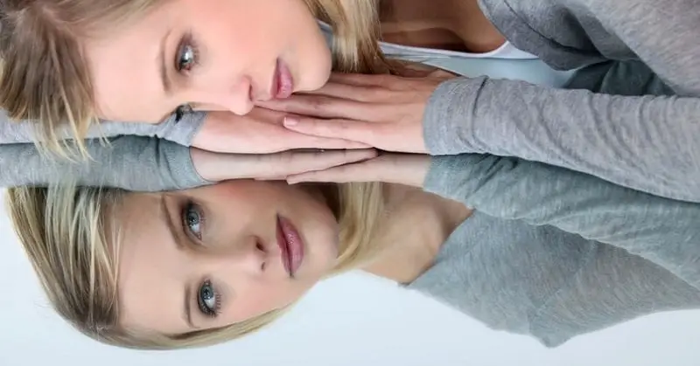
Reflection
It helps you to narrow down your focus.
It helps you to focus on what is important to you.
It shift your thinking to new possibilities.
Notes:
Reflection
It helps you to review different experiences. These experiences can may help you to understand who you are.
It helps you to focus in on what is important to you. It gives you an understanding of what is valuable to you.
It helps your mind to find different alternatives to reach a solution or goal in your life. It gets you thinking and being creative in your thoughts for solutions to better yourself and help you to see what you could have done differently.

Slide 11

Any questions
Notes:
This end the topic for Permission for self-love. Are there any questions about this topic?

Slide 12
Doing something you love
Notes:
By a show of hands, how many want to do something they love? How many of you know what that something is? In the next slide we will explore doing something you love.

Slide 13
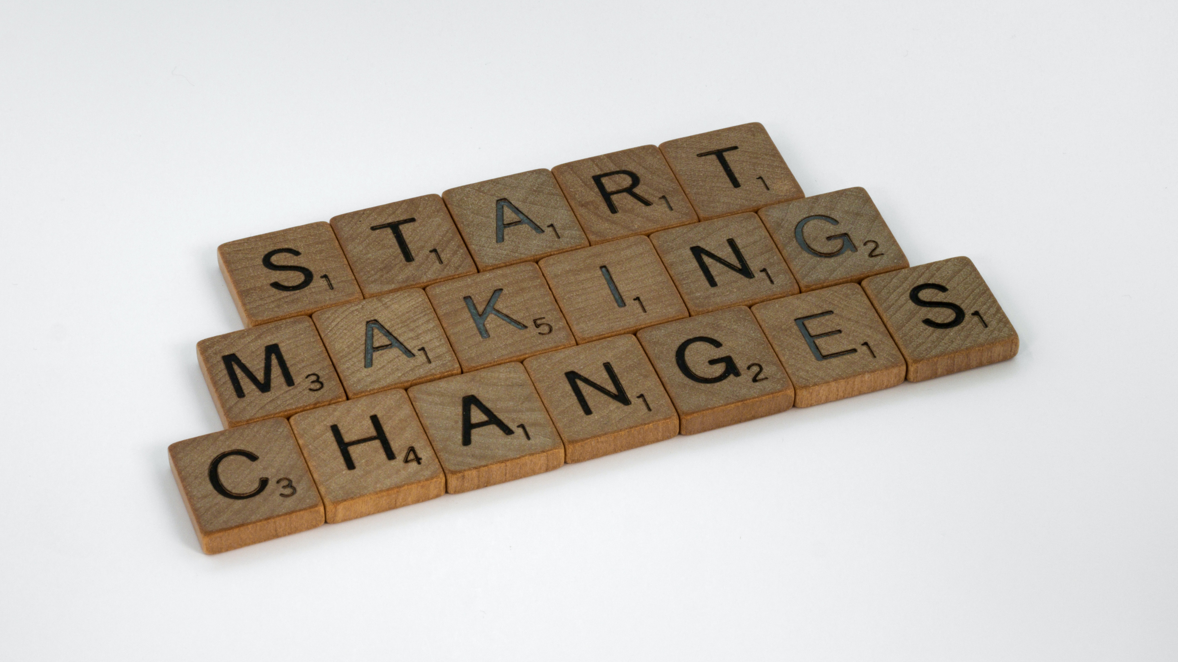
Things you enjoy
Notes:
Start by making a list of the things you enjoy doing.
On that list, remove anything you do not enjoy doing any longer.
Now that you have your new list, use your list to pick something to do in your day hat will make you happy.

Slide 14
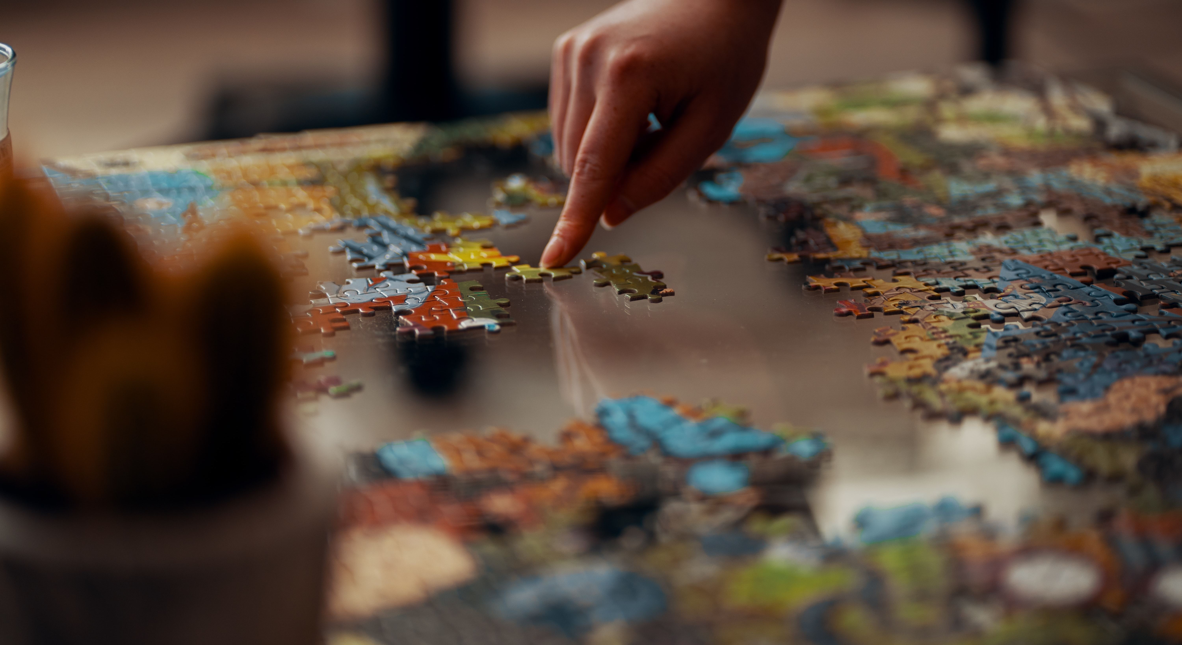
Indoor Activities
Notes:
Maybe you are an outdoor person. You spend a lot of time in outside of your home. Find an indoor activities you can do that will make you happy. This activity can be something you already enjoy but have not done in a while.

Slide 15

Outdoor activities
Notes:
Maybe you're in house person and spend a lot of time in the house or building for work. Trying going outside for a walk or other outdoor activities that will make you happy.

Slide 16

Reading a book in nature
Notes:
We spend a lot of time on our phone and connected to social media. Maybe taking sometime away from your phone will give you time to try something new, like read a book or enjoy nature.

Slide 17

Share one thing you enjoy doing with the class.
Notes:
Share with the class one activity you enjoy doing.

Slide 18
What is something new you would like to do?
Notes:
There are so many things we can do to find enjoyment or to have a great time.
What is something new you would like or wanted to do that you can do now?

Slide 19
Any questions
Notes:
This end the topic Doing something you enjoy. Are there any questions about this topic?

Slide 20
Taking action for yourself
Notes:
Taking Action for Yourself.
Taking action for yourself, is showing up for you and a new way.
It is making the changes that will better you as a person and practicing it daily.
It is giving yourself permission to grow.

Slide 21
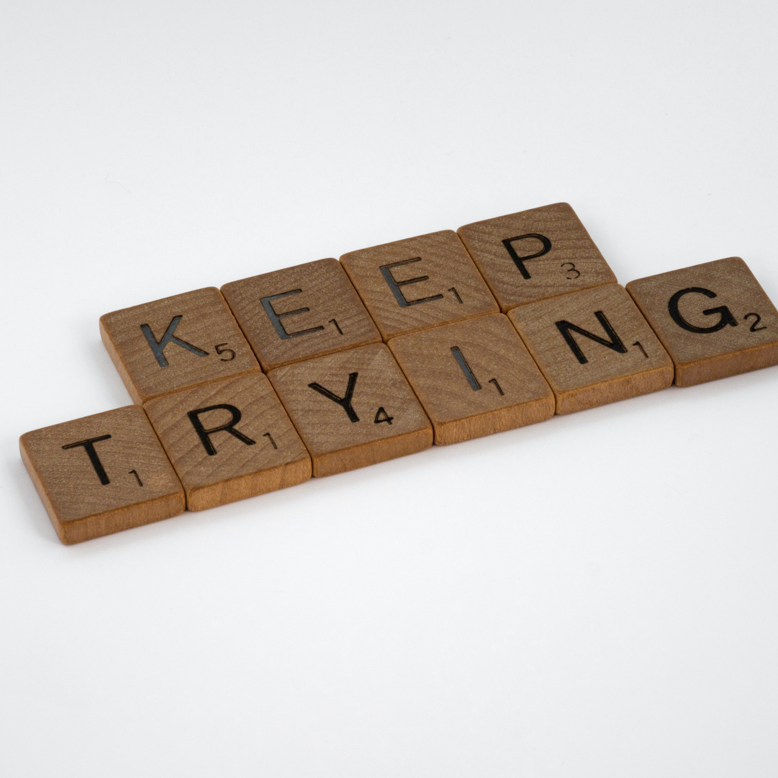
Your self-love pledge
Review your Self-love Permission Pledge from the eModule
What have you notice about yourself since signing your Pledge?
Share with the class one thing you notice differently about yourself.
What kept on track with you Pledge?
Share ways on how you will continue to put you first.
Notes:
Your Self-love Pledge from the eModule Give Yourself Permission, set the bases for you to authorize yourself to love you and make the changes you will need to develop your self-love.
What have you notice about yourself since signing your Pledge sheet?
Share with the class one thing you notice.
What kept you on track with your pledge?
What are some ways you will do to continue to put you first?

Slide 22
Any questions
Notes:
This is ending of this topic and session. Are there any question on Taking action for yourself?

Slide 23

Homework
Find something new you would like to try that will help you to enjoy the person you are.
Plan to do the new activity
Write down your experience in your journal
Continue to read your Self-love Pledge to yourself.
Share your journal entries with the RITMO Community Fellowship.
Access the RITMO Community Fellowship forum https://drshinshuri.com/forums/
Notes:
It’s Homework time!!!
There is so many things around us in our environment or surrounding area, that we may have thought about trying or doing and never found the time to do so.
Find something you would like to try that will help you embrace the person you are.
Plan to do the new activity or try it out.
In your journal write down your experience. Give an example of how the experience made your feel and if you would do it again.
Share you journal entries with the online RITMO Community Fellowship.

Slide 24
Schedule appointment
Each session is up to 1-hour max.
Click on link in form to schedule your appointment. https://drshinshuri.com/schedule-an-appointment/
Notes:
Class, after each eClass, you will have the opportunity to schedule an appointment to review any types covered in this session. Each session is up to1-hour max.
The appointment for this session will explore your understanding of Permission for self-love, doing something you love, and Self-love Permission Pledge.
This will also be a safe place to gain clarity of current or previous topics or issues you may be facing now.
Also, this will be a great time to start thinking about becoming a self-love mentor.

