Slide 1
eCourse
Self-love Experience Leadership
Notes:
Welcome participants to the Self-Love Experience Leadership eClass. I am your facilitator ___________________________.
This eClass is about you sharing your learning and understanding of the materials you learned in the eModule. The eClass is to aid you in your understanding of apply the materials to your daily routine and life

Slide 2

Transforming
Homework review
Learning to shift your perspective
Recognize your heartbeat
Accepting your inner voice
Notes:
This e-Class will be about Transforming. We will review the following topics: Homework Review, Learning to shift your perspective, Recognize your heartbeat, and lastly, Accepting your inner voice.
Throughout this presentation, I am asking that you be engaged in the class by sharing, answering questions, listening, supporting your peers with encouraging words, and showing up for yourself by doing the work and applying it to and in your life.

Slide 3

Homework review
Find something new you would like to try that will help you to enjoy the person you are.
Plan to do the new activity
Write down your experience in your journal
Continue to read your Self-love Pledge to yourself.
Share your journal entries with the RITMO Community Fellowship.
Access the RITMO Community Fellowship forum https://drshinshuri.com/forums/
Notes:
In our last session Permission, you were asked to do the following:
Find something new you would like to try that will help you to enjoy the person you are.
Plan to do the new activity.
Write your experience in your journal.
Continue to read your Self-love Pledge to yourself.
Share your journal entries with the online RITMO Fellowship Community.
Who would like to share with the class their experience with the new activity?

Slide 4

Session 6
In this session, you will apply your learning from the eModule Transform Your Viewpoint: This includes,
Learning to shift your perspective
Recognize your heartbeat
Accepting your inner voice
Notes:
Class Session 6
In this session of the eClass, you will apply your learning from the eModule lesson Transform Your Viewpoint.
In this session, we will apply learning to
Learning to shift your perspective
Recognize your heartbeat
Accepting your inner voice

Slide 5
Learning to shift your perspective
Notes:
Learning to Shift Your Perspective
Moving from one way of things and doing something can force you to change or shift your perspective. We can get in such a routine of doing things, that we forget or fail to think of the many different options we have available to make better choices or even opportunities to do the same thing but differently.

Slide 6

Shift your perspective
Throughout life we are often challenged with controlling our behavior when things happen to us that we do not agree with or are harmful to ourselves or others.
Many of our perspective comes from our surrounding and environment.
Our environment can cause us to respond to others from a place of Behavior or Trigger Responses.
However, how we respond, may not have originated from within but by our life experience(s) from our past, shared experience from others, or our current state of being.
Notes:
Shifting your perspective can be a game changer in how you see yourself, people, and things around you.
Throughout life we are often challenged with controlling our behavior, mood, thinking, attention.. when things happen to us that we do not agree with or are harmful to ourselves or others.
Many of our perspective has come from our surrounding and environment.
Its as if we see the glass half full or half empty. It all depends on your perspective at that moment. You can shape or reshape how you see things around you.

Slide 7

Shifting breakout activity
15 Minutes
This activity is about you sharing your perspective on how you responded in any given situation when at home or in your daily life when you do not receive attention or support with your breakout group.
Each group member must share 1 different situation to give the group a different perspective of how you respond when each situation is different for 15 mins.
The group members will take notes of key feedback to help the sharing members to see others perspective based on their situation.
Use discernment to understand if what someone is sharing is from a behavior or trigger response.
Give your feedback after everyone has presented their two perspective.
Notes:
Shifting Breakout Activity
This active is about you sharing your perspective on how you respond when you're not given attention or support from others.
Each member will have 1 minute to share within the group.
As one member is sharing their perspective, the other group member will listen and take notes using discernment to give feedback to the sharing members to see others perspective based on their situation.
After everyone has shared, you will give you feedback to the shared members.

Slide 8

Shifting breakout activity review
How was your experience in the breakout session?
What did you learn about yourself during the breakout session from the feedback with your peers?
Were there any similarities in how each of your peers handle their perspective compared to yours?
Did you learn anything new about how you view your perspective from being in the breakout session?
Notes:
Shifting Breakout Activity review.
Sometimes it takes us a moment to realize the what we thought was one thing is another. This is not saying that your feelings are not valued, its just given you different lens to see the whole situation or picture of your life situation.
How was your experience in the breakout session?
What did you learn about yourself during the breakout session from the feedback with your peers?
Were there any similarities in how each of your peers handle their perspective compared to yours?
Did you learn anything new about how you view your perspective from being in the breakout session?

Slide 9
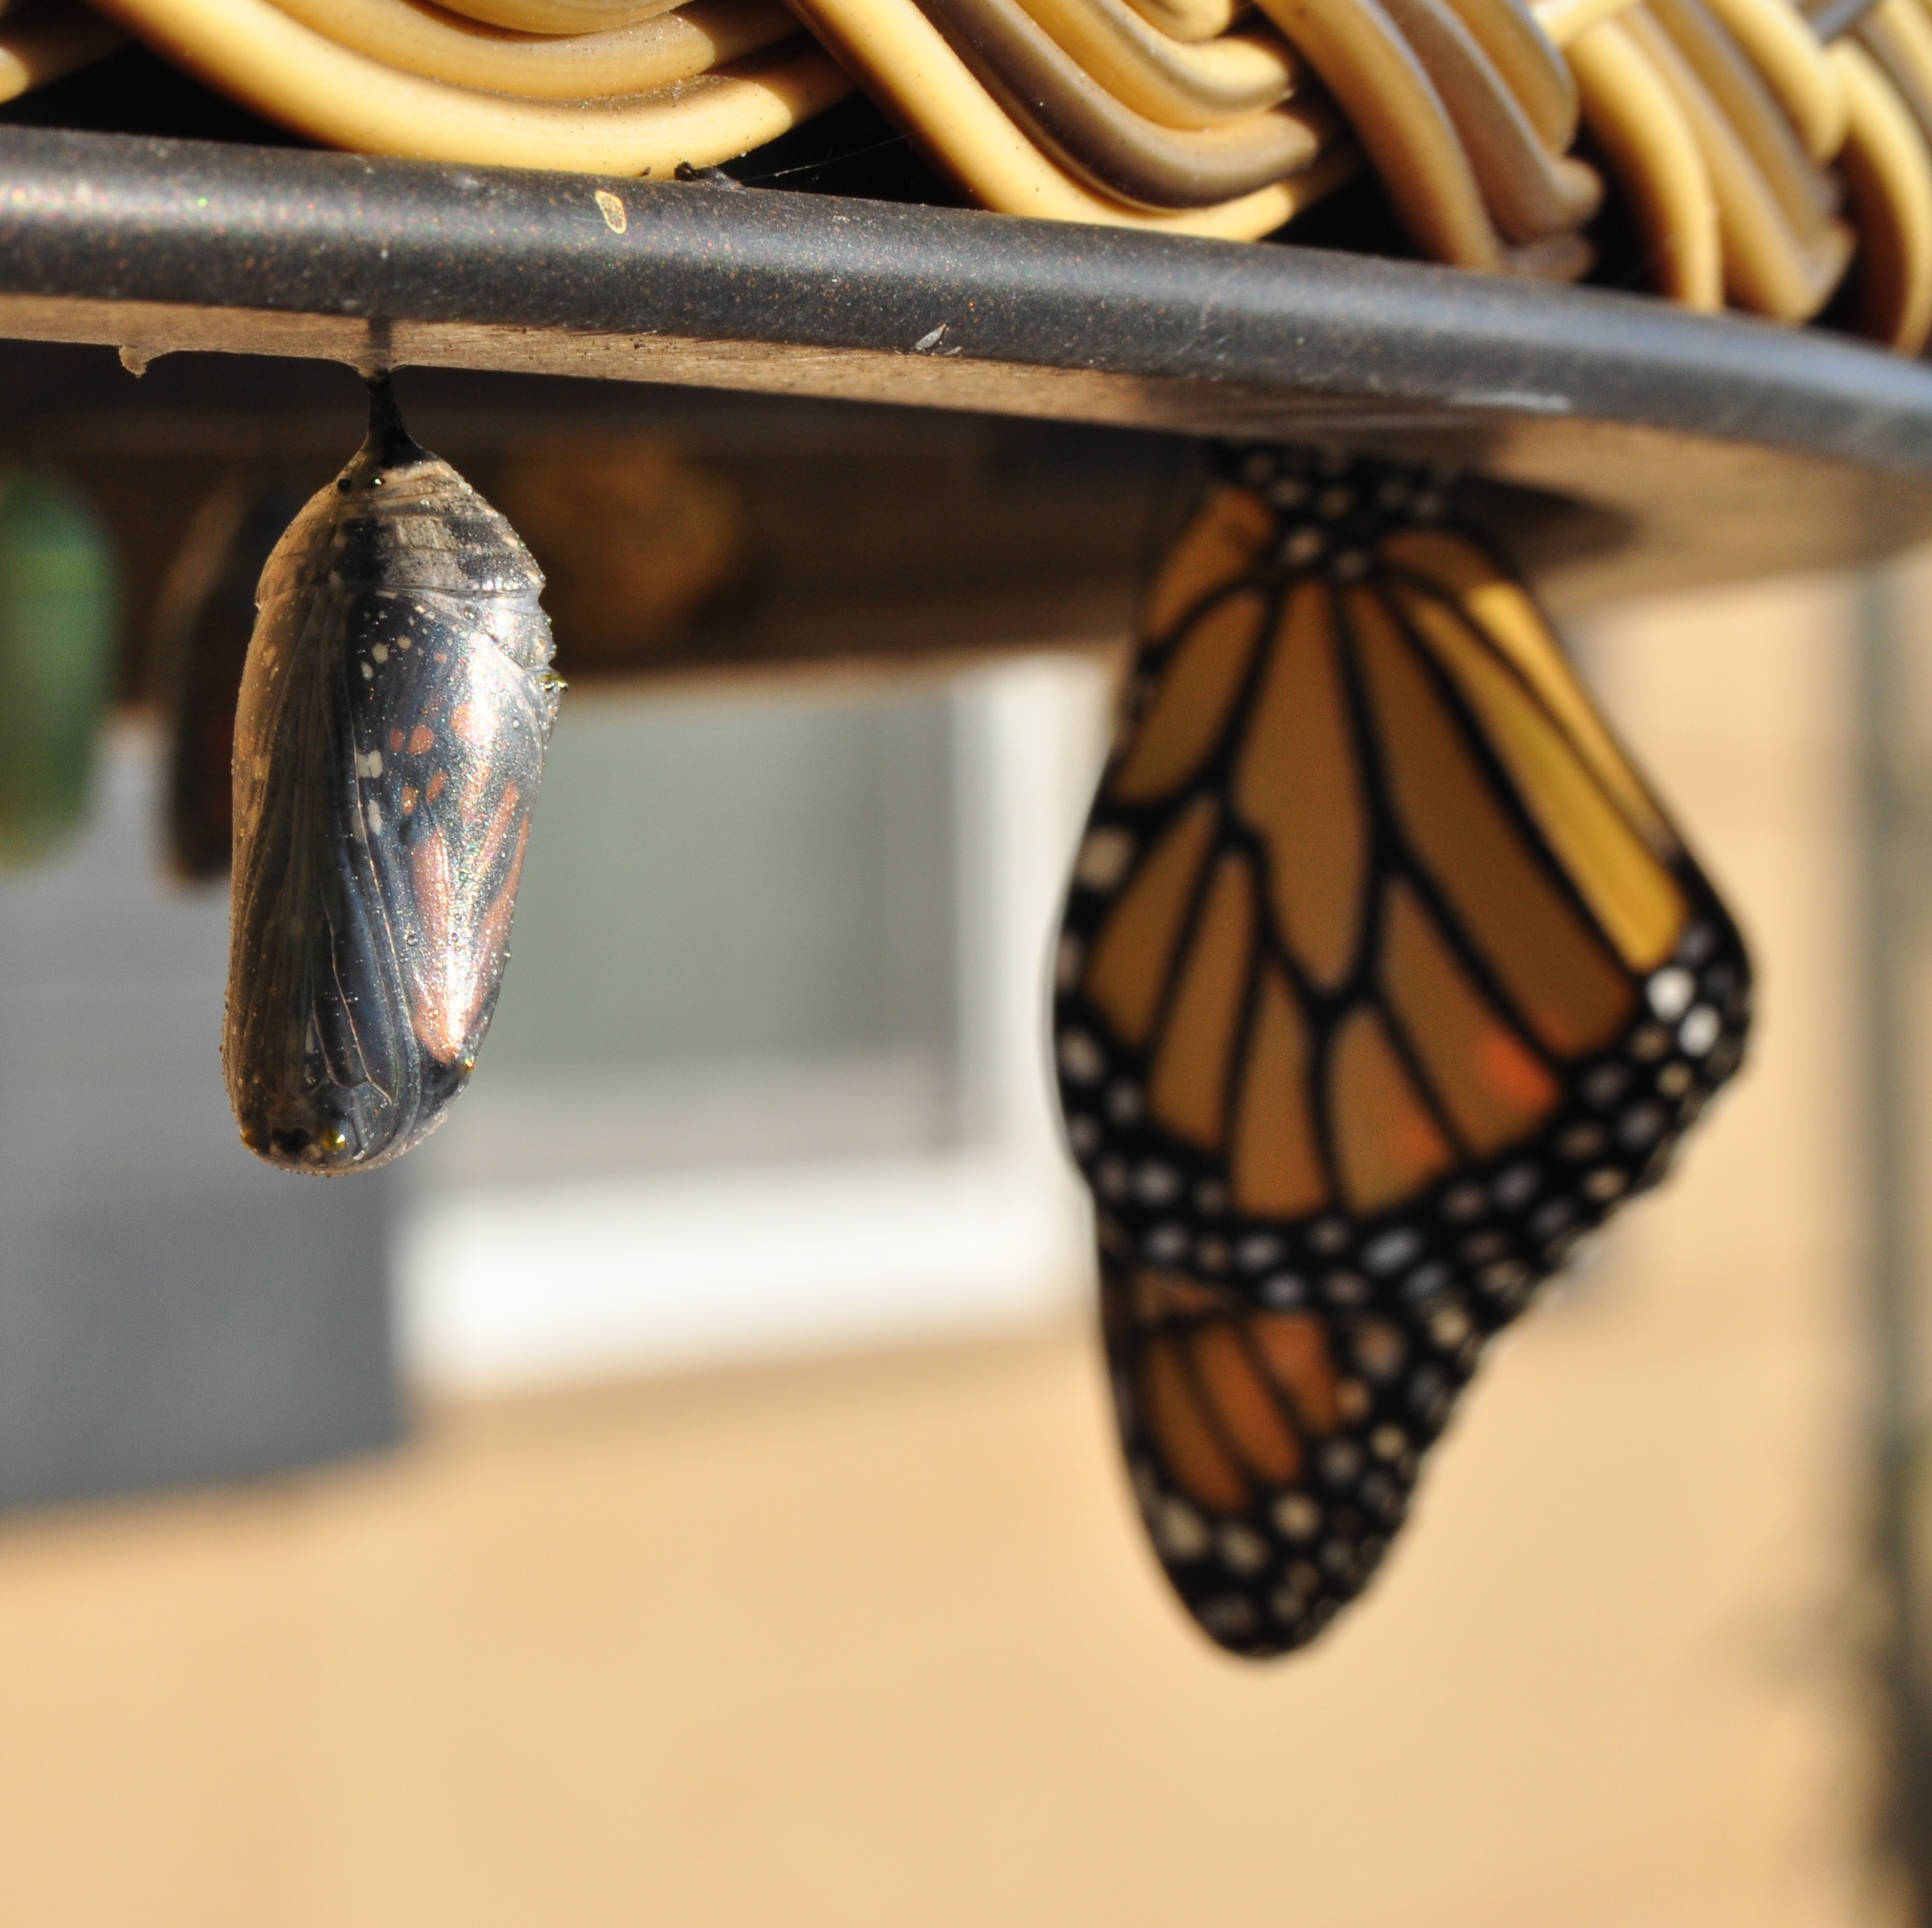
Changing your perspective
Change is not always easy for many. Sometimes finding the right approach is usually the hardest part of making the needed change.
The first process as we learned in the eModule: Give Yourself Permission, is giving yourself permission to change and love yourself first.
You can start small, by changing how you respond to different circumstances in your life.
You can choose a positive perspective over a negative one.
You decide how you see the world and make the changes needed for your growth and development.
Notes:
Changing Your Perspective can be challenging.
Change of any kind is not always easy for many of us to do. Sometimes finding the right approach is usually the hardest part of making the needed change.
The first process as we learned in the eModule Give Yourself Permission, is giving yourself permission to change and love yourself first.
You can start small, by changing how you respond to different circumstances in your life.
You can choose a positive perspective over a negative one.
You decide how you see the world and make the changes needed for your growth and development.

Slide 10

Any questions
Notes:
This end the topic the Effects of rushing your day-to-day.
(Ask the participants: if no volunteer, pick someone)
Are there any questions about the effects of rushing your day-to-day?

Slide 11
Recognize your heartbeat
Notes:
Recognize Your Heartbeat.
By a show of hands; how many of you recognize your heartbeat?
Do you recognize it like you can recognize a music beat?
In the next slide we will become more aware of our heartbeat.

Slide 12

Your heartbeat
How many have heard the saying “March to the beat of your drum or heartbeat”?
Who knows what that saying is about?
Have you ever taking time to listen to your own heartbeat?
Take three minutes to listen to your heartbeat.
Your heartbeat makes you; you.
It’s a rhythm setting you apart from others.
Notes:
Your heartbeat.
It is unique to you.
How many have heard the saying “March to the beat of your drum or heartbeat”?
Who knows what that saying is about? Please raise your hand to give your answer.
Have you ever taking the time to listen to your own heartbeat?
Today we will take the time to listen to our heartbeat. We will take three minutes to listen to the heartbeat that makes you You. We will become more aware of the rhytem setting you apart from others.

Slide 13
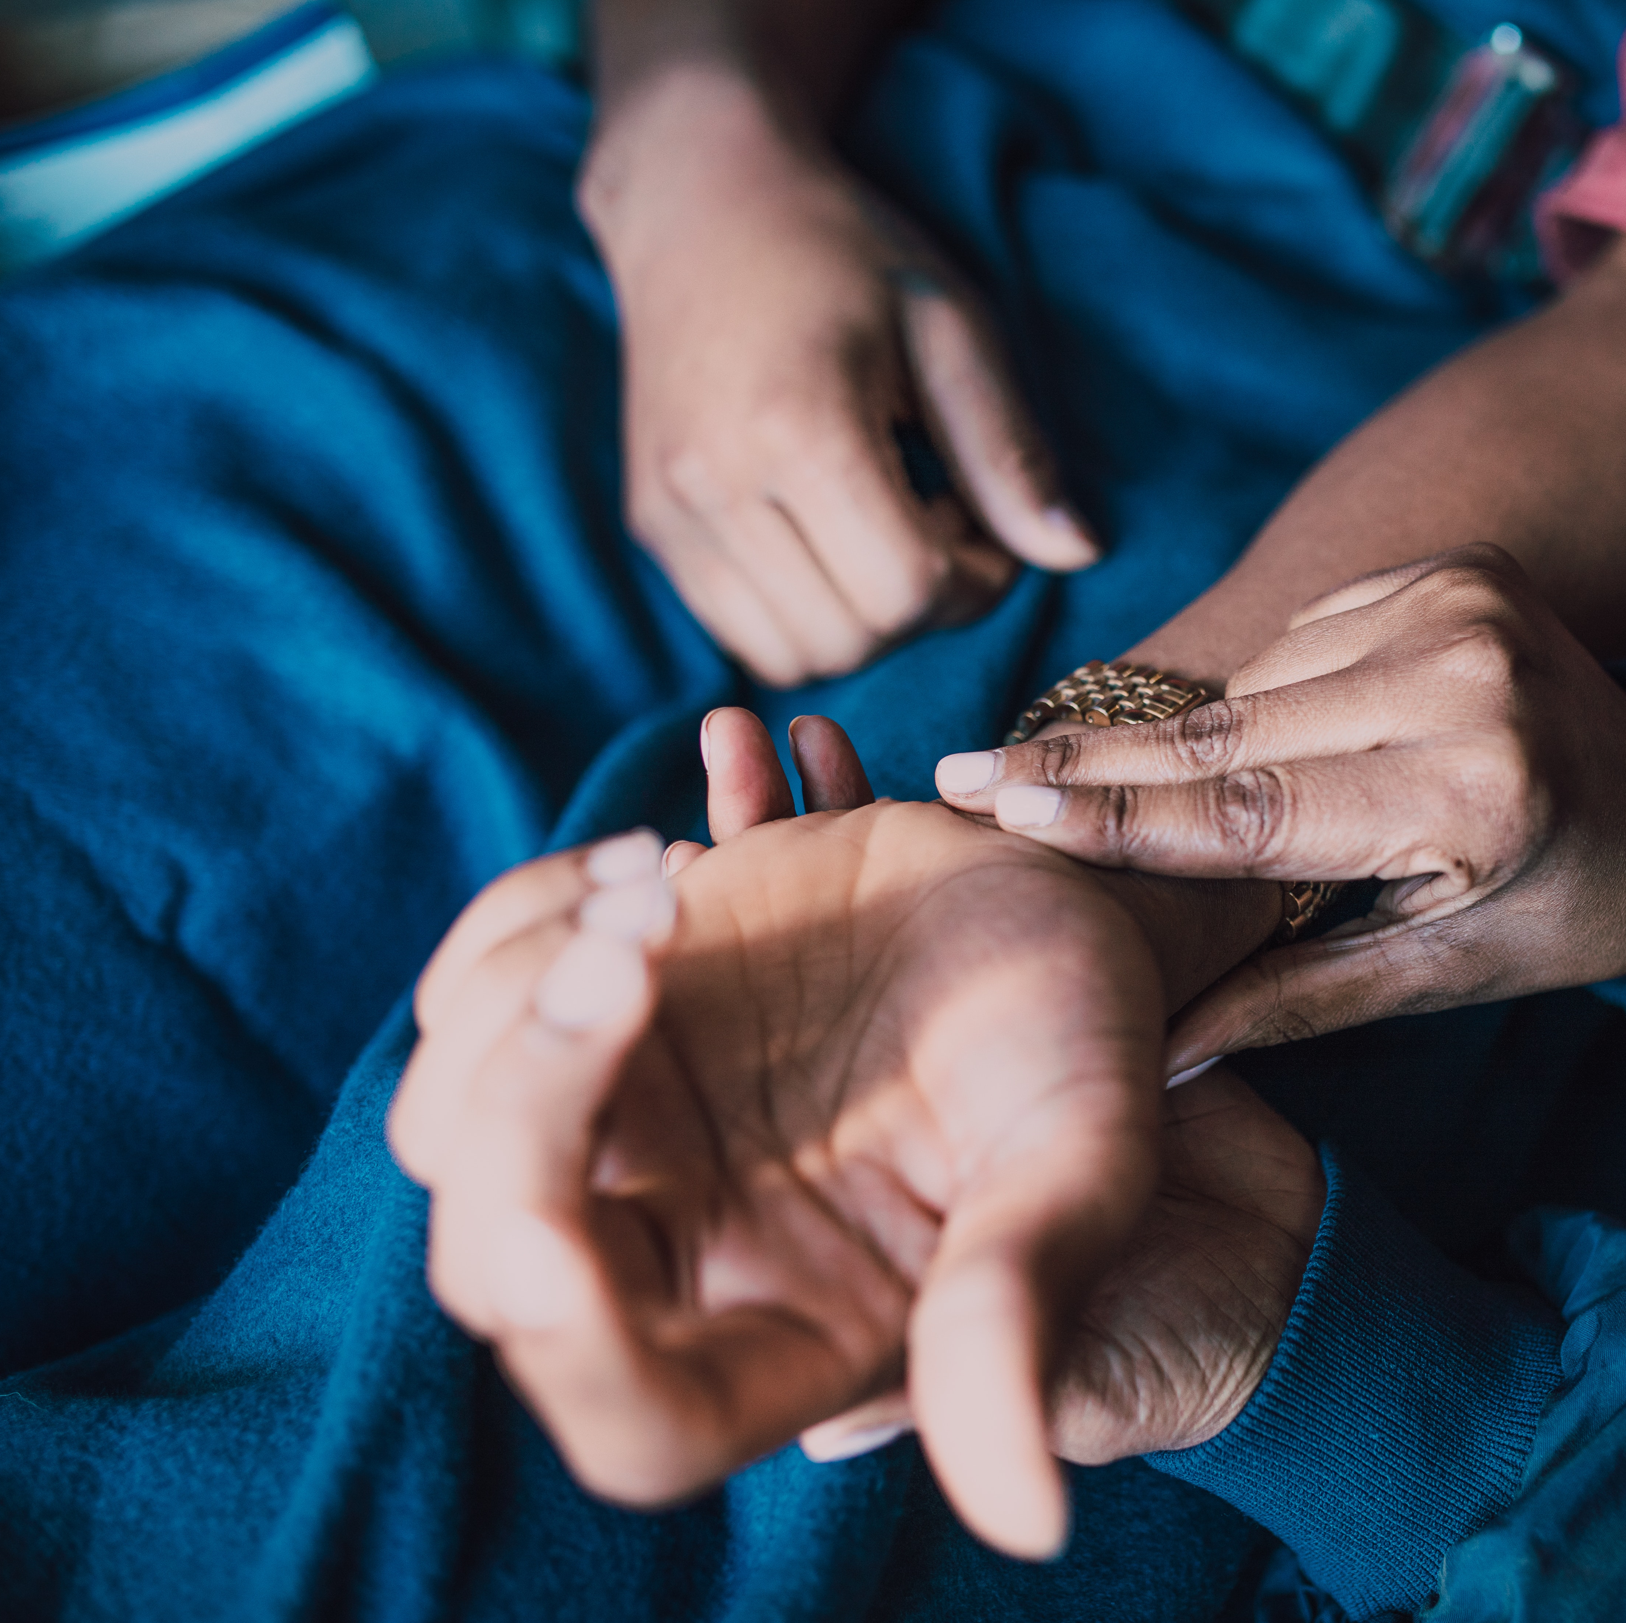
Heartbeat activity
According to Webmed.com, “Your heart rate, or pulse, is the number of times your heart beats in a minute. Everyone’s is different, and it changes as you get older. Understanding your heart rate and what’s a healthy one for you is an important part of taking care of yourself.”
Check your heart rate by placing your first two fingers on the inside of your wrist, the inside of your elbow, the side of your neck, or on the top of your foot.
Once you find your heartbeat, count how many beats you feel in 15 seconds, and multiply that number by 4.
$$HR=Number of Beats×4$$
Notes:
Heartbeat activity is helping you to find you’re heart rate or pulse.
According to Webmed.com, “Your heart rate, or pulse, is the number of times your heart beats in a minute. Everyone’s is different, and it changes as you get older. Understanding your heart rate and what’s a healthy one for you is an important part of taking care of yourself.”
Check your heart rate by placing your first two fingers (your index and middle) on the inside of your wrist, the inside of your elbow, the side of your neck, or on the top of your foot.
Once you find your heartbeat, count how many beats you feel in 15 seconds. Multiply that number by 4. The number you get is your heartrate.

Slide 14
Heartbeat activity review
Did you find it hard finding your heartbeat (pulse)?
Was this your first time checking your own heartbeat?
As you have learned everyone heartbeat is different.
It is set that why because your body needs something different to continue to operate and function for you.
Notes:
Doing the Heartrate Activity, did you find it hard to find your heartbeat (pulse)?
Was this your first time checking your own heartbeat?
As you have learned everyone heartbeat is different. Your heartbeat may require something different than others to continue to beat its unique beats. It is set that why because your body needs something different to continue to operate and function for you. It keeps you able to do what you need to do on a regular basis to continue to enjoy life as you know it.

Slide 15

Recognizing your essence
Just like you need to recognize your heartrate and when it is off, you need to be able to recognize who you are and when you are not being truthful to yourself.
Knowing who you are from the inside out, will help you to be more open to seeing when things are not going well, when things are going great in your life, or possible when you need to make a change for the better.
Who knows what “essence” means?
You should be able to identify when you are not being your true self or the essence of who you are.
Notes:
Recognizing Your Essence.
In the previous slide, you were able to learn and recognize your heartbeat. In this slide you will begin to learn how to recognize who you are and when you are not being truthful to yourself.
Knowing who you are from the inside out will help you to be open to seeing when things are not going well, when things are going great in your life, or possible when you need to make a change for the better….we all have those moments. However being aware of who you are will keep you honest with yourself on how your feeling and doing.
Who knows what “Essence” means?
Essence means….according to Merriam-Webster “The permanent as contrasted with the accidental element of being. The individual, real, or ultimate nature of a thing especially as opposed to its existence”.
You should be able to identify when you are not being your true self or the essence of who you are.

Slide 16
Recognizing your essence (cont.)
This form of being require you to become one with your high-self, higher essence, transforming your viewpoint, or super consciousness.
It is about knowing and understanding your complete connection to oneness.
It is knowing who you are when you walk into a room full of people, interested in know more about you.
Its your very own brand. No different than a major company like Nike.
Notes:
This form of being require you to become one with your high-self, higher essence, transforming your viewpoint, or super consciousness.
It is about knowing and understanding your complete connection to oneness.
It is knowing who you are when you walk into a room full of people, interested in know more about you…It like knowing without a doubt your name.
Its your very own brand. No different than a major company like Nike.

Slide 17
Any questions
Notes:
This end the topic of Recognizing your heartbeat. I know that was a lot to cover, are there any questions about the topics covered in this session?

Slide 18
Accepting your inner voice
Notes:
Accepting Your Inner Voice, is accepting who you are from the inside out. Its gaining a better understanding of who you are from the inside out.

Slide 19

Accepting
As you may have notice, throughout this eCourse accepting plays a major role in self-love.
Self-love requires your total commitment to yourself.
It is needed for continual growth and develop into the person you are purposely intended to be.
Accepting who you are challenges you to no longer accept things as they once have been in your life.
Accepting allows flow in your innate perspective
Who knows what the innate means from the eModule Transforming your Viewpoint?
Notes:
Accepting.
As you may have notice, throughout this eCourse, accepting plays a major and key role in self-love.
Self-love requires your total commitment to yourself first. It is you being loyal to you.
You accepting you is needed for continual growth and development into the person you are purposely intended to be.
Accepting who you are challenges you to no longer accept things as they once were or have been in your life.
Accepting allows you to flow in your innate perspective.
What is meaning of Innate from the eModule Transforming your Viewpoint? Please raise your hand to give your response.
Innate according to American Heritage, is the existing naturally or by hereditary rather than being learned through experience….Or or produced by the mind other than learned through experience”. Merriam-Webster states it is the “Existing in, belonging to, or determined by factors in an individual from birth”.
Your innate perspective, is your how you view or see yourself being or belonging without your life experiences or learning.

Slide 20

Self-love essence in you
Reactivating Self-love essence in you start with changing how you think and perceive yourself, others, and the world around you.
There are many factors that influences how you see yourself, things around you, and how you accept your true essence and power.
Practice and study new ways to aid you in changing your mindset.
Meditation, Mantras, Affirmations, or sitting in silence.
Learning new activities or methods will allow your mind to be open to changing behavior and healing from triggers.
Notes:
Self-love Essence in You
Reactivating Self-love Essence in you starts with changing how you think and perceive yourself, others, and the world around you.
It finding the good or staying positive when things around you are not going as you may have hoped.
There are many factors around you influencing how you see yourself and your environment. Sometimes, our environment or surrounding will make it difficult to find hope in yourself and others.
Practice and study new ways to aid you in changing your mindset. You may try to Meditation, Mantras, Affirmation, or sitting in silence.
Learning new activities or methods will allow your mind to be open to changing behavior and healing from triggers.

Slide 21


Self-love essence mantra activity
SELF-LOVE ESSENCE MANTRA (Short Version)
om aham asmi aikātmya
अहम् अस्मि ऐकात्म्य
Notes:
Self-love Essence Mantra Activity
In this activity you will apply your understanding of the Self-love Essence Mantra.
Listen, and follow along to the audio for the Self-love Essence Mantra.
Continue to repeat the Mantra.

Slide 22
Self-love essence mantra
Self-love Essence is the substance holding all of you together from the inside out. It is the quality of being your true purest and original self-focused on reunification of spirit to align the mind within the heart, and body.
Its you getting close to yourself in oneness.
Notes:
Self-love Essence Mantra
Self-love Essence is the substance holding all of you together from the inside out. It is the quality of being your true purest and original self-focused on reunification of spirit to align the mind within the heart, and body.
Its you getting closer to yourself in oneness.

Slide 23
Any questions
Notes:
This end the topic Accepting Your Inner Voice. Are there any questions about this session? Who would like to share what they have learned from this session?

Slide 24

Homework
Listen to the Self-love Essence Mantra
Write in your journal your experience and reaction to the Self-love Essence Mantra.
Share your journal entries with the online RITMO Community Fellowship.
Access the RITMO Community Fellowship forum https://drshinshuri.com/forums/
Notes:
For this homework, class continue to listen to the Self-love Essence Mantra. Write in your journal your experience and reaction to the Self-love Essence Mantra.
Share with the RITMO community Fellowship Community.

Slide 25

Schedule appointment
Each session is up to 1-hour max.
Click on link in form to schedule your appointment. https://drshinshuri.com/schedule-an-appointment/
Notes:
Class, after each eClass, you will have the opportunity to schedule an appointment to review any types covered in this session. Each session is up to1-hour max.
The appointment for this session will explore your understanding of Shifting your perspective, recognize your heartbeat, and your inner voice.
This will also be a safe place to gain clarity of current or previous topics or issues you may be facing now.
Also, this will be a great time to start thinking about becoming a self-love mentor.

