Slide 1
eClass
Self-love Experience Leadership
Notes:
Welcome participants to the Self-Love Experience Leadership eClass. I am your facilitator ___________________________.
This eClass is about you sharing your learning and understanding of the materials you learned in the eModule. The eClass is to aid you in your understanding of apply the materials to your daily routine and life.

Slide 2

Embracing
Homework review
Shame no more
Sharing your story with others
Celebration of Becoming
Notes:
Welcome back, This eClass is about Embracing. This eClass will review Homework, Shame no more, Sharing your story with others, and Celebration of Becoming.
Throughout this presentation, I am asking that you be engaged in the class by sharing, answering questions, listening, supporting your peers with encouraging words, and showing up for yourself by doing the work and applying it to and in your life.

Slide 3
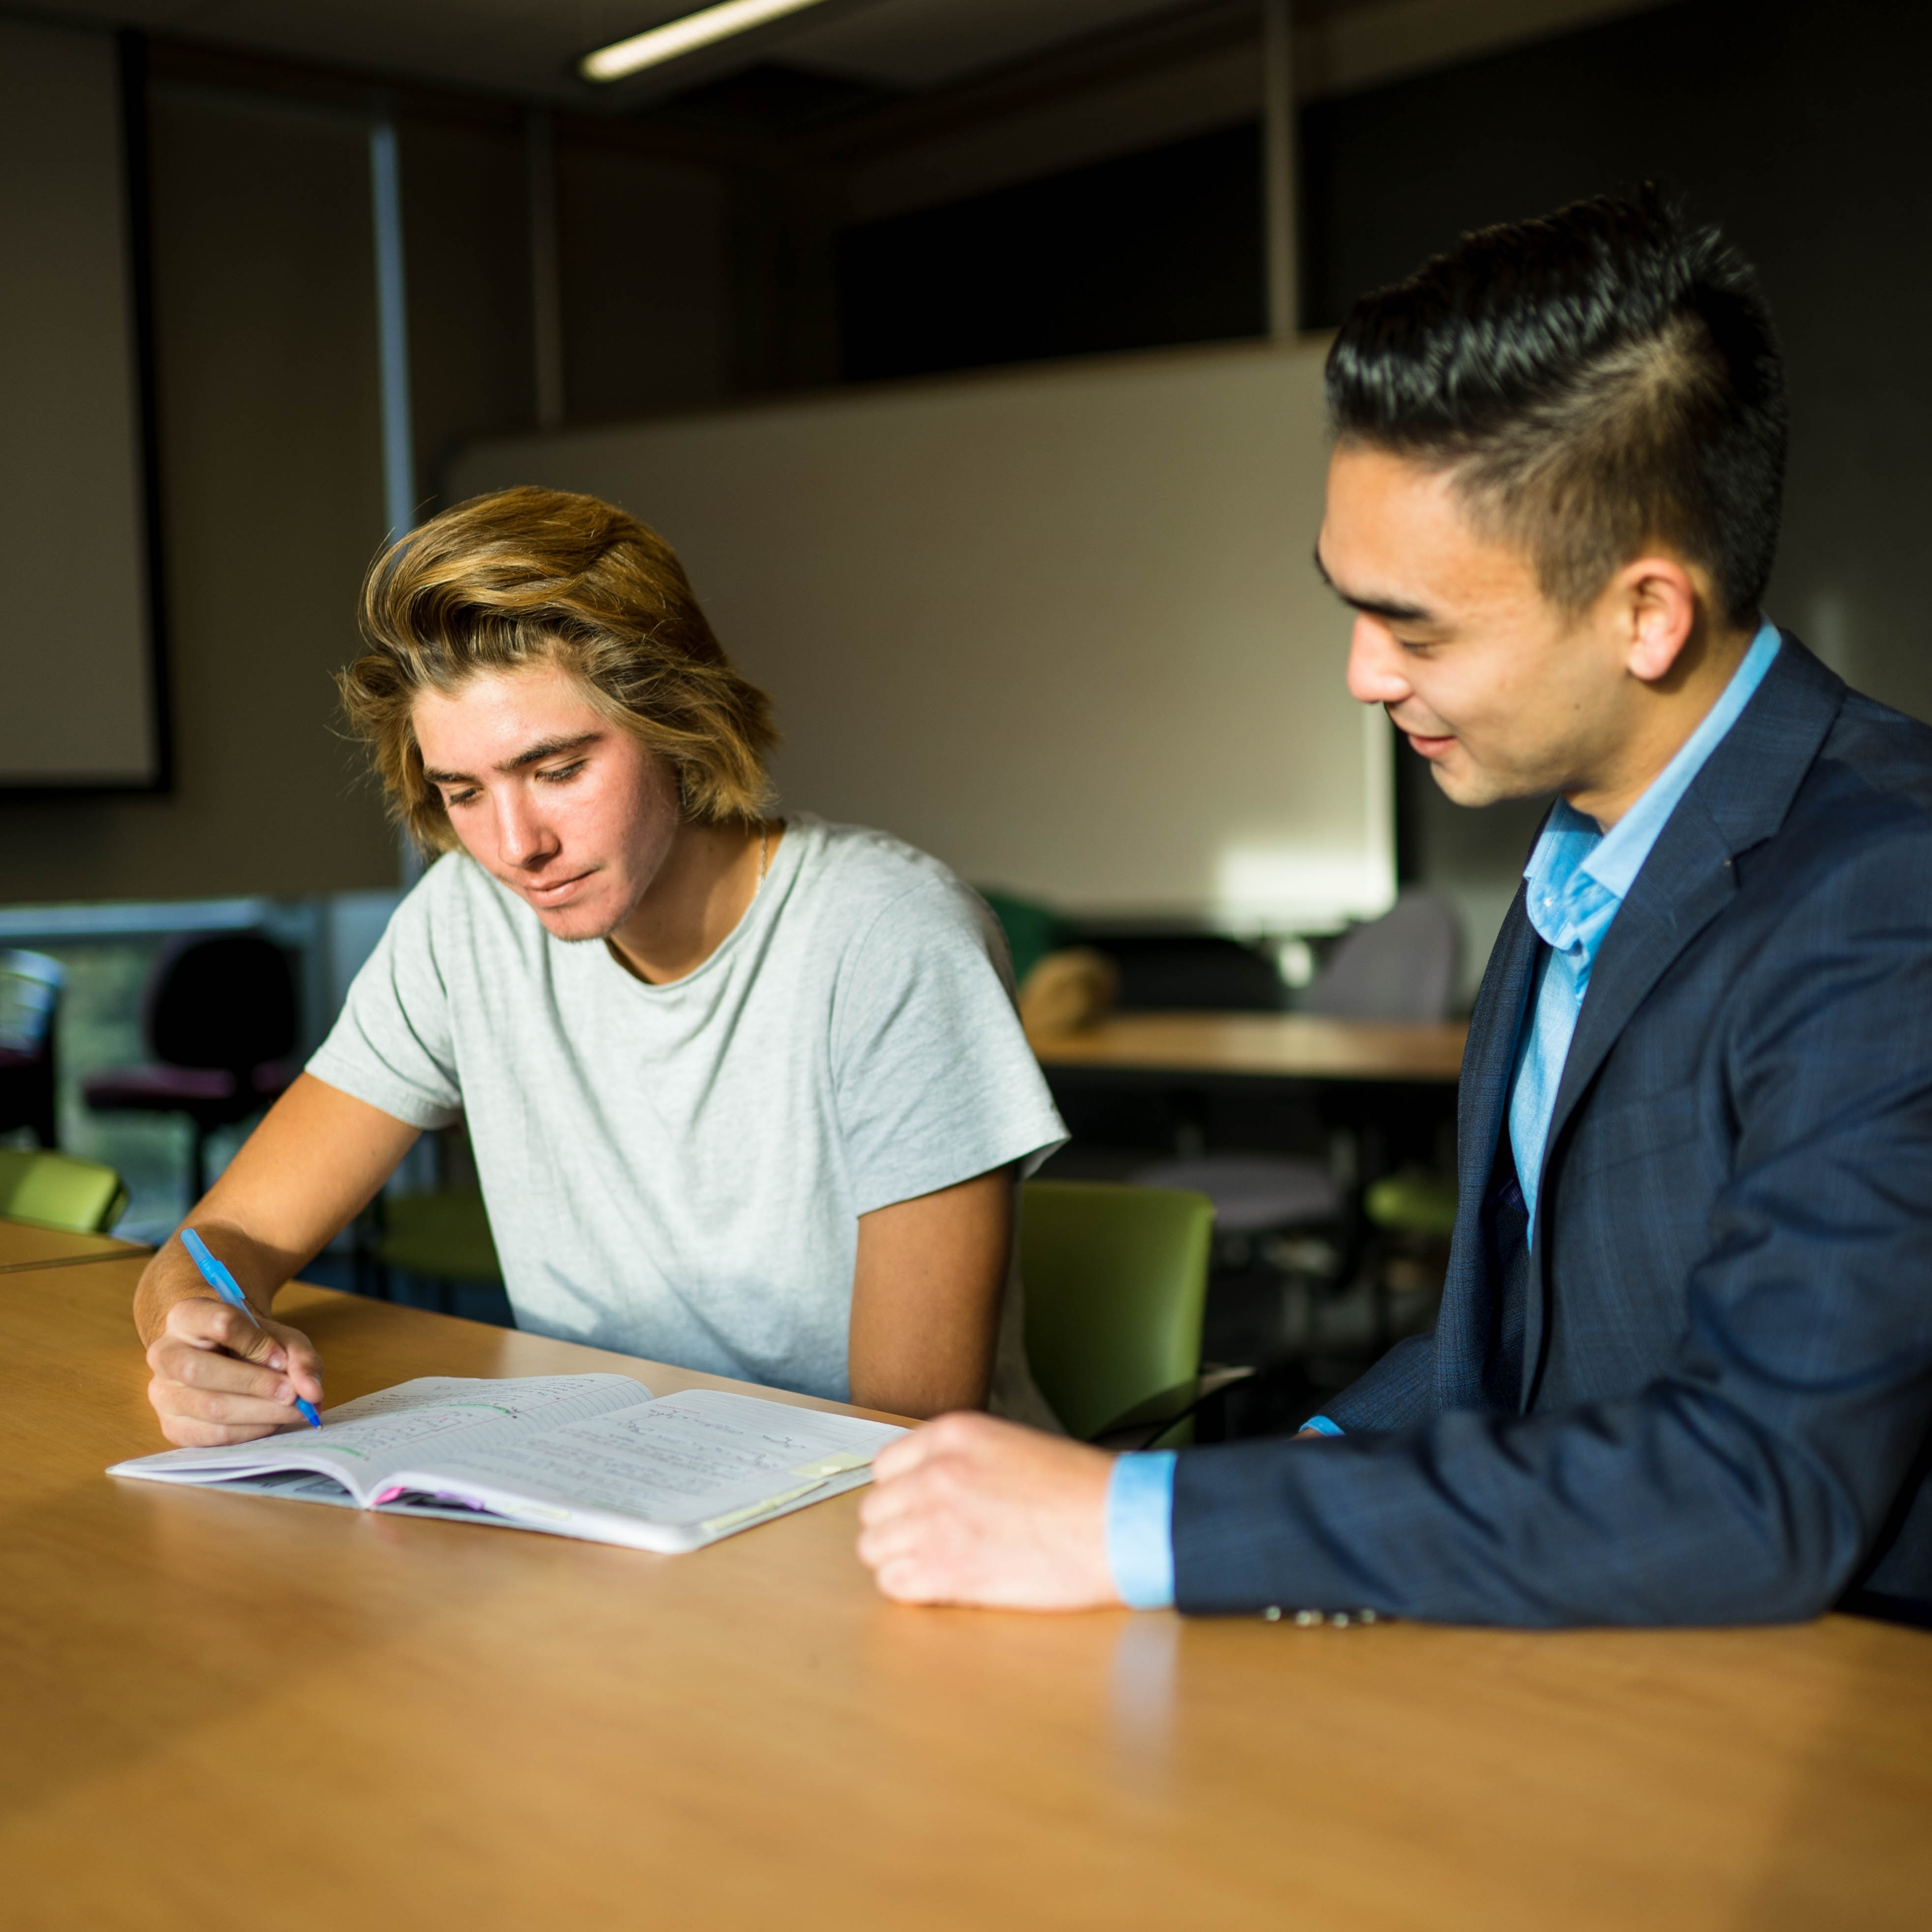
Homework review
Throughout the week, when you feel rushed, take a second to breathe.
Continue to practice and develop your breathing skills from the 4-7-8 video.
Write in your journal your experience with the breathing techniques.
Share with the online community, how you plan to enjoy every moment and how breathing impacted your day.
Click on the link access the RITMO Community Fellowship forum https://drshinshuri.com/forums/
Notes:
Homework Review!!
For this homework, you were to continue practicing breathing throughout the week when you felt rushed.
You were to continue to practice and develop your breathing skills from the 4-7-8 breathing video, write in your journal your experience with the breathing techniques, and share with the RITMO community.
Who would like to share their homework experience?

Slide 4

Session 8
In this session, you will apply your learning from the eModule Embrace Yourself: This includes,
Shame no more
Sharing your story with others
Celebration of becoming
Notes:
Session 8:
In this session of the eClass, you will apply your learning from the eModule Embrace Yourself.
During this session, you will apply your learning to Shame no more, Sharing your story with others, and Celebration of becoming.

Slide 5
Shame no more
Notes:
Shame comes and so many forms and it has a different affect on our lives depending on the shame and who is shaming us. Shame no more is letting go of all shame.

Slide 6
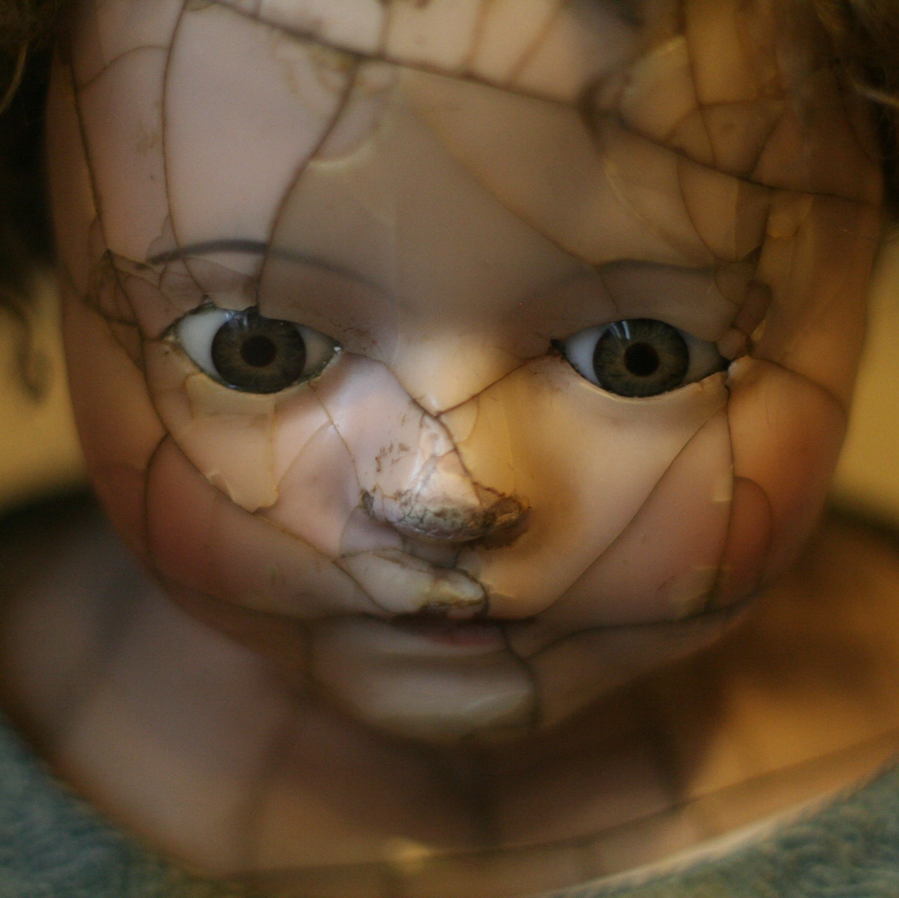
Flaws
We all have flaws.
Some flaws are visual, and some are not.
Flaws can cause many to live in fear of other perspectives of ourselves.
It can hinder you from moving forward or enjoying life experiences.
Being aware of your flaws.
Notes:
We all have flaws we are not proud of having. These flaws can be visible, and some are not, however, they may hold the same feeling of shame.
Flaws can cause many to life in fear of other perspectives of ourselves.
It can hinder you from moving forward or enjoying life experiences.
Being aware of your flaws can lead you to embracing your flaws and find the good and changing whatever need to be change. This change maybe as easy as learning a new skill, or embracing physically features of yourself that in the past brought you shame.
Embracing your flaws will allow you to take action on loving yourself and making the needed adjustment to be develop area that need growth and development, however, accepting all of you from the inside out in a more positive outlook.

Slide 7

Being you
Commit to being who you are.
Embracing all of who you are no matter how scary or a shameful you may feel.
Name one thing holding you back from being your true self around family or friends?
What area of your life does it affect you?
What difference would it make if you take control of your mindset about being you?
Notes:
Being you.
Commit to being who you are. Everyone is taking. You can only be the person you are design to be.
Embrace all of who you are no matter how scary or shameful you may feel. You will need to show up for you and support your growth and development long term.
Name one thing holding you back from being your true self around family or friends?
Sometimes the value we place on others, hold us back from being a disappointment to others. All while being a disappointment to ourselves. Value your opinion about yourself before others. Others perspective can be given when you seek it, however, not at the cost of putting yourself down.
What area of your life does it affect you? Understand how others perspective affect your life. It may not be in every area of your life, but beginning to understand where there is a strong hold from others that is keeping you from being you.
What difference would it make if you take control of your mindset about being you?
Taking back control gives you the ability to be you. It give you the permission to grow and develop into your innate being without shame. Being your true self is important to living your best life.

Slide 8

Any questions
Notes:
Are there any questions or feedback about this session of Shame No More?

Slide 9
Sharing your story with others
Notes:
Sharing My Story With Others.
Sharing your story with others can sometimes be challenging. However, it is beneficial to your growth just as much as it is to those around you.

Slide 10
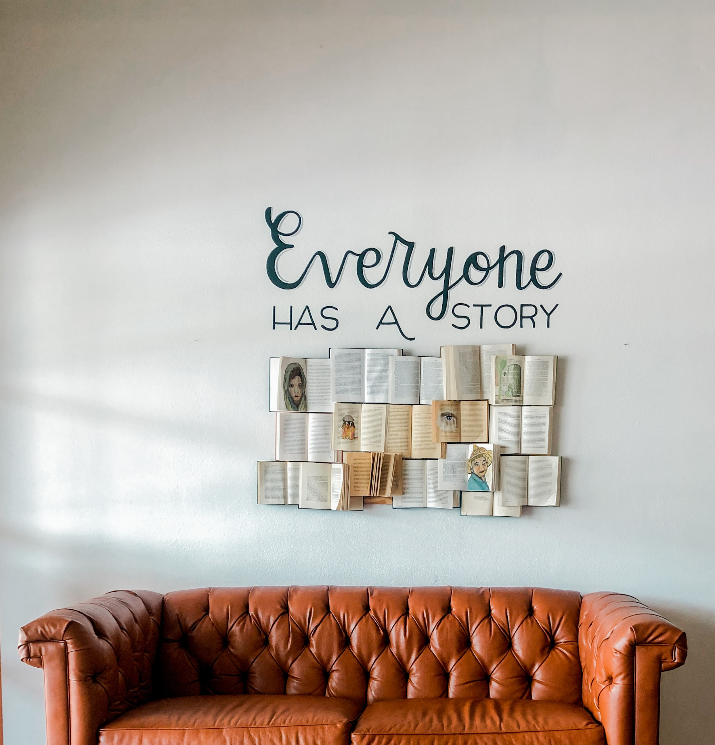
What’s your story?
“Owning our story and loving ourselves through that process is the bravest thing that we will ever do.” ~ Brené Brown
Own who you are: It is your story.
Have you thought about what makes you, you?
Share something you have become aware of about yourself with the group.
Was this something you knew about and forgot or something you discovered since being in this class?
Notes:
What’s your story?
“Owning our story and loving ourselves through that process is the bravest thing that we will ever do”.
It is the bravest thing you will ever do because of all of your experiences good or bad you still choose to own your story. You still choose to embrace you and your experiences.
Own who are you: It is your story to tell. It is telling your truth as you see it and experienced it. It is also, being aware, others may have a different perspective of the same event but still being willing to write your story.
By a show of hands, class, have you thought about what makes you, you? We all have moments where we think about what made us into who we are today. It may have even came up after dealing with a difficult moment or possible even experience something you never experience before.
Share something you have become aware of about yourself with the group. ( At this moment seek out volunteers or call on someone).
(Ask the volunteer) Was this something you knew about and forgot or something you discovered since being in this class?
As we experience life, we will have those moments that requires us to pay attention to the things or opportunity to learn that we tried to avoid about ourselves and experiences. Take time to listen to your own story and learn from them as you would any life lesson.

Slide 11

Rewrite your story
You can always write a new story about yourself.
No matter what the old story reviled about you, you control the narrative.
What would you like for people to know about you now?
You are the author of you book, rewrite the upcoming chapters of your life.
You can choose to make it great.
Notes:
Rewrite your story
You can always write a new story about yourself.
No matter what your story is, you can rewrite your story. No matter what the old story reviled, you control the narrative. You are the author of it.
What would you like for people to know about you now that you are the author of your own story?
You are the author of your book (story), rewrite the upcoming chapters of your life to reflect what you want others to know about you.
You can choose to make it a top seller.

Slide 12
Any questions
Notes:
Do you have any questions about Sharing your story with others?

Slide 13
Celebration of becoming
Notes:
Celebration of Becoming.
Celebrate who are becoming. The person you are becoming is worth celebrating and embracing.

Slide 14

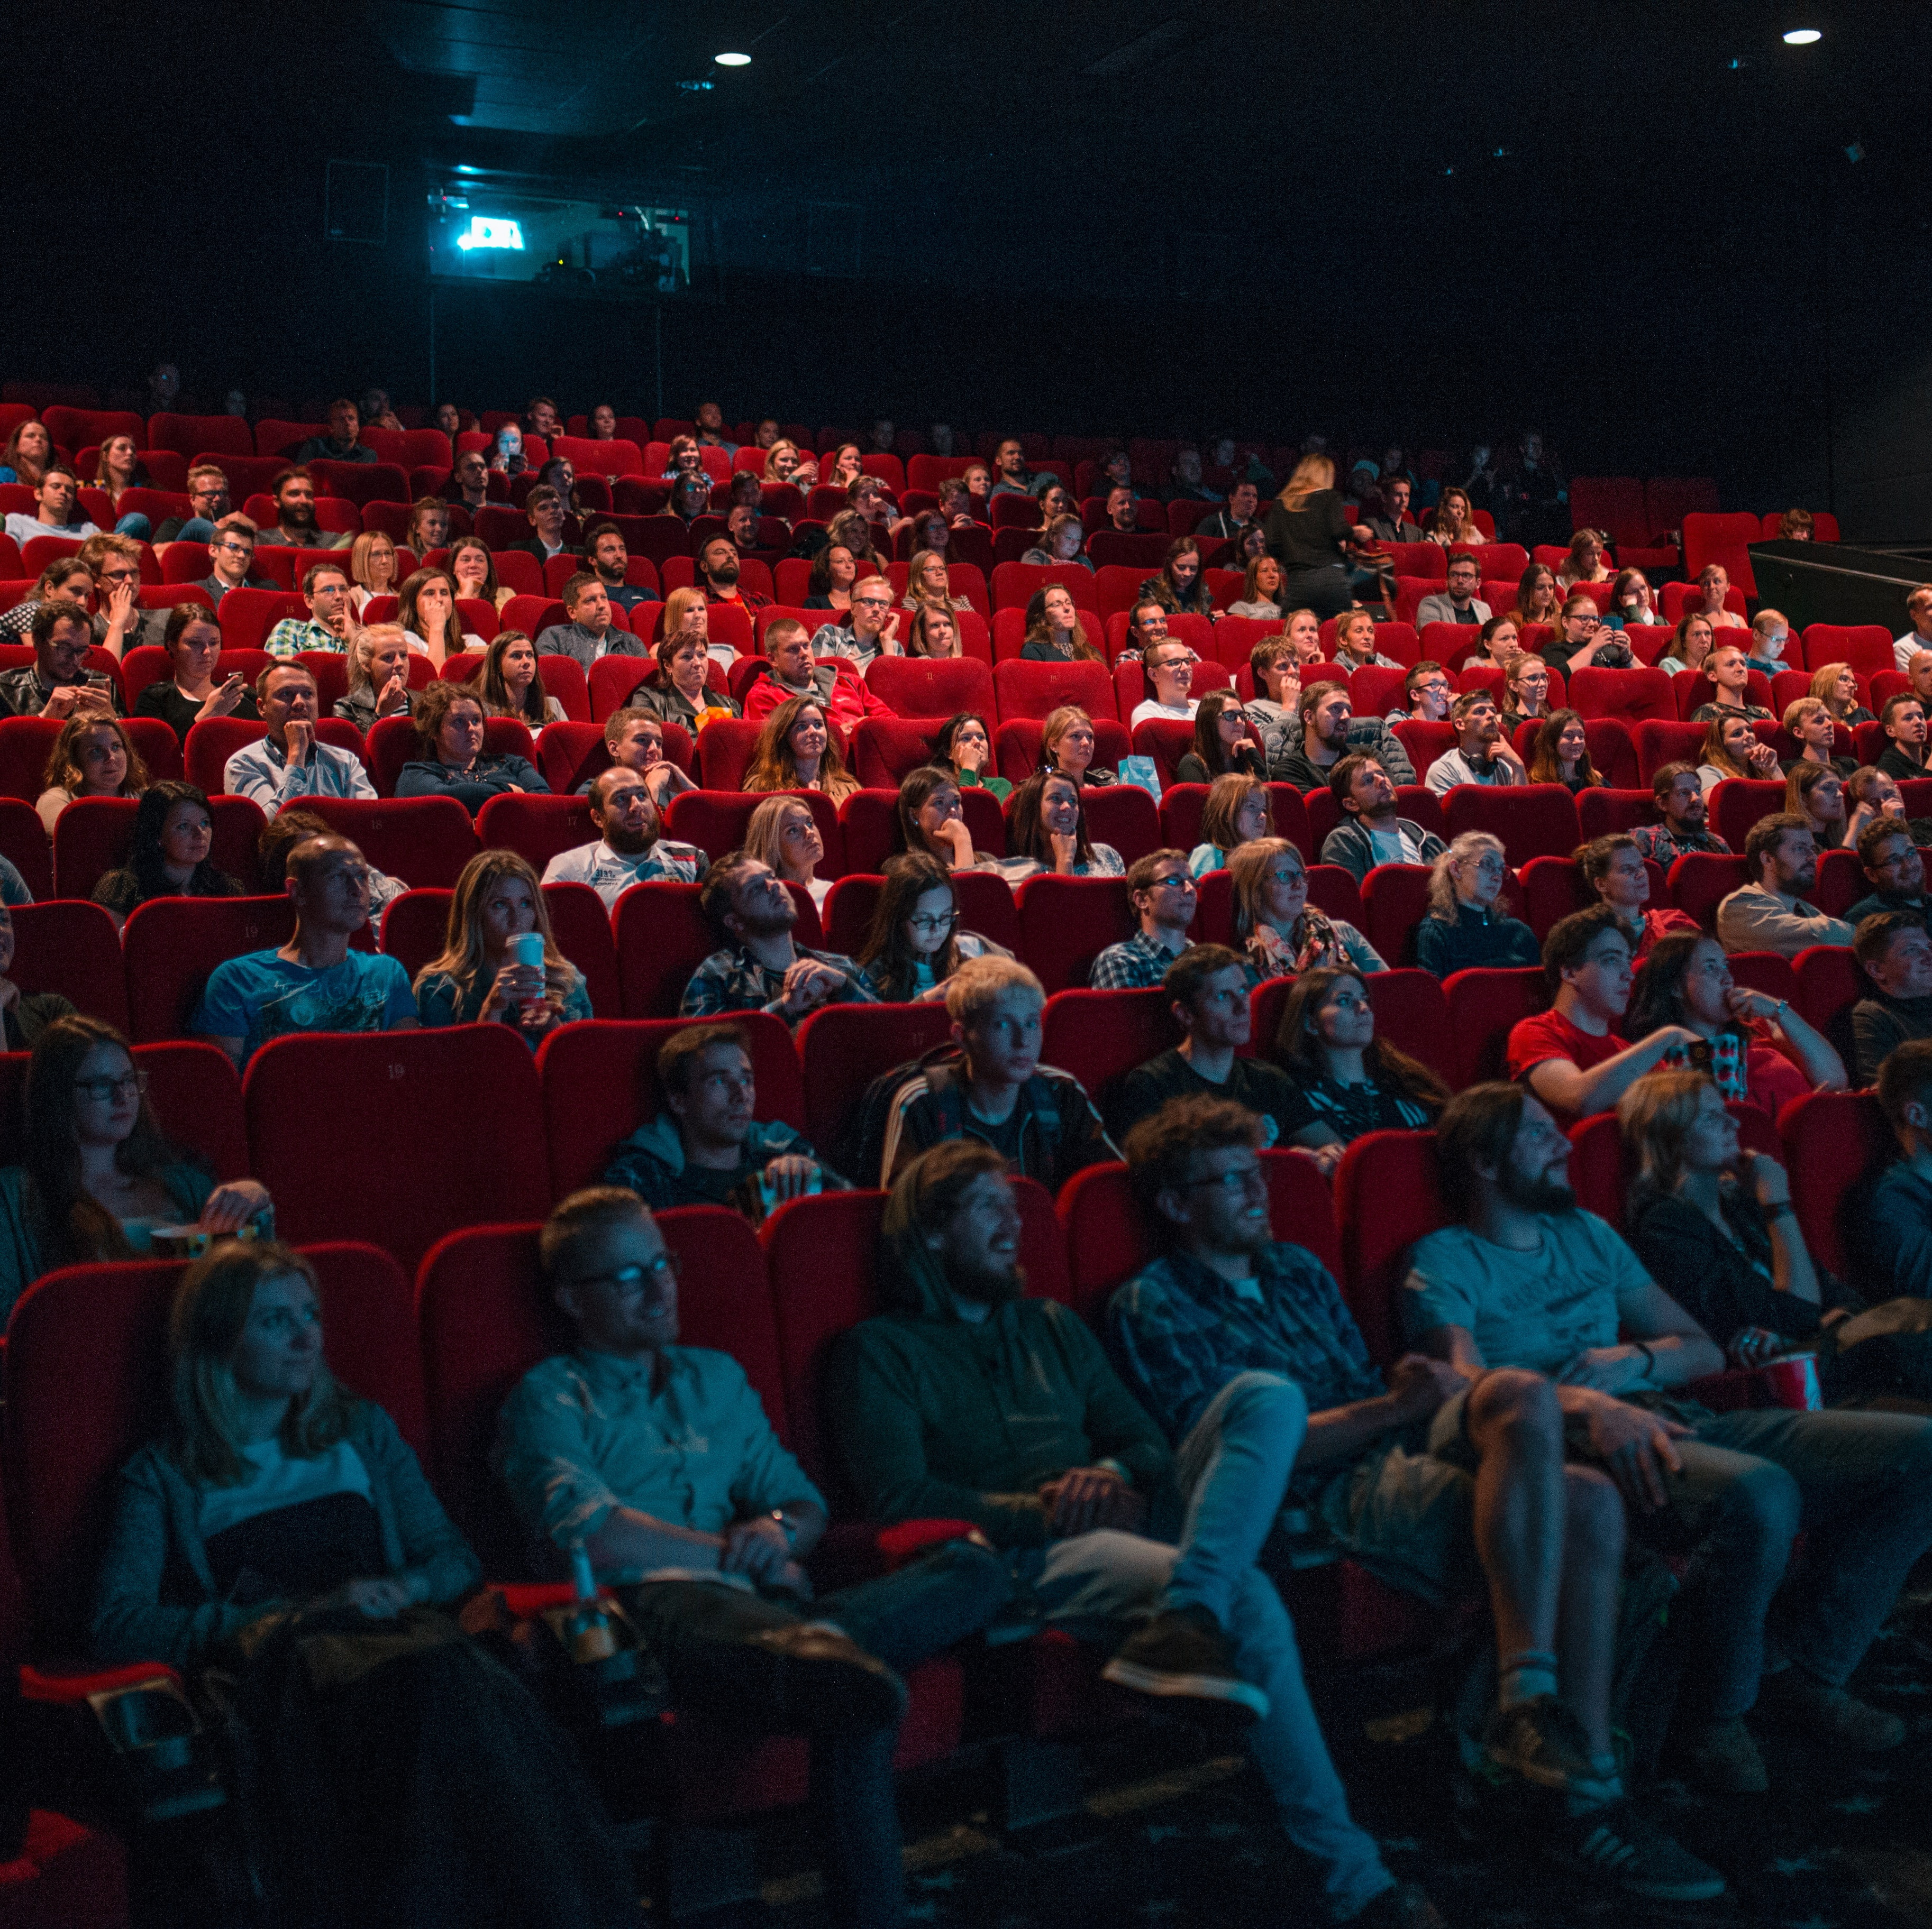
How to know yourself
Let’s watch a video on How To Know Yourself.
Listen for understanding.
Think about how your experience compare to the video.
Click on the link in the chat to view the video
https://youtu.be/4lTbWQ8zD3w?si=9qe5RU-9r-p4_Wdj
Notes:
How to know yourself.
Let’s watch a video on How to know yourself. This video is about 5:56 minutes.
Listen for understanding in learning how to know yourself.
Think about how your experience compare to the video.

Slide 15

How to know yourself video review
What did you think about the video?
Did you learn anything new?
What was your key take away from the video?
Notes:
How to Know Yourself video review.
Class what did you think about the video? (have the class volunteer or call on someone).
Did you learn anything new?
What was your key take away from the video?

Slide 16
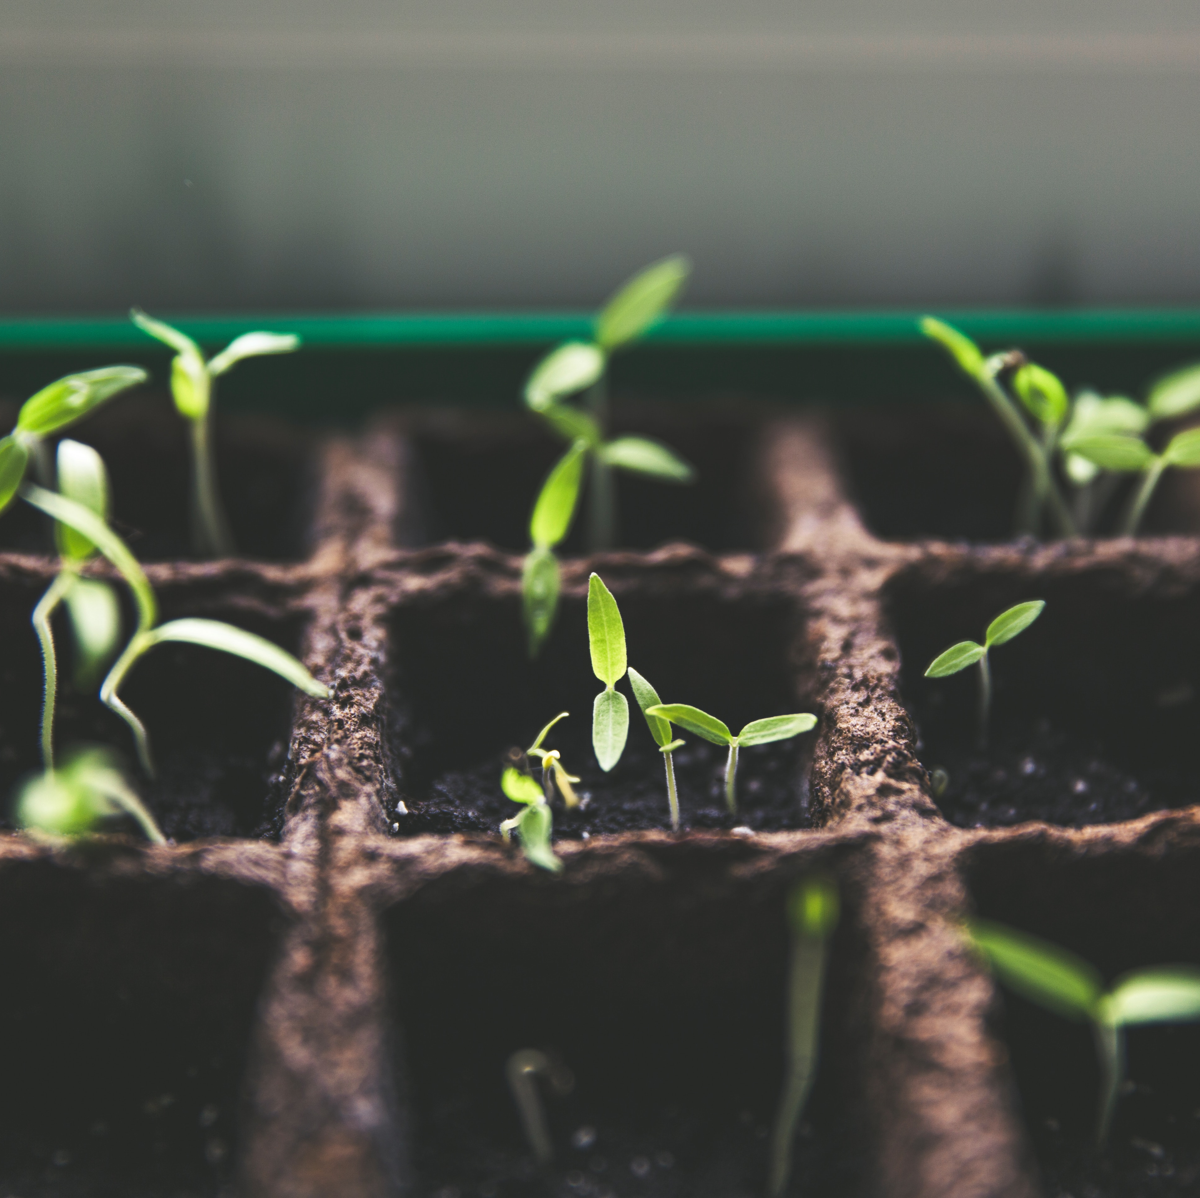
Becoming
Change starts with you.
Challenges will always appear.
You decide the person you are and becoming.
Start with a positive mindset.
Review your affirmations daily.
Acknowledge the changed within you and even the visible changes you have made around you.
Embrace new opportunities to grow and develop into the new you daily.
Notes:
Becoming
To become; change starts with you. Its you deciding to change.
Challenges will always appear, however continue to decide to become your best person.
You decide the person you are and becoming.
Start with a positive mindset. Have a desire to change your thinking and do it.
Acknowledge the change within you and even the visible changes you have made around you.
Embrace new opportunities to grow and develop into the new you daily. There is aways opportunity to improve yourself as a person.
Review and recite your Self-love Affirmation to stay positive and retrain your thinking.

Slide 17
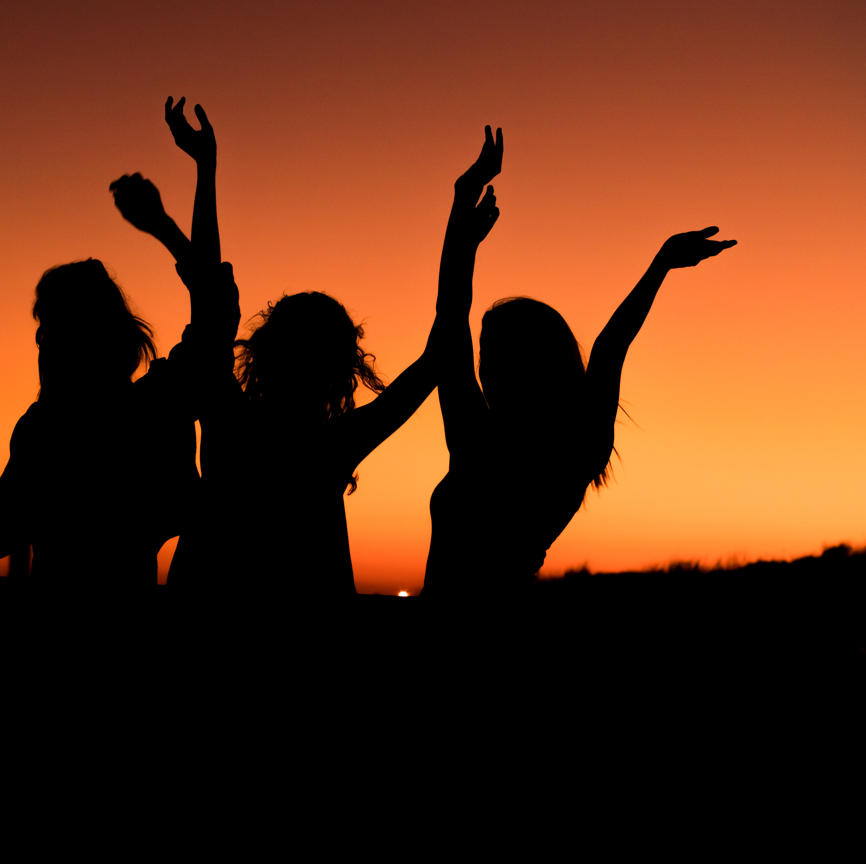
Celebrate yourself
Give yourself a hand clap.
Enjoy becoming your new person.
What are some ways you can celebrated yourself?
Would you choose to share your enjoyment with others?
Notes:
Celebrate Yourself!
Give yourself a hand clap. You deserve it. The journey has not always been so clear or easy. Yet you made it to where you are now.
No matter how it may have appeared in the past today is a new day. As you have read in Self-love, the art of loving oneself; our journey is ever-changing. Embrace your changes.
Enjoy becoming your new person. You have made the biggest decision to love you no matter what. You are worth of your life too.
Class what are some ways you can celebrate yourself? (ask for volunteer or call on someone).
Would you choose to share your enjoyment with others?
Every celebration may not need to be shared with others, however, give those who are supportive and cheering you on, the opportunity to celebrate your wins with you.

Slide 18
Any questions
Notes:
Class do any have any questions or want to share your feedback on Celebrating Becoming?

Slide 19

Homework
Continue to write your story on how you are becoming the new and better version of yourself.
What have you notice differently about yourself than you have in the past?
How big of a difference does the new and better you handle conflicts?
How will you celebrate yourself?
Write in your journal your experience on becoming the new and better version of yourself.
Share with the online community, how you plan to enjoy every moment and how breathing impacted your day.
Access the RITMO Community Fellowship forum https://drshinshuri.com/forums/
Notes:
Homework!!!
Continue to rewrite your story on how you are becoming the new and better version of yourself.
What have you notice differently about yourself than you have in the past?
How big of a difference does the new and better you handle conflicts?
How will you celebrate yourself?
Write about the above question in your journal about your experience on becoming your best version.
Share with the community, how you plan to enjoy every moment of becoming your best self.

Slide 20
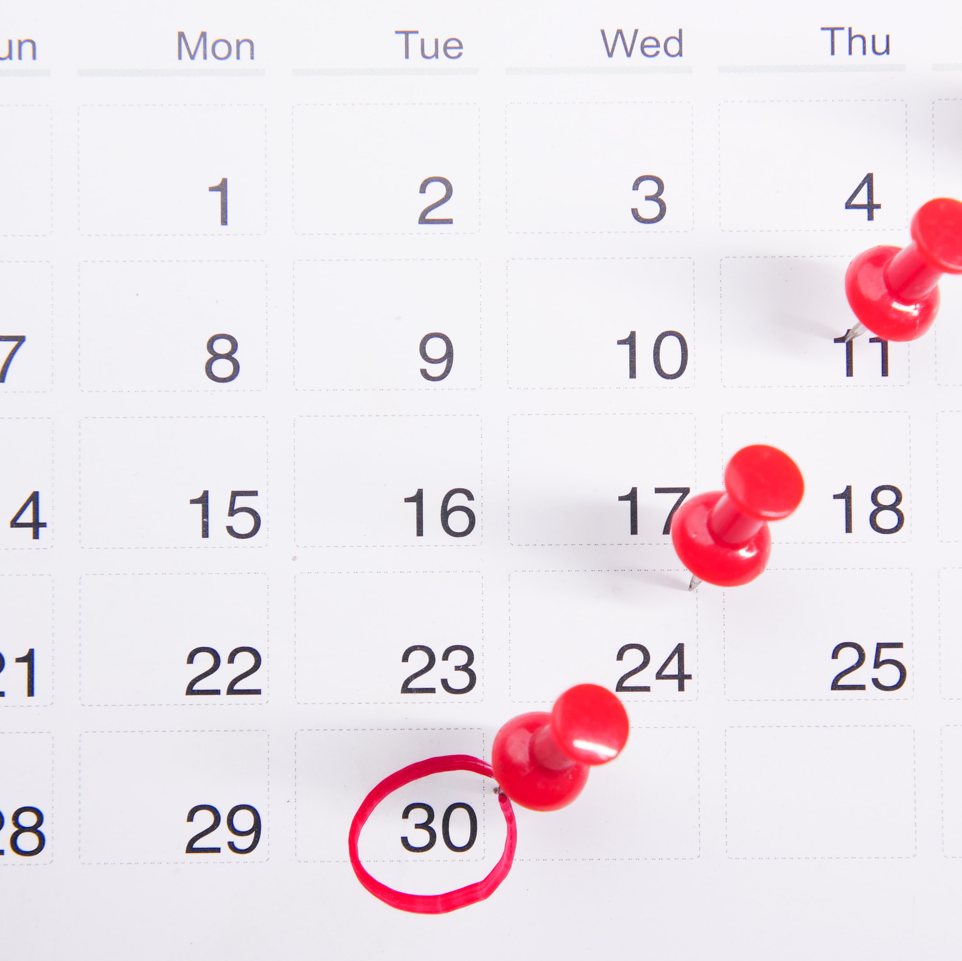
Schedule appointment
Each session is up to 1-hour max.
Click on link in form to schedule your appointment. https://drshinshuri.com/schedule-an-appointment/
Notes:
Class, after each eClass, you will have the opportunity to schedule an appointment to review any types covered in this session. Each session is up to1-hour max.
The appointment for this session will explore your understanding of shame no more, sharing my story with others, and celebration of becoming.
This will also be a safe place to gain clarity of current or previous topics or issues you may be facing now.
Also, this will be a great time to start thinking about becoming a self-love mentor.

