Slide 1
eCourse
Self-love Experience Leadership

Slide 2

Self-love Toolkit
Homework review
Helpful tips
Self-love toolkit
Self-love
Notes:
Welcome back, This eClass is about Self-love Toolkit. It is also, your last eClass for this eCourse.
This eClass will review Homework, Helpful Tips, Self-love Toolkit, and Self-love.
Even, thought this is our last eClass, I am still asking and looking forward to you being engaged in the class by sharing, answering questions, listening, supporting your peers with encouraging words, and showing up for yourself by doing the work and applying it to and in your life.

Slide 3
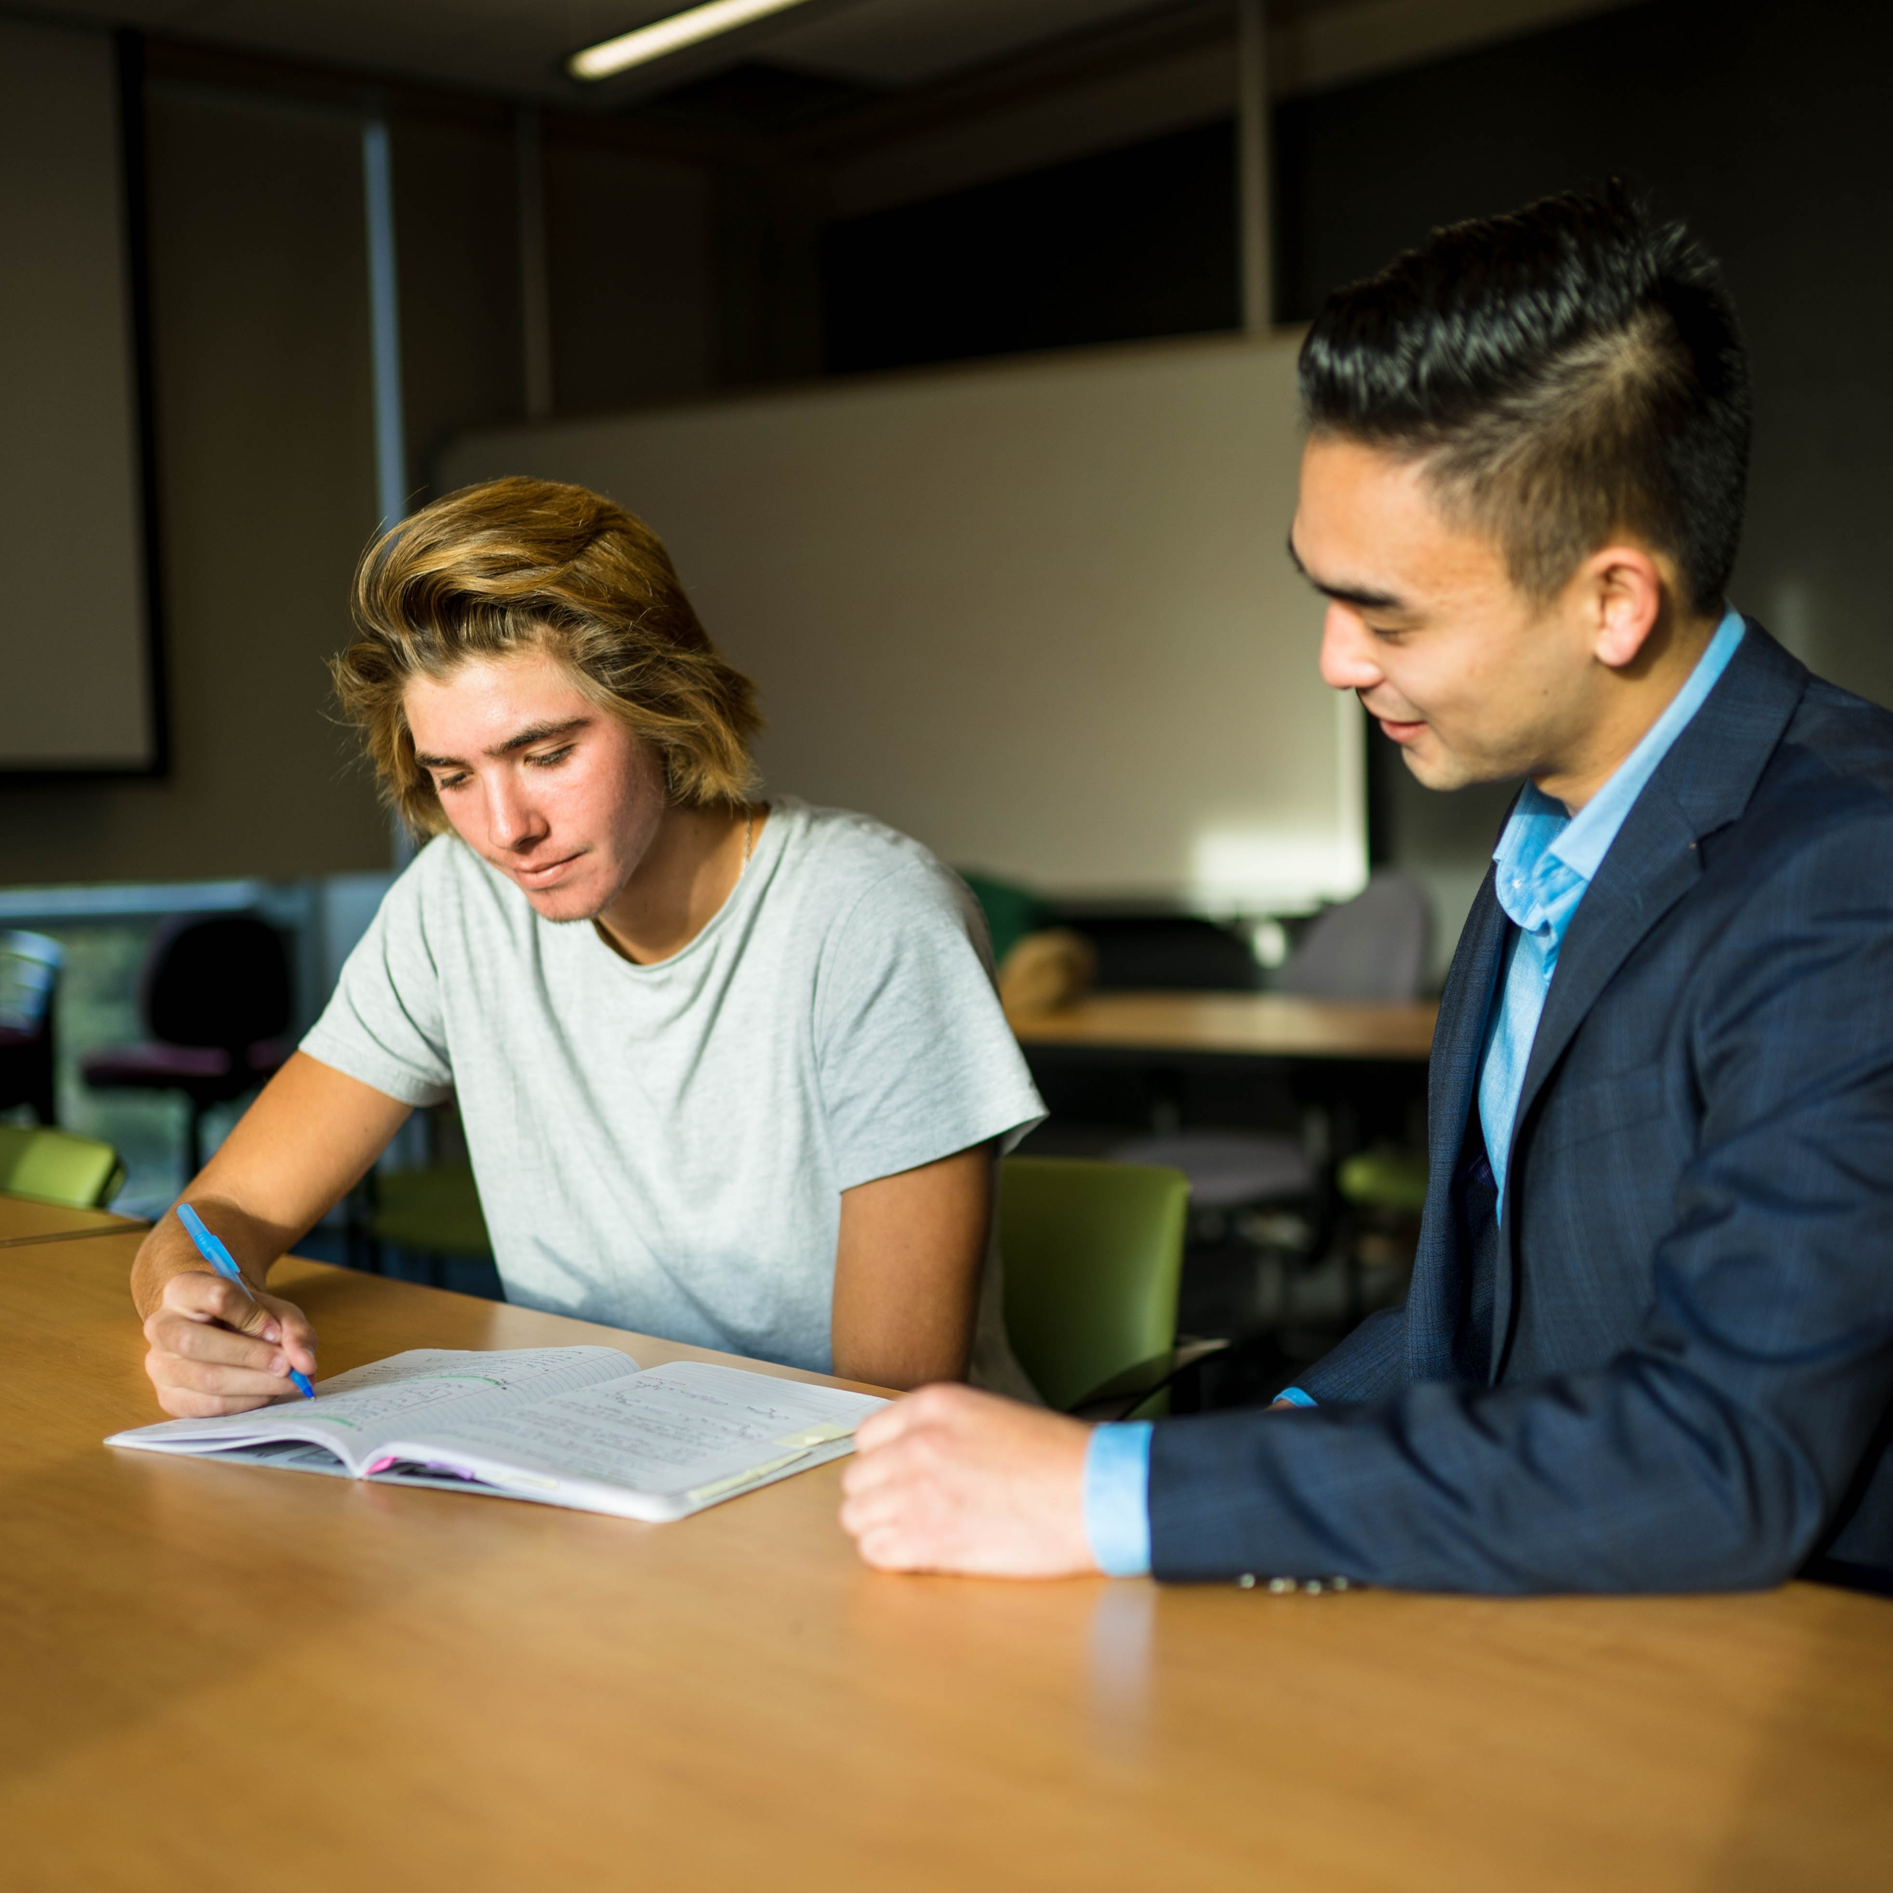
Homework review
Continue to write your story on how you are becoming the new and better version of yourself.
What have you notice differently about yourself than you have in the past?
How big of a difference does the new and better you handle conflicts?
How will you celebrate yourself?
Write in your journal your experience on becoming the new and better version of yourself.
Share with the online community, how you plan to enjoy every moment and how breathing impacted your day.
Access the RITMO Community Fellowship forum https://drshinshuri.com/forums/
Notes:
Homework Review
Your homework was for you to continue to write your story on how you are becoming the new and better version of yourself.
Who have completed their homework? (Randomly call on a participant to share their homework)
What have you notice differently about yourself than you have in the past?
How does the new and better you handle conflict?
How did you celebrate yourself?
Share your experience from your journal on becoming the new and better version of yourself.

Slide 4

Session 9
In this eClass, you will apply your learning from the eModule Self-love Toolkit this includes:
Helpful Tips
Self-love Toolkit
Self-love
Notes:
Session 9
In this eClass, you will apply your learning from the eModule Self-love Toolkit.
During this session, you will apply your learning to Helpful Tips, Self-love Toolkit, Self-love.

Slide 5
Helpful Tips
Notes:
Helpful Tips
Helpful Tips are tools to help you to do something without the ongoing shortfall of trying it over and over again. Its tips that will help you to move forward quicker than later. These helpful tips will always be useful no matter how often you need them.

Slide 6

Resources
There are many resources we have access to more so than 10 or 20 years ago.
Now we have the internet to access information in a matter of seconds.
Use every resources you have available to you to learn how to love a life of Self-love.
Study self-love and live it as a lifestyle and not a trend.
Notes:
Resources
If you need to build a house, what type of resources would you need?
What type of resources do you currently use in the day-to-day?
Resources comes in so many forms. 10 and 20 years ago the resources available today may not have been available than.
The internet has open up so much more resources at the tip of our hands. Most of the resources are available in seconds.
Use all resources available to you to learn more about Self-love and yourself.
Study and practice it, as you would any hobby or sports.
Self-love is a lifestyle and not a trend. It never goes out of style.

Slide 7
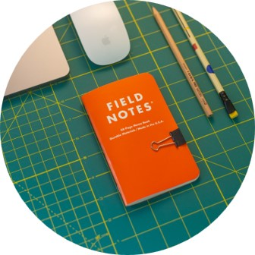
Tips
Be willing to research what you need to be a better person.
Embrace who you are from the inside out.
Find a support system that will keep you accountable for your growth and development.
Take time to tune into how you are feeling daily.
Focus on your overall wellbeing
Change happen when you open yourself to change
Stay positive and always move forward.
Notes:
Tips
There is so much research available to help you to be a better person. Use it and learn from it. No matter how small or big it is compared to your life or story find what you need to push you forward in your self-love journey.
Embrace who you are always from the inside out. No one knows you better than you know yourself.
Find a support system that will be honest yet use kindness to help you become your better version of yourself.
Take time to reflect and tune into how you are feeling daily. Learn what triggers your moods and what makes you happy.
Focus on your overall wellbeing. Exercise your mind and body. Both is need to live a heathy life.
Change happen when you open yourself to change. Give yourself permission to change and become the best version of yourself.
Always stay positive and moving forward. You have experienced the past and learned some or all you needed to learn. Now embrace moving forward.

Slide 8

Any questions
Notes:
Class do any have any questions or feedback on Helpful Tips?

Slide 9
Self-love Toolkit
Notes:
Self-love Toolkit
Who can tell me what a toolkit is? ( if no volunteers, call on someone)
A toolkit is used to store your hammers, nails, screwdriver and other tools you need around the house.
The difference in the two toolkit is that the Self-love Toolkit store mental and physical resources you can use to better yourself all around for wellness and wellbeing. This toolkit gives you what you need when you need it be a better version of yourself and to aid in making the right decision for yourself.

Slide 10
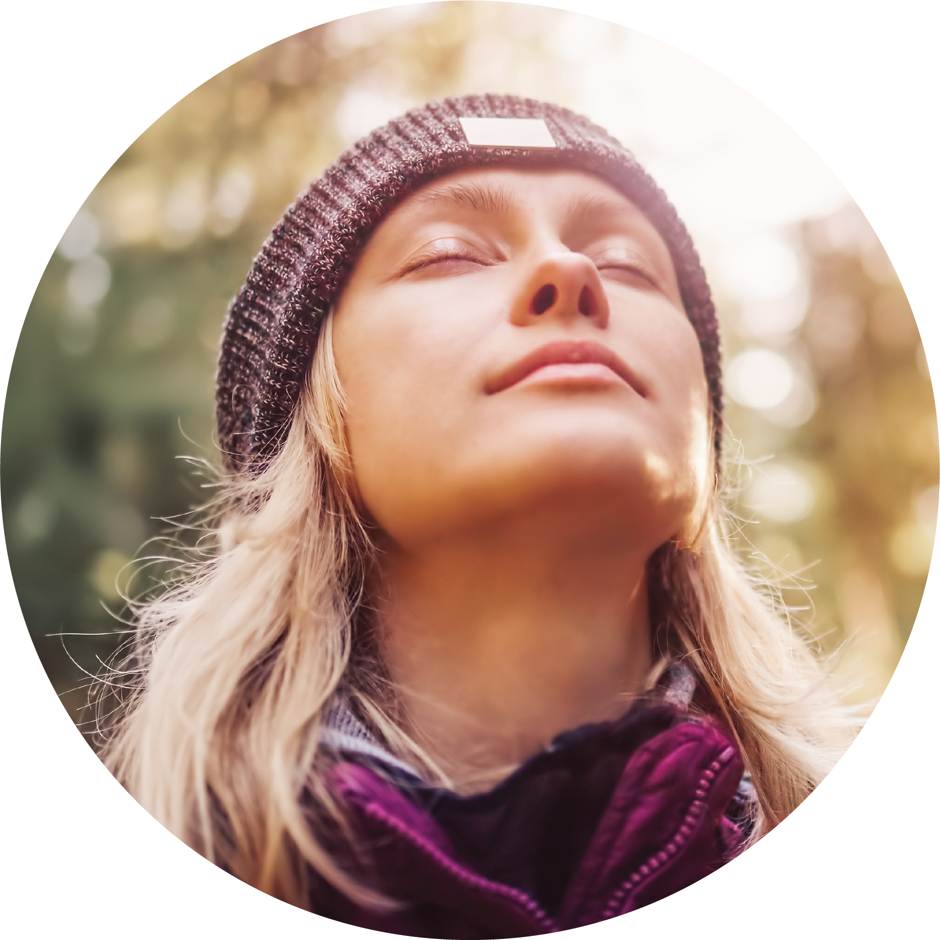
Breathing exercise
The flow and operation of our body depend on each breath we inhale and exhale.
In Sanskrit, this flow is called Prana meaning “Life force energy.”
No matter what you are doing or encounter in life, take time to breathe and breathe properly.
4-7-8 Breathing exercise technique learned during he eModule will allow you to calm your state of being.
The breathing exercise will take you from being overwhelmed or stressed to a calmness.
Notes:
Class by a show of hands, how many of you have focus on how your breath throughout the day?
The flow and operation of our body depends on each breath we inhale and exhale. Breathing is exxentail to life, our brain can only go 3 minutes without air.
Prana (breath) is the Life force energy that flows through our body when we inhale and exhale. Do you know why this is so important to our wellbeing? ( Call on random students or ask for volunteer).
Using the 4-7-8 Breathing exercise technique helps us to connect each breathe to the purpose of our wellbeing.
( Have the student practice doing the 4-7-8 Breathing exercise at this moment).
As you can see the breathing exercise will aid you in focusing on calming your body and mind from any situation; no matter if it a lose of focus or stress. It will center you to be present in the moment.

Slide 11
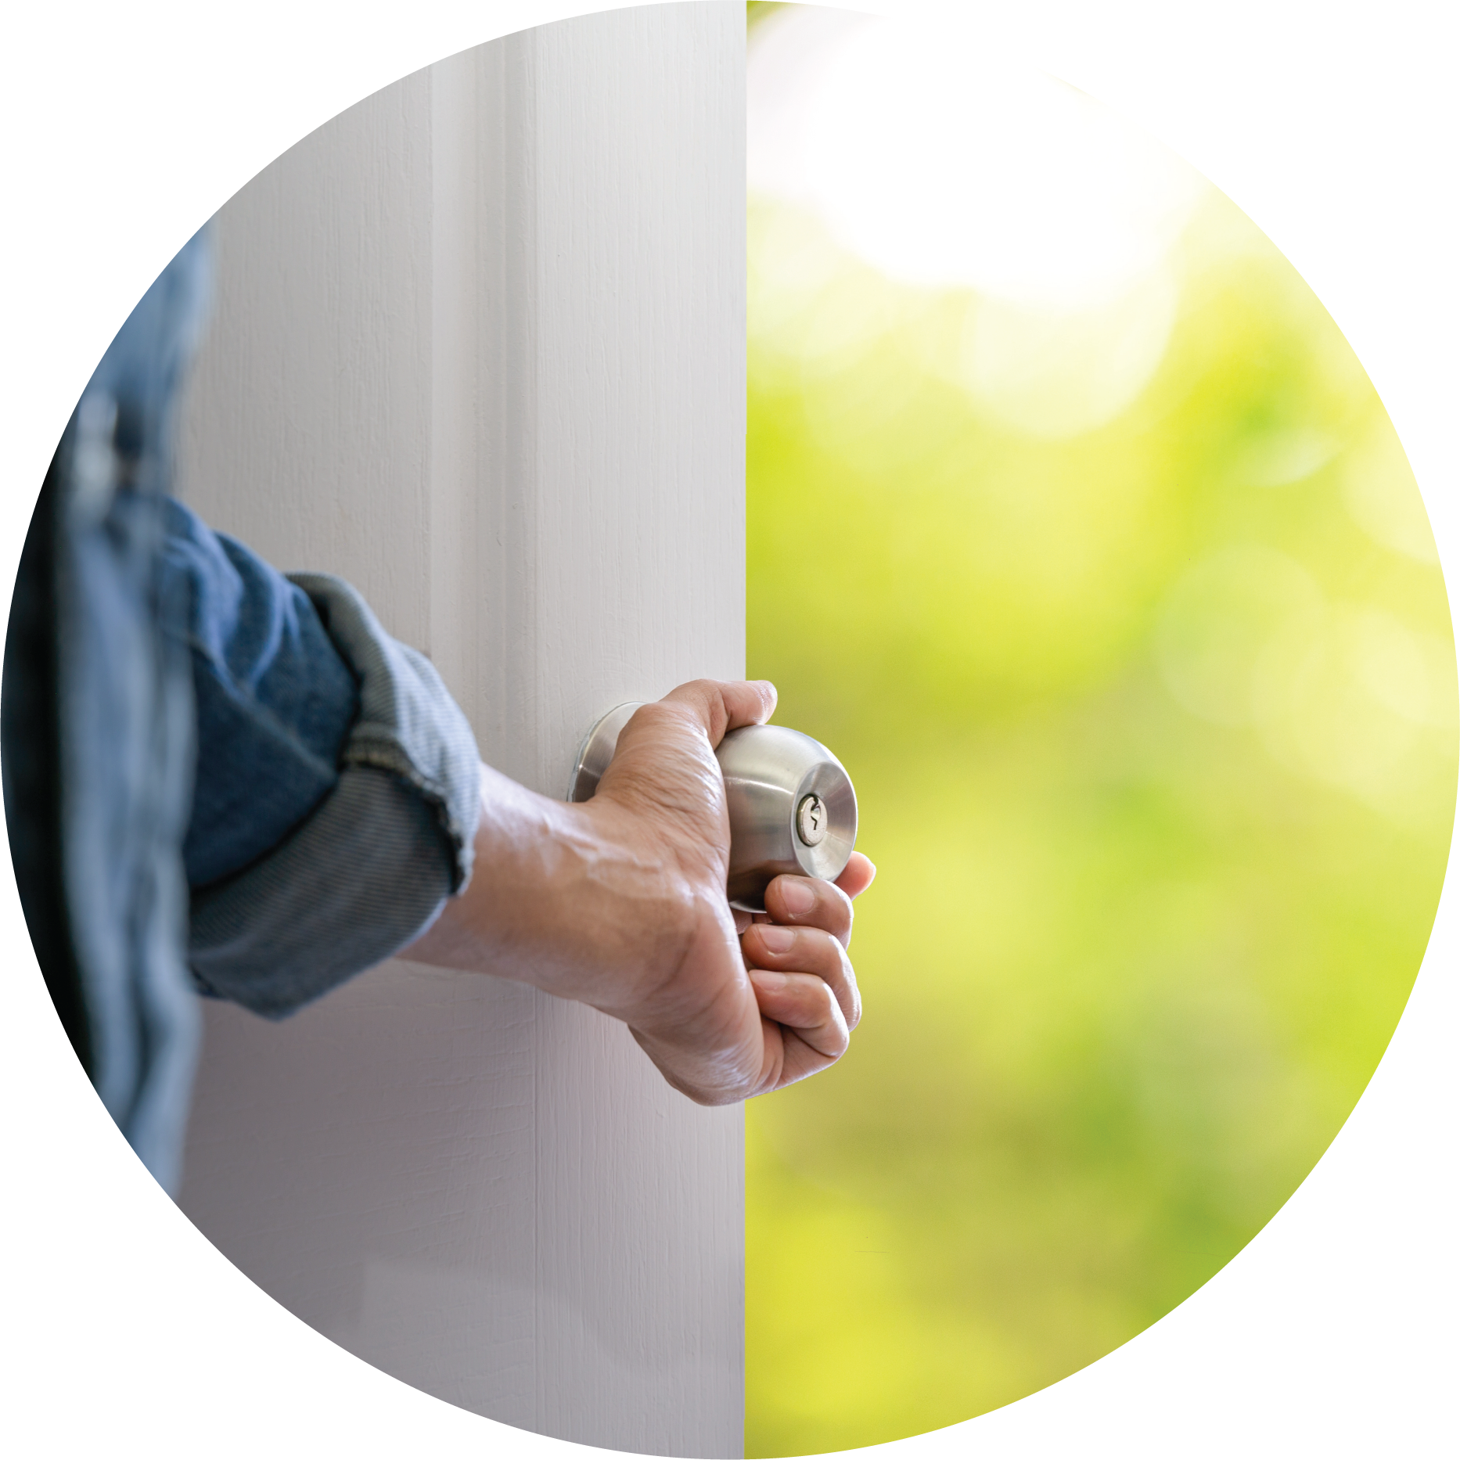
Get started
For many this is the hardest part of any journey.
Getting started takes a willingness to change your mindset for change or acceptance of new opportunities.
Life happens to us all. The perfect timing is always now.
Embracing your self-love journey requires commitment and communication; both are equally important in developing you from the inside out.
Rember to be patience with yourself.
This is not a race but a lifestyle that you are learning and becoming
Notes:
Getting Stated
For many this is the hardest part of any journey. Everyone, has a hard time deciding or knowing where to start.
The first step in any journey, is a willingness to change your mindset for change or acceptance of new opportunities.
The perfect timing is always now. No matter what the situation or what is going on around you, now is always the best time to start.
Embrace your self-love journey requires commitment and communication; both are equally important in developing you from the inside out. This is no different than deciding to take a trip or going to the local store. Both, requires you to be commitment to the process.
Always be patience with yourself. There is no need to rush you.

Slide 12
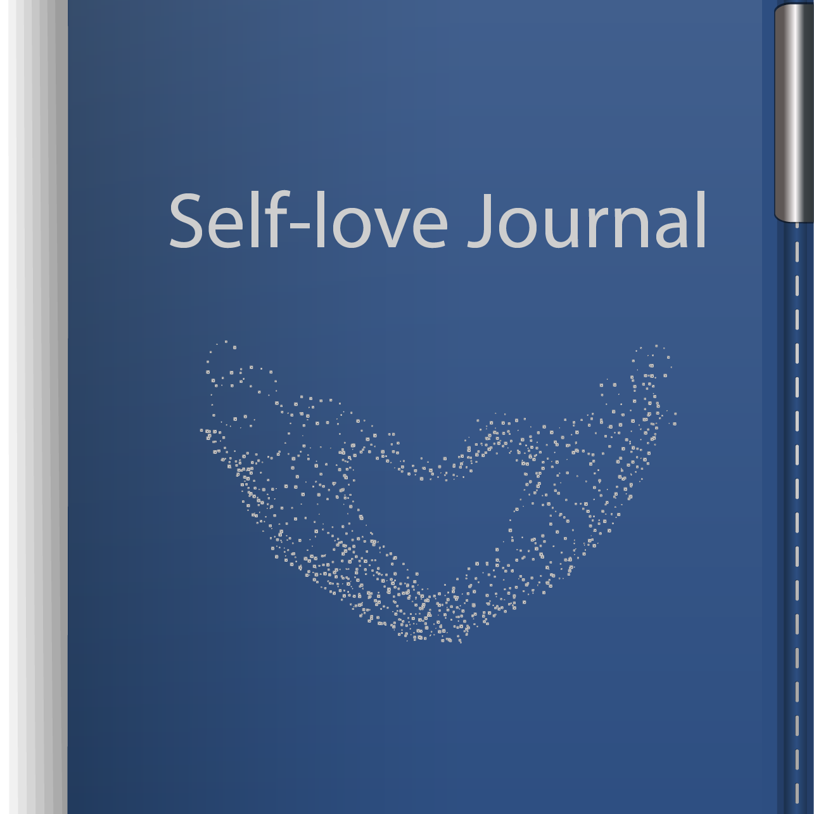
Self-love journal
Use your Self-love journal to write about your self-love experiences.
It is a possibility you may have many journals with notes of all kind written within the pages. However, this journal should only reflect your experiences while on your self-love journey.
Within the pages it should be a reflection of your day-to-day routine, life, moods, short coming, celebrations and more.
It is your life story and more.
Notes:
Your Self-love Journal is for you to write about your self-love experiences.
I know you may have many journals that you have used or are using, however, use this one for only your self-love experiences.
Use this tool to express your thoughts, experiences, advantages, routines, changes, challenges, and whatever you need to reflect on throughout the day about your self-love experience and journey.
You journey is your story, tell and experience it as it unfold.

Slide 13

Accountability partnership
Accountability Partners are connection with a person who wants to see you win in life.
This is the person, who will not only say what you want to hear but even those things to aid you to make the right and best decision for yourself.
Connecting with others who may have similar experiences or struggles who have overcome the odds.
Its your personal community or village to help you to stay focus and even get you back on track.
They are your cheerleaders, in that they celebrate with and for you.
Notes:
By a show of hands, who have had an accountability partner? (if the class, have had an accountability partner; ask what area were the accountability partner helping?)
self-love accountability partner, will make sure you are given yourself the best chance at embracing yourself and position you to win.
Your self-love accountability partner will say things to get you back on track. They will support you when you are doing right and aid your in correction when you are dong wrong against yourself.
They will push you to make the changes you need to move forward and to grow.

Slide 14
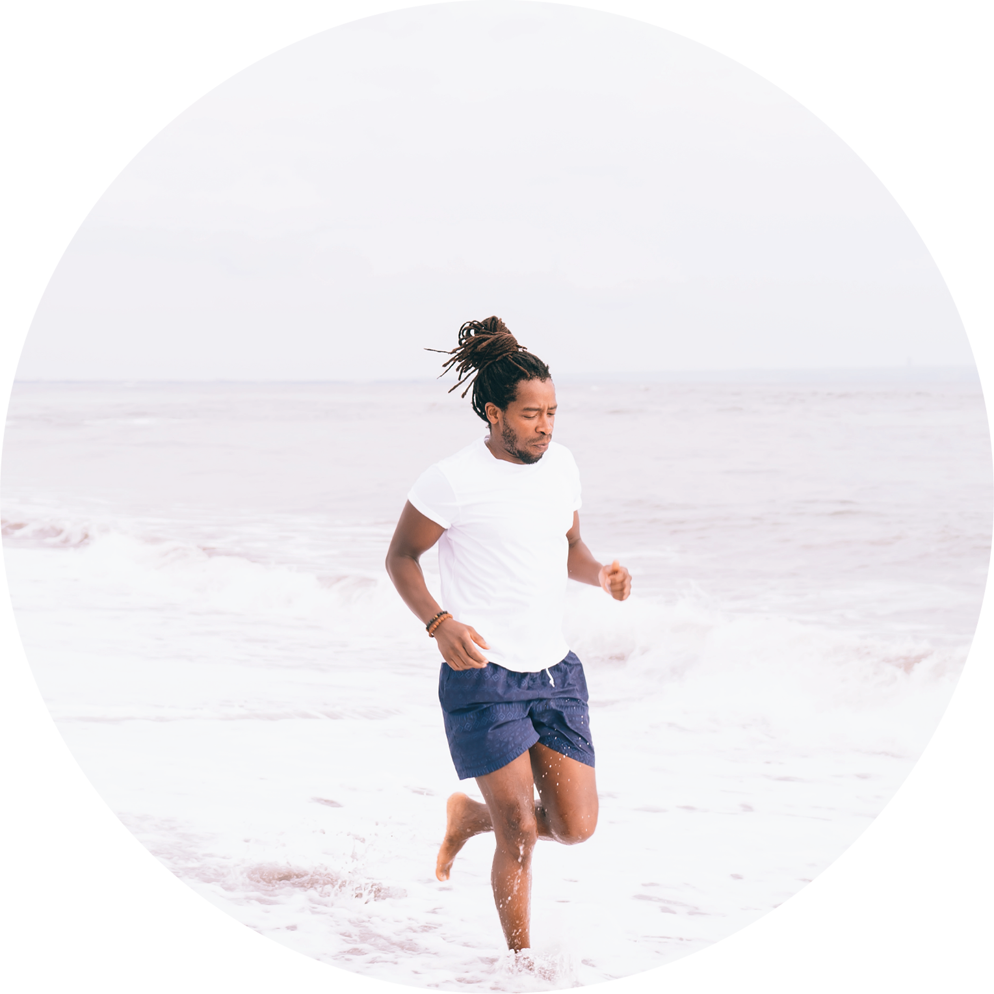
Explore nature or exercise
There maybe situation where you cannot control your living environment.
You may not be able to control the people around you, however, you can control yourself.
Take time to take a walk or explore different parks if you are able.
Exercise to help clear your mind. Focusing on your total wellness.
Find something new and try it.
Notes:
What in your living environment, you cannot change? ( ask for volunteers or randomly call on a student).
Many of our living environment is out of our control. However, the one thing we do control is ourselves. We decide on how we allow the things happen around us, to effect our day, add stress, change our mood or even how we see the world.
Taking time for yourself is needed to calm your mind and focus on those things that matter for the purpose of growth and development of oneself.
Exercise, allow you to work towards a goal of wellness, reduce stress, relax your day, and much more.
What do you do, when you feel overwhelmed or stress? (Randomly pick a participant.)
Find time to try something new or do something you already love. Whatever, it is enjoy doing it.

Slide 15
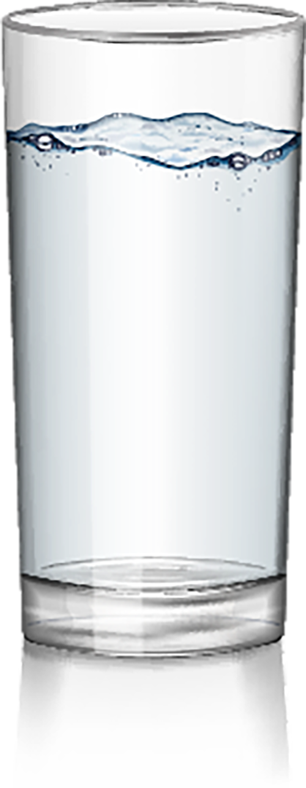
Drink water
Do you prefer water or juice?
Drinking water has many benefits that will aid our body.
Some of the benefits of drinking water is that it carry nutrients and oxygen to your cell, flush bacterial from your bladder, and protecting organs and tissues.
Water keep every system in the body functioning properly.
Notes:
What are the benefits of drinking water? (Randomly call on the participant ).
Some of the benefits of drinking water is that it carry nutrients and oxygen to your cells, flushing bacterial from your bladder, and Protecting organs and tissues.
There many more benefits of drinking water, who can name a some of the others benefits of drinking water? (call on participants who raise their hand. If no one, randomly pick someone
Water keeps the body functioning properly.

Slide 16

Be okay with not being okay
No one is perfect.
Everyone has something they are dealing with, overcoming, or learning from.
No matter what it maybe, be okay with not being okay.
Be okay with not having a good day. Learn from it.
Continue to use your mirror exercise to build your confidence, until you learn how to embrace all of yourself.
Notes:
No one is perfect, so its okay for you not to be perfect.
Life happens to us all. Each and everyone of us have something we are srruggleing and overcoming. Continue to choose to grow and develop the person you are becoming on this self-love journey.
Be okay with not being okay. It is okay to not feel ok. Every moment is a teachable moment. Keep moving forward and find something good about yourself to celebrate.
Take time to use your mirror exercise to help you to create and recreate your affirmation and repeat them daily.

Slide 17
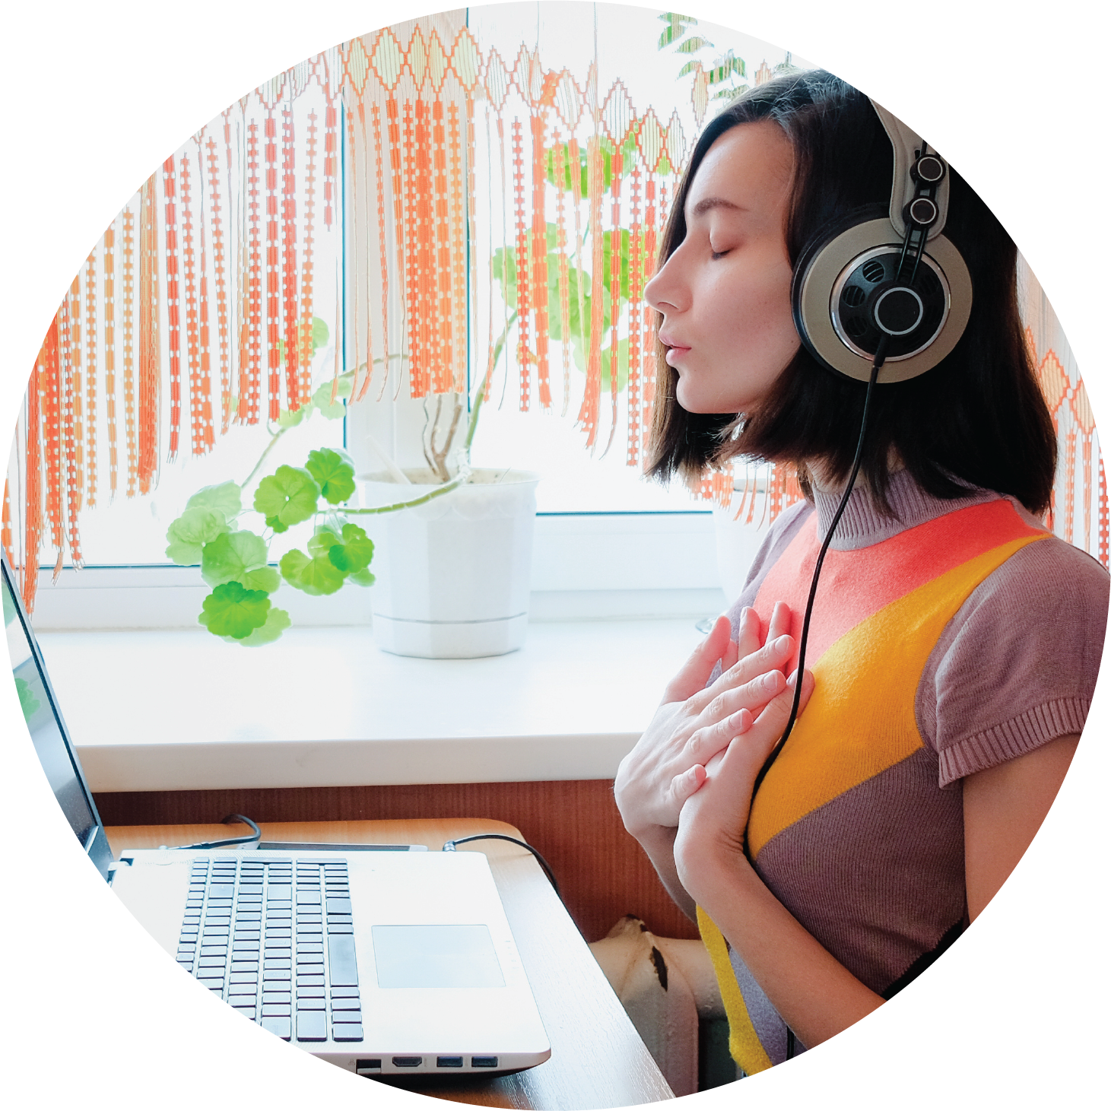
Self-love essence mantra
Tune into who you are from the inside out.
Give yourself a break and sit still with being in oneness with yourself.
Listen to the Self-love Essence Mantra and repeat it daily.
Set time aside to practice the Self-love Essence Mantra along with your personal affirmations of empowerment
In order for you to succeed and reach your Self-love goals you will need to embrace being open.
Notes:
Self-love Mantra
Tuning into yourself. Being aware of who you are from the inside out. This is the good and bad of who you are.
Give yourself a break. Sometimes and many times we never slow down or stop to smell the roses of life. This around, give yourself a break to breath. You can continue to use the breathing techniques to take that pause within your day.
Surround yourself with positive massages. Listen to the Self-love Essence Mantra. Allow yourself to change the energy and vibe around you.
Practice your self-love journey like you would any sports or hobby you enjoy and want to be better at doing. Practice to become better at being aware of who you are daily no matter the situation. The more you know about yourself the better you are at making the needed changes in your life.
In order for you to succeed and reaching your goals, you must embrace being open to change and willing to grow and develop into your authentic self.

Slide 18
Any questions
Notes:
Class do any have any questions or feedback on Self-love Toolkit?

Slide 19
Self-love
Notes:
Self-love
Self-love is all about you.
This journey is about your story, life experiences both shared and individually.
It is embracing all of you from the inside out.

Slide 20
Self-love
Self-love is a lifestyle not a trend
Its you saying yes to you first before any and everyone.
Self-love is giving yourself a fair chance at living your authentic self.
It is getting you to accept who you are now and becoming.
Self-love is equally as important as loving on others.
Self-love teaches you how to love yourself and others on purpose.
Notes:
Self-love
It Is not a trend; it is a lifestyle. Do you know the difference between a trend and lifestyle? ( Have participant volunteer or randomly select someone)
It is you saying yes to you first before others. Sometimes the hardest part is telling someone no. Self-love requires for you to not please others at the chance of disappointing yourself. Its pleasing your first.
Give yourself a fair chance at living your authentic self. It is better to be the best version of yourself, than to be a copy of someone else.
Accept who you are now and becoming. Both are equally important in developing.
Self-love is just as important as it is to love others.
Self-love teaches you how to love yourself and others on purpose. Sometimes we are going through the motions of life.

Slide 21
Any questions
Notes:
This conclude session 9 Self-love Toolkit. Do you have any questions or want to share your feedback on Self-love Experience Leadership eCourse?

Slide 22
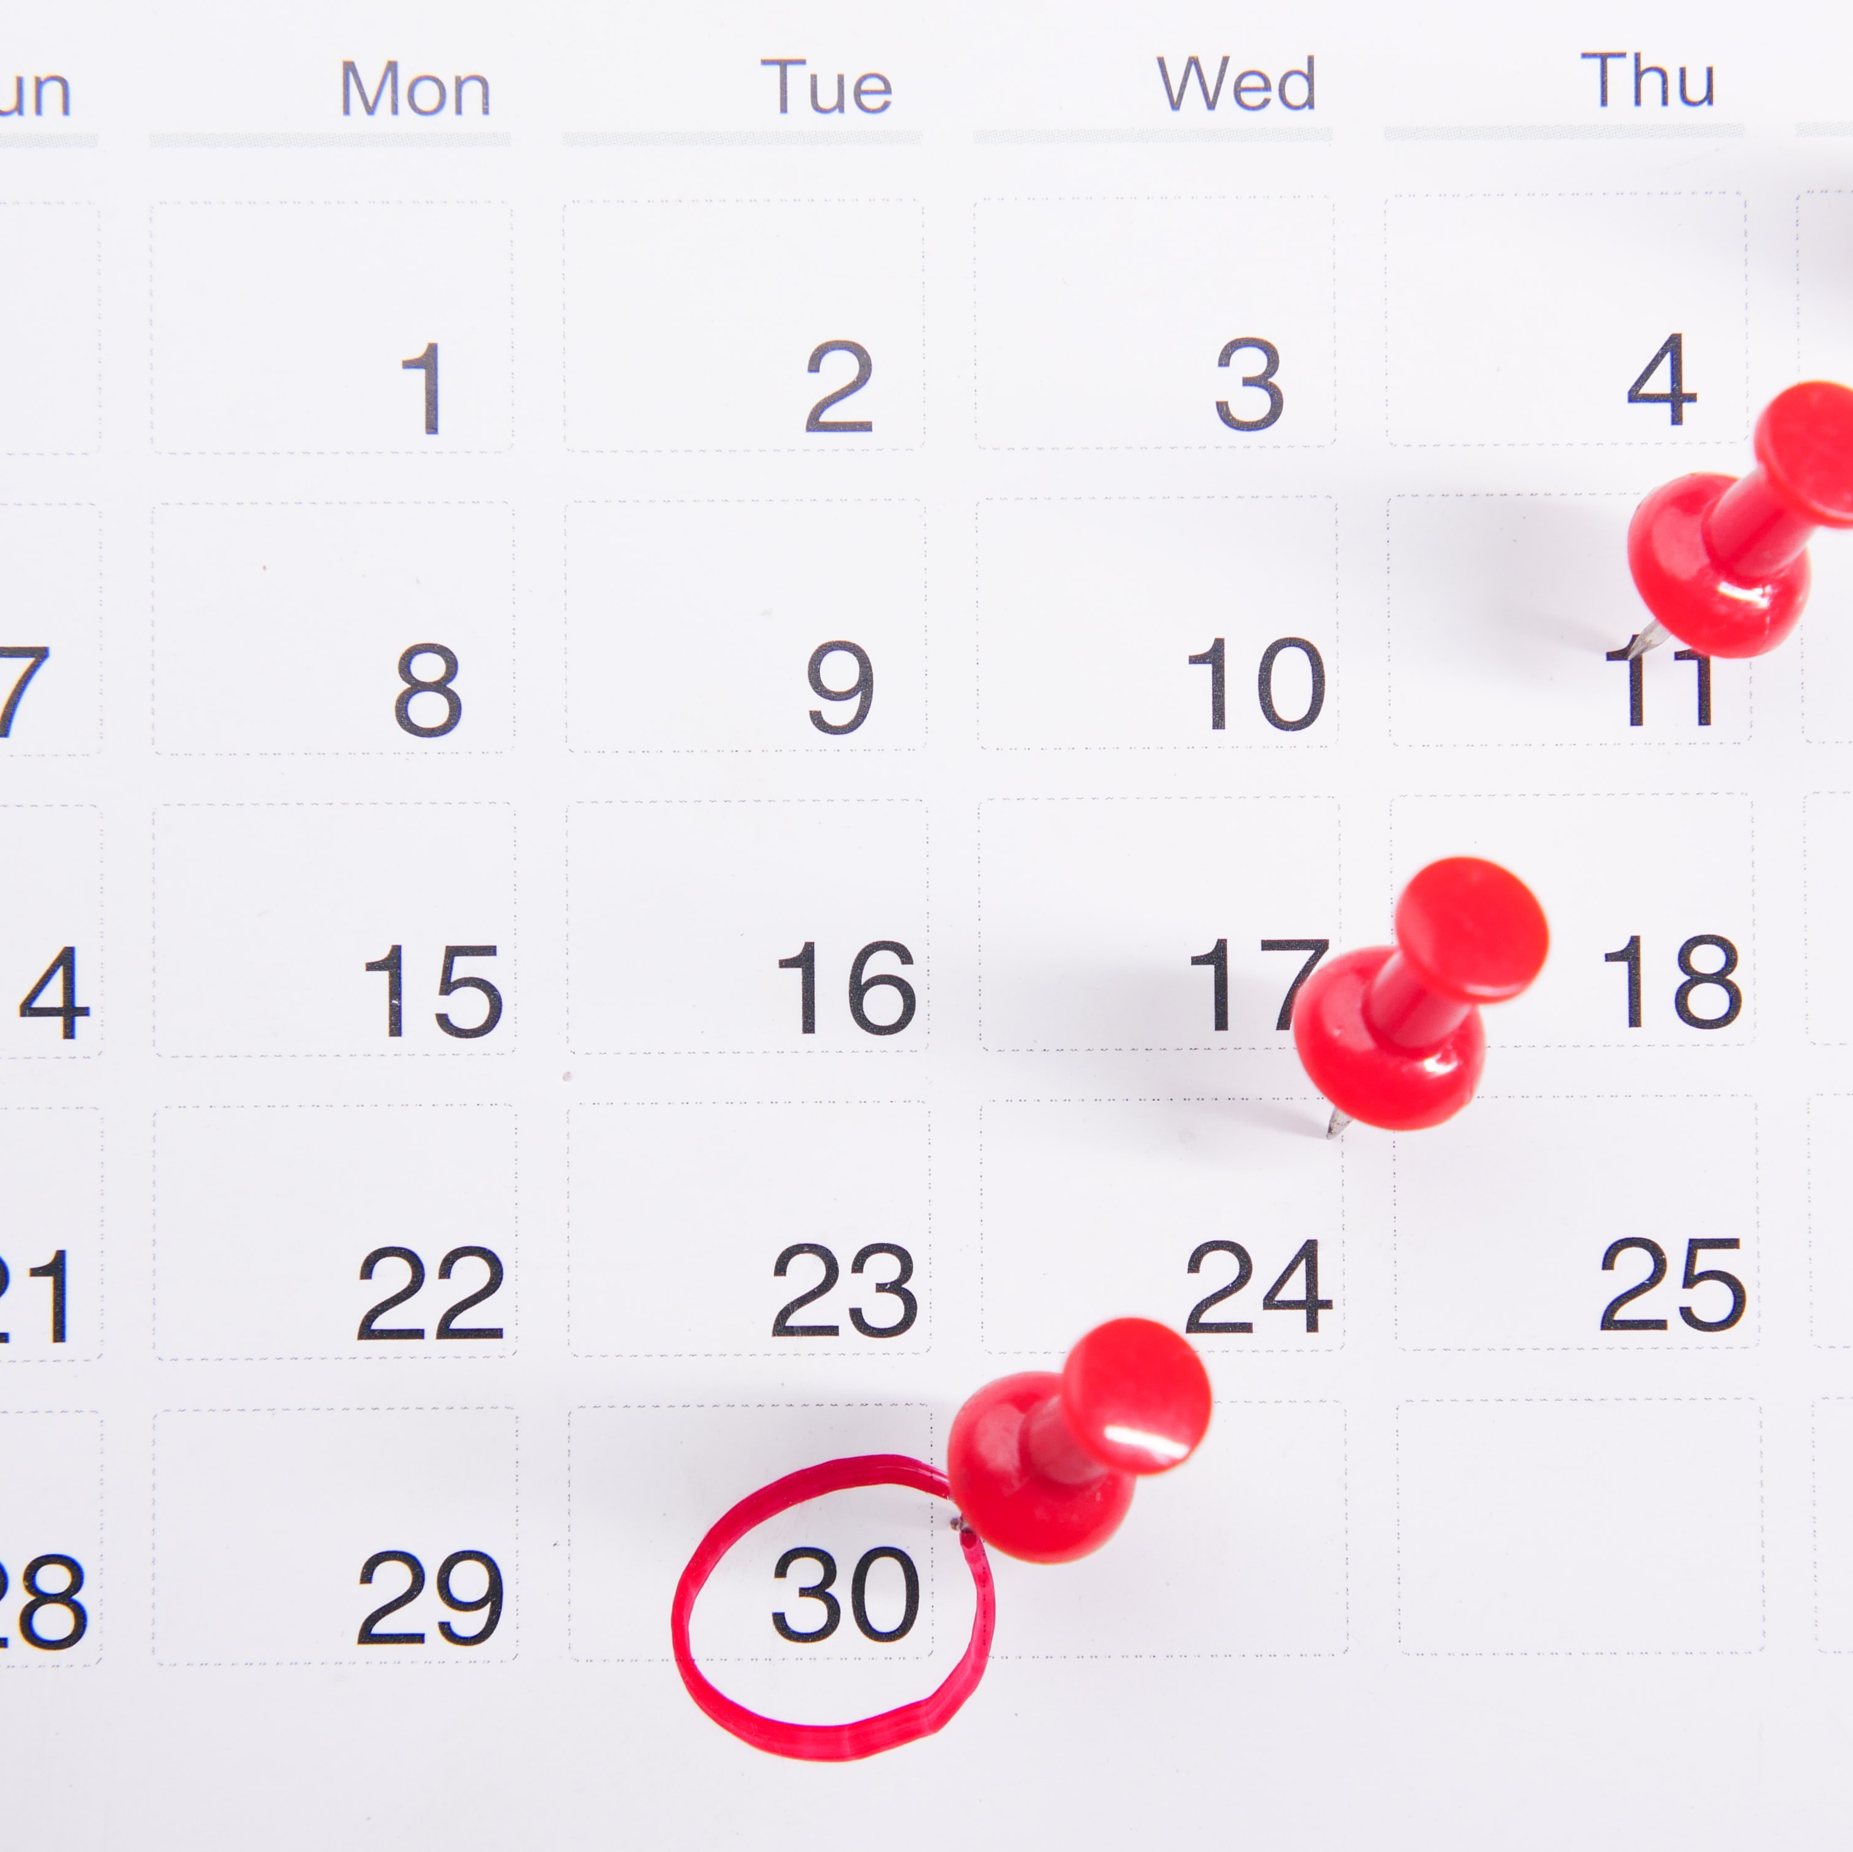
Schedule 1x1 Interview
1x1 exit interview is up to 1-hour max.
Click on link in form to schedule your appointment. https://drshinshuri.com/schedule-an-appointment/
Notes:
Class, you will have the opportunity to schedule your 1x1 exit interview. The exit interview will cover your overall understanding of Self-love Leadership eCourse, allow you to share your experience and feedback about the eModule and eClass materials. The exit interview is up to1-hour max.
The appointment for this session will explore your understanding of the helpful tips, self-love toolkit, and self-love.
This will also be a safe place to gain clarity of current or previous topics or issues you may be facing now.
Also, this will be a great time to start thinking about becoming a self-love mentor.

